Slide 1

PRESENTATION TITLE
OPEN SOURCE Strategy multi approach
    BPCE
    OW2Con
    03/06/2026
Presentation subtitle

Slide 2
contents
01
Our context & the Open Source market
02
Open Source for the Group
03
The missions of the Open Source team
04
Internal governance of Open Source
05
Appendices

Slide 3

OUR CONTEXT & OPEN SOURCE
01

Slide 4
BPCE challenge: finding the right balance between functionality / innovation capacity and the need for strategic autonomy
Having state-of-the-art functionality and fully benefiting from technological innovations...
...while keeping risk under control on issues related to strategic autonomy
  Leverage the best solutions on the market for cloud, AI, and big data innovation topics
  Benefit from state-of-the-art functionality
  Benefit in particular from the rapid pace of innovation of hyperscalers as well as from their robustness (i.e. 99.999% availability)
  Service diversification
  Frequent delivery of new services
  Ensure continuity at a defined level for critical functions in the event of an outage of third-party services
  Implementation, where possible, of reversibility policies or alternative solutions
  Preservation of an autonomous technical foundation
  Mitigate budgetary and compliance risks related to certain suppliers
  Supplier diversification
  Strengthening contractual levers
  Assessment of strategic exits
Need to assess mitigation scenarios (costs, timelines, complexity, new risks generated) for each solution to inform decisions in light of the level of projected risk and the desired autonomy

Slide 5
Options to strengthen autonomy to be considered on a case-by-case basis and that can build on a strong internal foundation
Open Source is one of the relevant levers for strengthening our strategic autonomy
A strong foundation for our autonomy that has already enabled us to emerge from situations of dependency…
…on which to build the options for strengthening strategic autonomy, to be assessed for each solution
Our own Datacenters
(4 BPCE-IT centers, 7,500 m²)
and our private Cloud
Software sourcing choices
In-house developments, “Open Source” solutions, European market solutions,
multi-sourcing
Hosting conditions
BPCE Datacenters,
offers qualified as “SecNumCloud ” by ANSSI,
European Cloud, trusted Cloud
Level of coverage
Full replacement, dependency reduction, reversibility plan, crisis plan
Host more than 80% of our applications,
including our Core Banking Systems
our secure source customer data
The skills and
expertise within the Group’s IT
> 10,000 internal FTEs + 6,500 external staff
covering all Tech professions

Slide 6

OPEN SOURCE IS MORE THAN JUST FREE SOFTWARE...
A rich ecosystem to understand
Open source is not “free” software; it is:
Software with published code under a legal license that grants usage rights
Developed in a collaborative way (community)
It enables transparency of the code and reversibility
You can use it, contribute & create Open Source
Necessarily with some upfront work :​
​
✅ Assess the vitality of projects and communities by relying on local communities such as TOSIT ​
​
✅ Rely on strong open source foundations for governance. (OW2, Apache Foundation)​
​
✅ Structure your approach by relying on an Open Source Program Office (OSPO) to secure the software supply chain (SBOM, SCA), ensure compliance (NIS2, CRA), organize internal contribution, and facilitate open source assessments​
Three usage models stand out, each with its own challenges :
Community-based: neutral, sustainable governance, but demanding in terms of involvement.
Packaged OSS: more structured, but with a relationship to the vendor that can recreate dependencies.
Open core: a delicate balance between open and proprietary components, to be analyzed carefully

Slide 7
Open source for the Group
02

Slide 8







Pratique de place
Synthèse des interviews externes menés par OSE (2025)
 |  | Approche intégrée OS First | OSCoE OS Center of Excellence | Approche culturelle alignée sur les valeurs, charte de contribution | OSPO spécialisé avec gouvernance centralisée | Programme OS Communautaire | IOSPO spécialisé avec gouvernance centralisée
PRINCIPALES MOTIVATIONS | Souveraineté numérique et indépendance technologique
 | Réduction de la dépendance vis-à-vis des grands éditeurs
 | Attirer des talents avec une culture collaborative
 | Innovation / flexibilité d’utilisation et contribution
 | Modèle économique
Réalisations (migrations, supports, contributions) |  | Oracle: PostgreSQL, Marché 300 logiciels |  | 44 repositories GitHub Création du fonds OSS by MAIF | Oracle: PostgreSQL, Marché 300 logiciels* | Marché 300 logiciels | Organisation de hackathons
Principaux freins: résistance culturelle, complexité juridique (charte, outils type Hermine), difficultés d’intégration
* prochainement

Slide 9
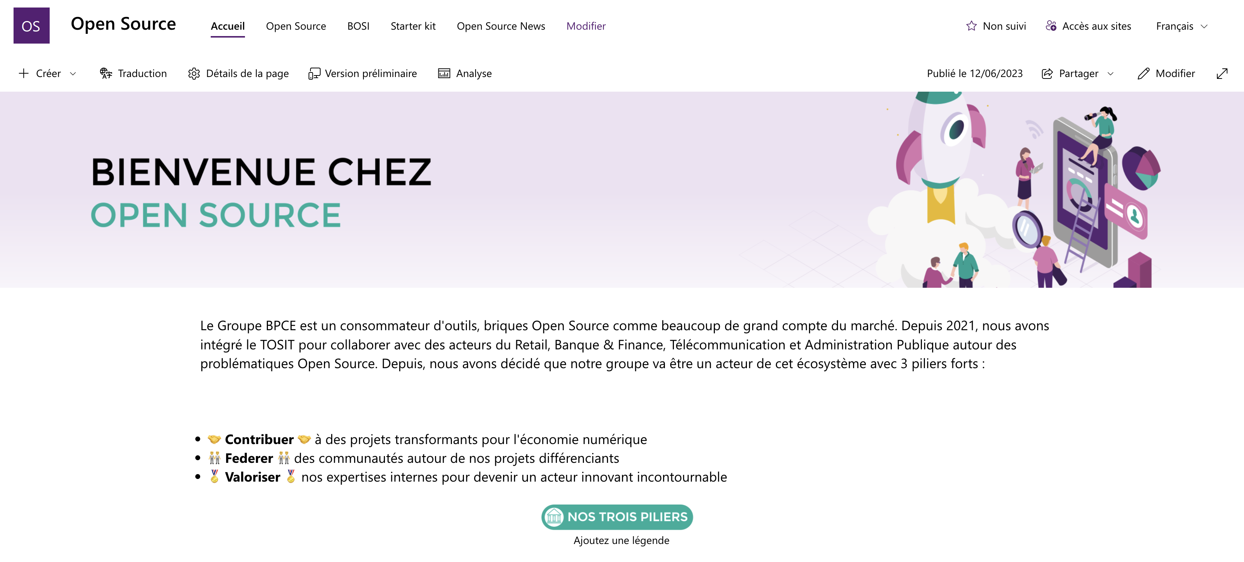


A Group Already Active
Internal OS SharePoint
Dynamic Internal and External Engagement
Monthly meetings to share TOSIT topics, ongoing work, and the economic models
Awareness sessions: morning session on IRN and openness in March
BPCE
Tech Day
Open Source: a Lever for Sovereignty and the Group’s Challenges
Launch of the Groupe BPCE Collective
70+ Connected Employees
OSE
Support on Our Governance and Monitoring Challenges
BPCE
Data Tech Day
Scaleway: Open-Source Data & AI Stack
OSE
Presentation of the Strategic Study
Talk at BPCE SI Inno Talk
Internal Engagement
BCG Study on Sovereignty
June 2025
Dec.
Jan. 2026
February
March
April
May
June
External Engagement
Community Working Groups
via TOSIT
TOSIT Data & AI Day, 4th Edition at BPCE
100+ People On Site
OpenStack Club
Worteks
OW2
Membership in the European OW2 Foundation
TOSIT Day
at Caisse des Dépôts
with Postgre on Project Governance, Encryption, and Product Strategy
DEVOXX France
TOSIT Booth + BOF
Urba-EA Club, Procurement Community, ToBeContinuous, Digital Workplace, Data & AI
Discussions on Technical Support and Digital Sovereignty with Atos
Communication

Slide 10
OPEN SOURCE WITHIN THE BPCE GROUP
Three pillars aimed at strengthen technological autonomy, security and competitiveness
A lever for autonomy & sovereignty
Alignment with the priorities of the Procurement & Services and Legal Departments
Security, compliance & risk control
The Group’s preferred priority is to move toward independence from American software vendors, the exploration of open source alternatives and the management of geopolitical risks related to software dependency.
Integration of the principle of assessing Open Source solutions into procurement processes as well as the methods for evaluating legal risk of Open Source solutions.
Adopting Open Source as a lever to ensure better control, greater auditability and proactive risk management.
A strategic direction that embeds Open Source in a long-term dynamic
A deliberate approach encouraging innovation and collective collaboration
A sourcing strategy focused on cost control, resilience and sustainability
Attractiveness for talent by offering a stimulating environment

Slide 11
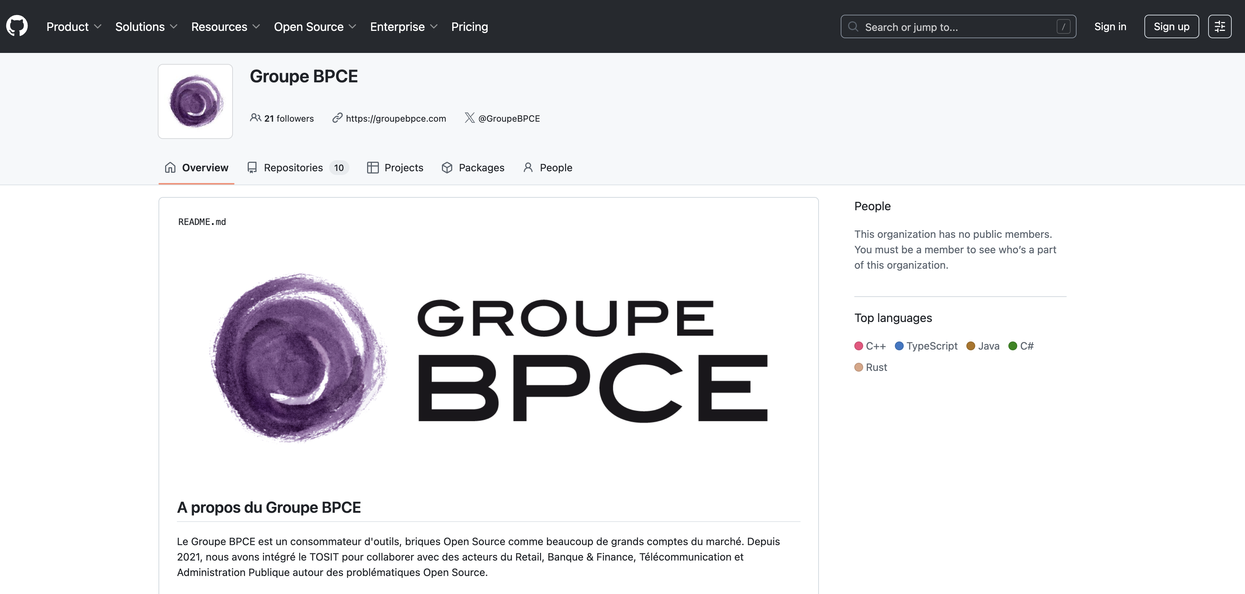
BPCE GITHUB

Slide 12
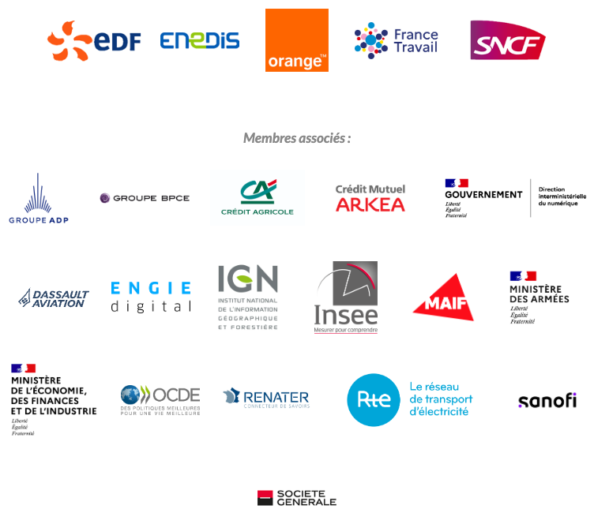
TOGETHER
BPCE is a member of TOSIT
Since then?
TOSIT (The Open Source I Trust) is an association that works and fights to support open source for a better quality in its use
Who is a member?
2021

Slide 13
A success
Tosit as an accelerator
This association goes beyond simple discussions and exchanges of good practices with the realization of joint projects, from the simple contribution to a community to the creation of end-to-end projects.
1
2
3
4
5
6
€
€
To be, for its members, a place to meet and exchange around Open Source solutions.
Promote the sharing of feedback and best practices in the use of Open Source solutions
Collect and identify its members' needs for open source solutions
.
Carry out or have carried out strategic or technical studies and follow-ups related to the use of Open Source solutions
Promote the most effective open source solutions in various areas of interest to its members
Carry out communication and publication actions relating to the use of Open Source solutions.

Slide 14
tHE MISSIONS OF THE oPEN sOURCE
03

Slide 15
Establishing the open source team
A team to develop OS expertise within the Group
Open Source Project Manager
Open Source Governance Expert
Open Source Technical Lead
Open Source Market
Expert
✓Structuring & steering the OS program
✓Scoping initiatives
✓OSA governance and visibility of OS value
✓Cross-functional internal facilitation
✓Organization of the awareness-building plan
Structuring & steering the OS upstream contribution program
Structuring & steering the OS contribution program
Scoping Inner Source governance
Documentation
Definition of the contribution CI/CD pipeline
Definition of the upstream contribution CI/CD pipeline
Implementation of technical pipelines
Sharing with the Devops BPCE IT teams
Market monitoring
Coordination with the external ecosystem
Facilitation
Study of Open Source product governance

Slide 16
The Open Source Team’s Missions
A practical implementation of the strategy defined by the Group’s Open Source pillars
Securing the use of Open Source
Promoting a collaborative culture around Open Source
R&D, innovation & Inner Source
Open Source mapping across the Group
Study Open Source software across the BPCE Group in order to map the existing landscape in collaboration with BPCE IT and all the Group’s publishers
Awareness and training
Develop an awareness and training strategy to educate our business teams with a dedicated budget
Monitoring and alternative assessment
Carry out active monitoring, review Open Source licenses, and issue recommendations based on compliance, security, viability, reliability, quality, maturity, costs (Capex vs OpEx), and status
Governance and compliance
Ensure compliance of the Open Source software used (consumption & contributions) in collaboration with Security and the Legal Department
Internal engagement
Bring the internal community together (France & Portugal) and build a collaborative open source culture
Project contributions
Identify key projects and contribute to them actively or financially to strengthen our role in the Open Source ecosystem
External engagement
Be a leading player in the Open Source ecosystem and benefit from external feedback and working groups
Support and operating model
Help support Open Source software to ensure the sustainability and reliability of the solutions adopted by the Group
Inner Source at BPCE
Define governance models and promote a collaborative culture
These missions ensure consistency in open source practices across the Group while stimulating innovation and facilitating the adoption of solutions
The Open Source team is a central player in ensuring the efficiency, governance, and success of open source integration in the Group’s activities

Slide 17
Governance: Open Source Authority
04

Slide 18
OSA (Open Source Authority)
👉 IT & Procurement coordination and steering body, co-sponsored by TE&S & CIO Office, responsible for embodying, structuring, capitalizing on, and governing Open Source across the Group, in alignment with the Group governance
  Overall missions:
  Share the Group’s overall Open Source roadmap
  Decide on studying the integration of new Open Source components with a support model, in coordination with the existing architecture committees
  Track ongoing studies and our Open Source projects
  Control the risks and compliance of our components
  Share new studies and opportunities
  Identify potential synergies between projects or needs and with external parties
  Coordinate our internal vision with the external ecosystem (TOSIT, EuroCommons, etc.)
  Ensure compliance with recommendations / best practices (inner source, contribution back, contributing)
  Participants:
    Facilitation: TE&S & CIO Office
    Procurement, Services & Legal stakeholders:
    Procurement & Services
    Legal
    Security stakeholders:
    Group Security
    BPCE-IT Security
Proposed frequency: monthly, to be validated by the Executive Committee
    Multi-entity representatives appointed by the business IT departments & BPCE IT
    IT Payments
    BPCE-SI
    IT-CIB
    IT-AWM
    Corporate IT Department
    BPCE-IT

