Slide 1
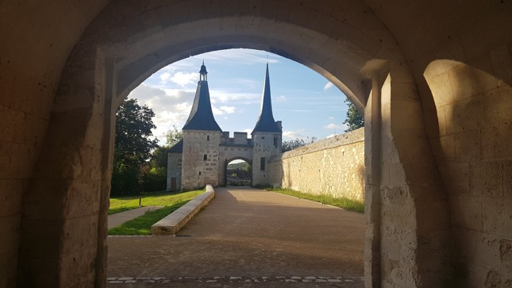
Bec Hellouin Normandie

Slide 2
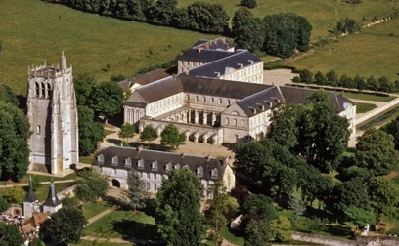
Bec Hellouin
Abbaye

Slide 3
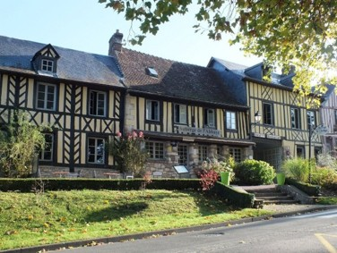
Bec Hellouin Village

Slide 4
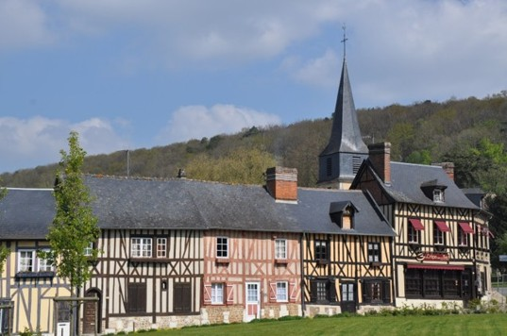
Bec Hellouin Village

Slide 5
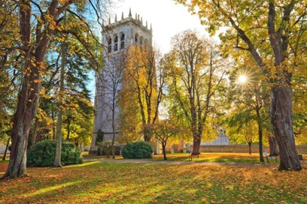
Abbaye

Slide 6
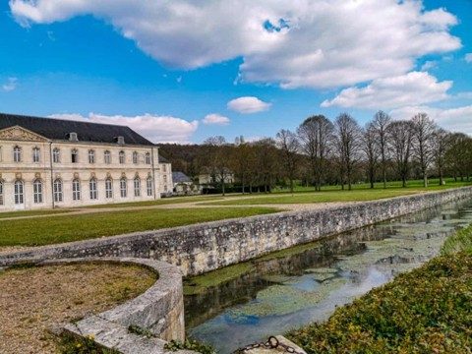
Bec Hellouin
Abbaye

Slide 7
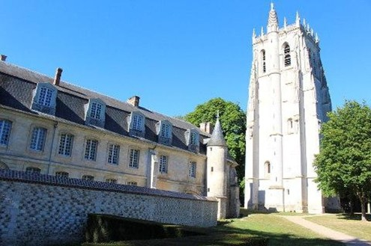
Bec Hellouin
Abbaye

Slide 8
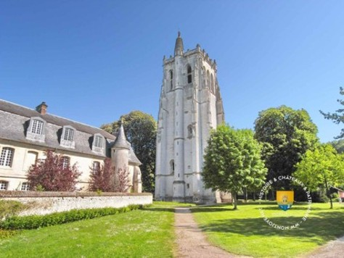
Bec Hellouin
Abbaye

Slide 9
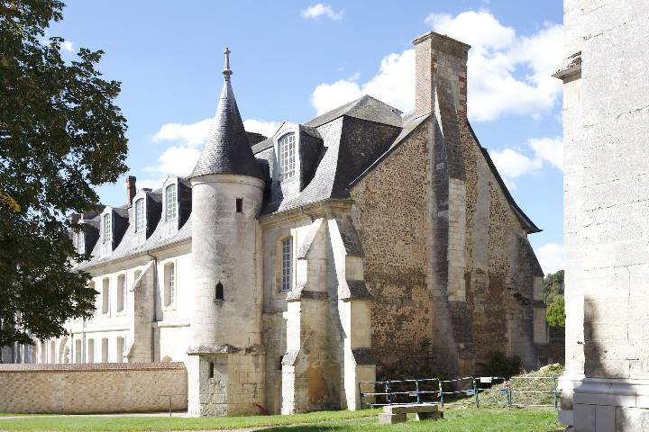
Bec Hellouin
Abbaye

Slide 10

Bec Hellouin
Abbaye

Slide 11
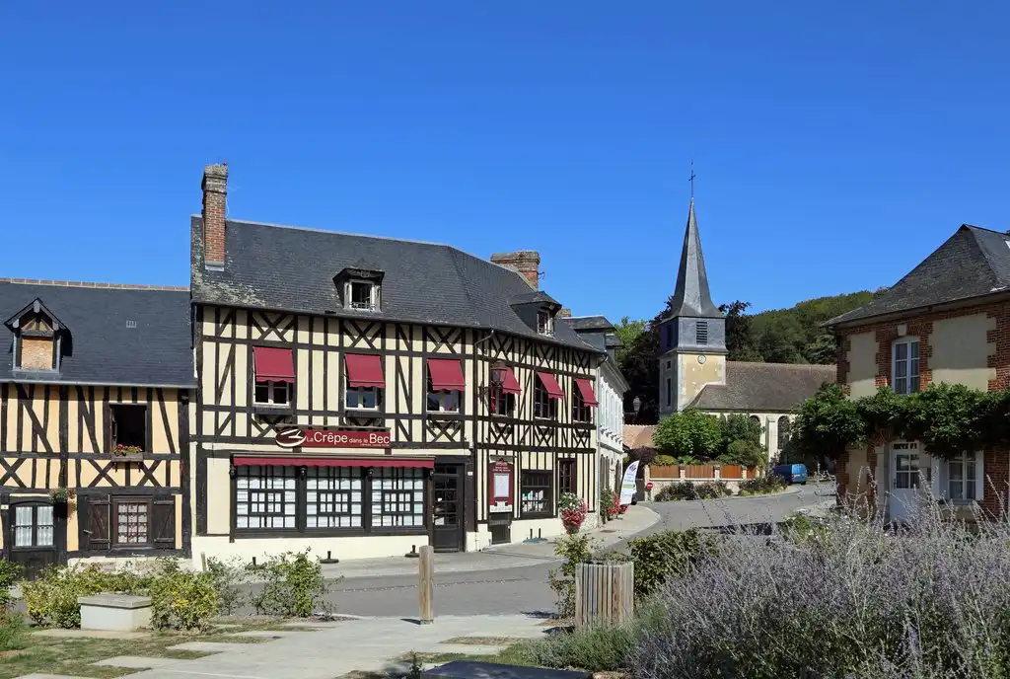

Bec Hellouin Village

Slide 12
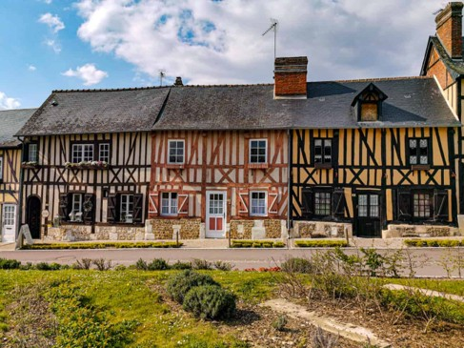
Bec Hellouin Village

Slide 13
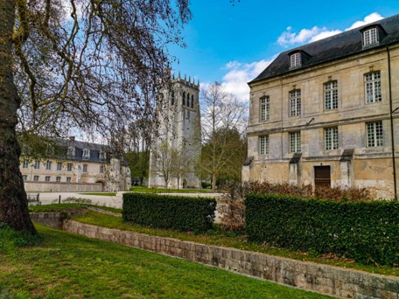
Bec Hellouin
Abbaye

Slide 14
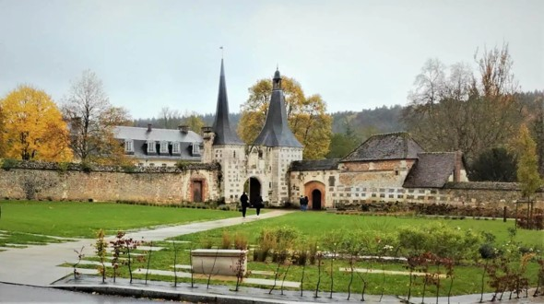


Bec Hellouin

Slide 15
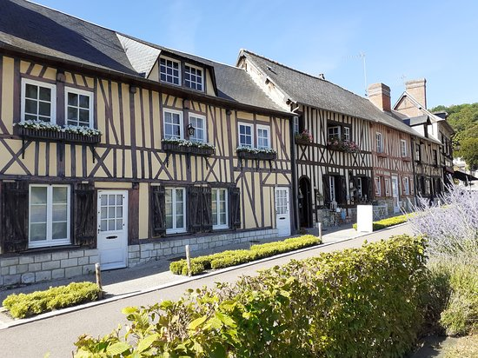
Bec Hellouin Village

Slide 16
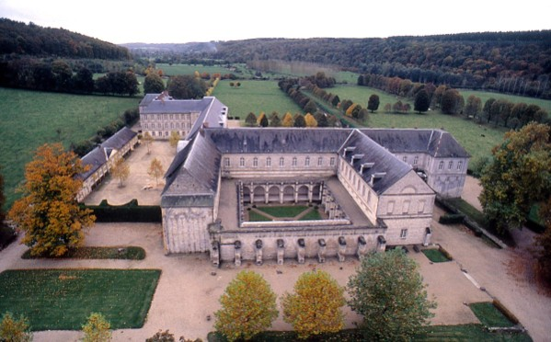
Bec Hellouin
Abbaye

Slide 17
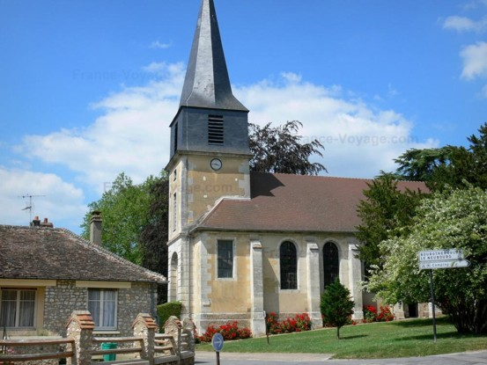
Bec Hellouin Village

Slide 18
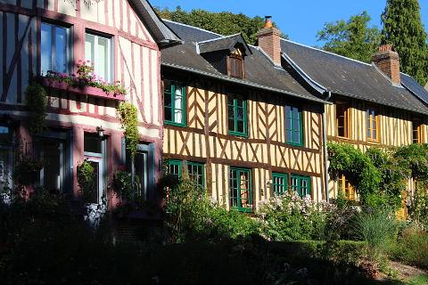
Bec Hellouin Village

Slide 19
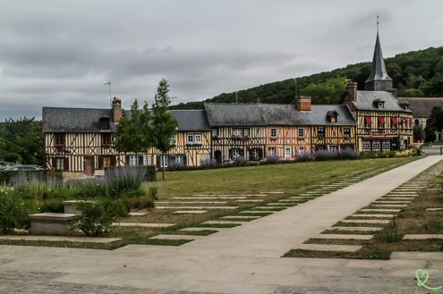

Bec Hellouin Village

Slide 20
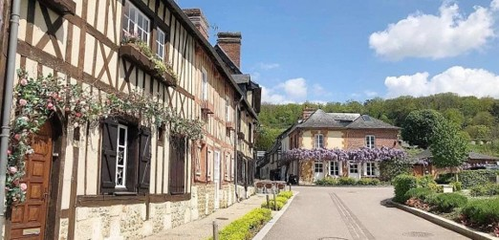

Bec Hellouin
Village

Slide 21
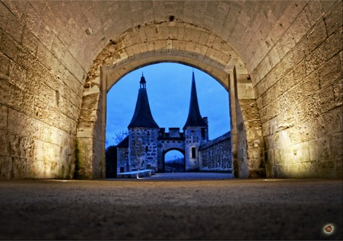
Mireille

Slide 22

PPSMAMIEMIMI

