Slide 1
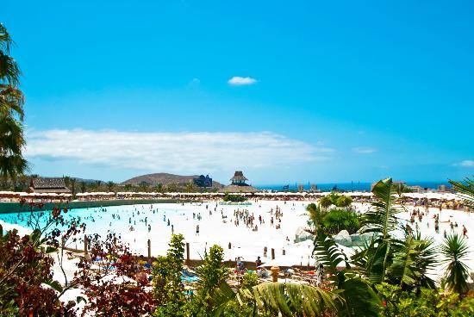

25 meilleurs des parcs aquatiques du Monde
Siam_Park-Adeje_Tenerife_Canary_IslandsEspagne.

Slide 2
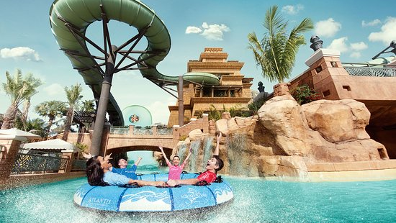
-Atlantis_Aquaventure_Waterpark-Dubai_Emirate_Arabis Unis

Slide 3
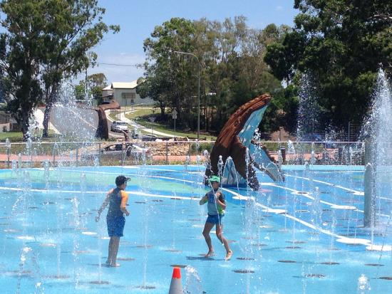
Wetside_Water_Park-Hervey_Bay_Fraser_Coast_Queensland.Australie

Slide 4
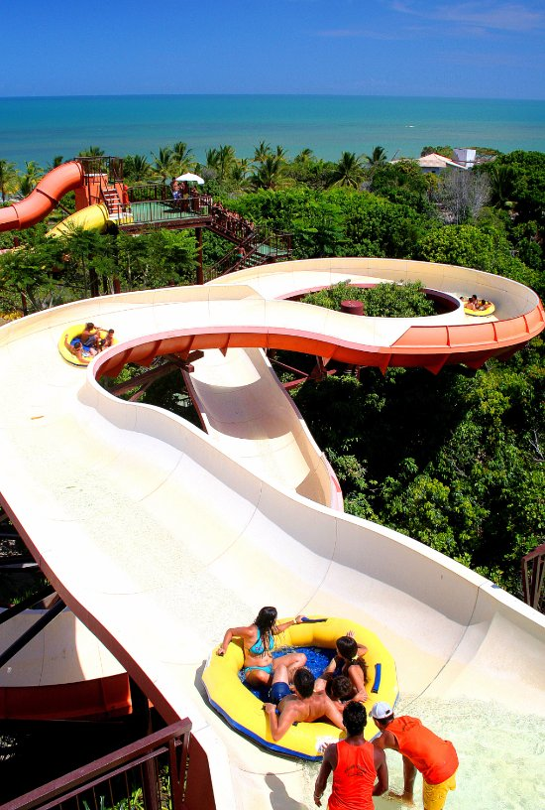
Eco Parque_Arraial_d’Ajuda-Arraial_d_Ajuda_Porto_Seguro_Brésil

Slide 5
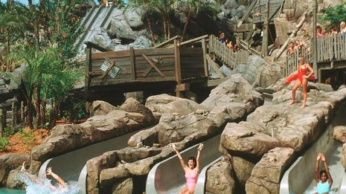
Disney Typhoon_Lagoon_Water_Park-Orlando_Florida.

Slide 6
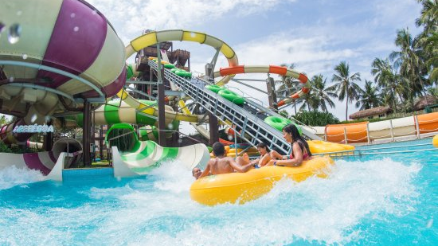
-Beach_Park-Aquiraz_State_of_Ceara.Brésil

Slide 7
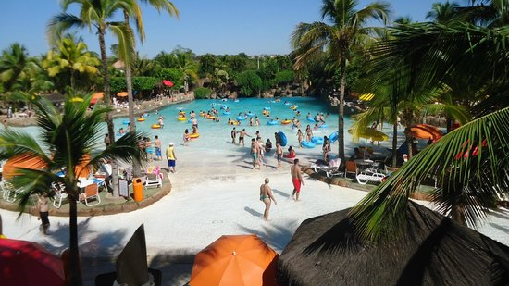
-Thermas_dos_Laranjais-Olimpia_State_of_Sao_Paulo.Brésil

Slide 8
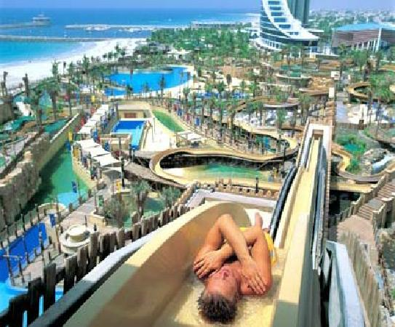
Wild_Wadi_Waterpark-Dubai_Emirate Arabies Unis

Slide 9
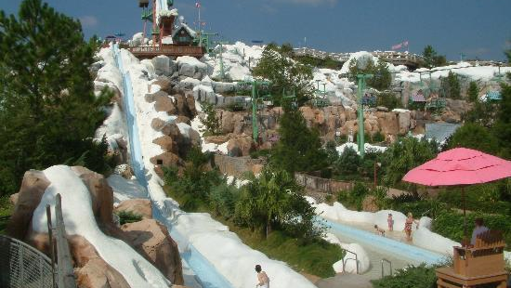
Disney_Blizzard_Beach_Water_Park-Orlando_Florida.

Slide 10
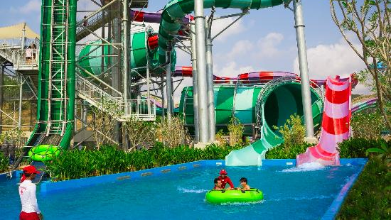
Ramayana_Water_Park-Pattaya_Chonburi_Thailande

Slide 11
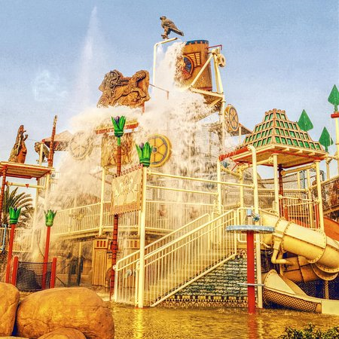
-Lost_Paradise_of_Dilmun_Water_Park-Manama Bahrein.

Slide 12
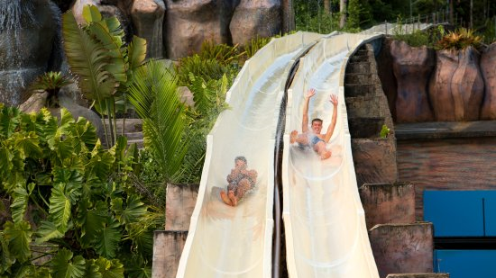
Parque_Aquatico_Cascaneia-Gaspar_State_of_Santa_Catarina Brésil.

Slide 13
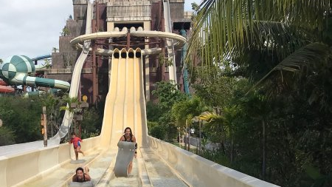
Maya_Lost_Mayan_Kingdom-Mahahual_Costa_Maya_Yucatan_Peninsula Nexique

Slide 14
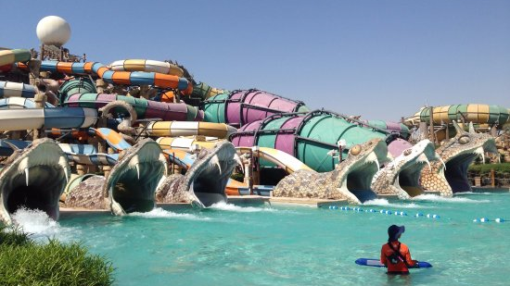
Yas_Waterworld_Abu_Dhabi-Abu_Dhabi_Emirates Arabes Unis

Slide 15
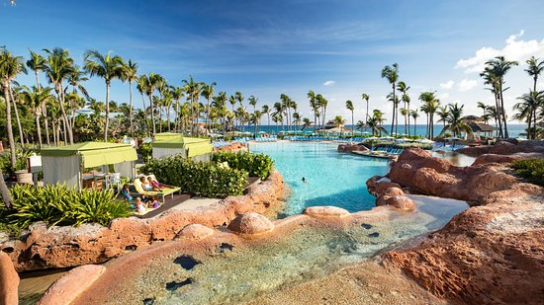
-Aquaventure-Nassau_New_Providence_Island_Bahamas.

Slide 16
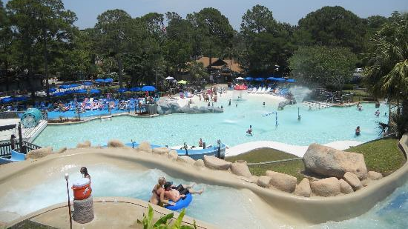
Shipwreck_Island_Waterpark-Panama_City_Beach_Florida.

Slide 17
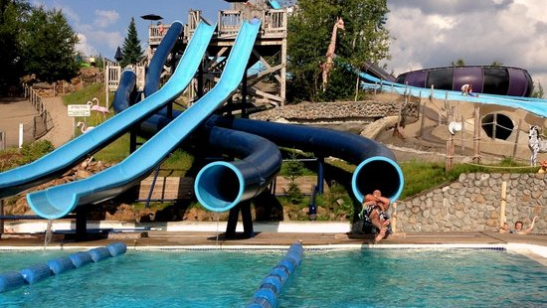
-Enchanted_Forest_Water_Safari-Old_Forge_New_York.

Slide 18
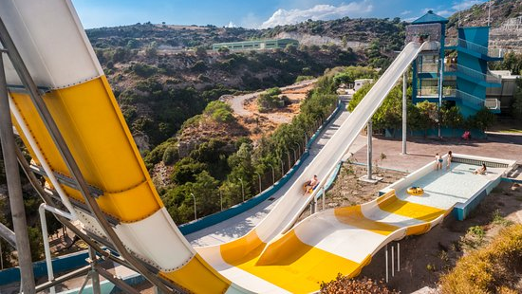
Water_Park-Faliraki_Rhodes_Dodecanese_South_Aegean.Grèce

Slide 19
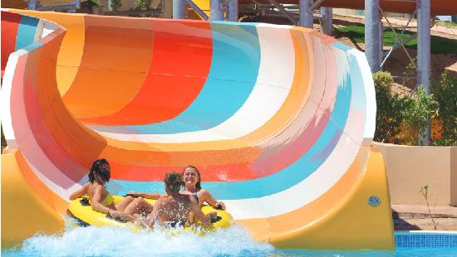
Makadi_Water_World-Hurghada_Red_Sea_and_Sinai.Egypte

Slide 20
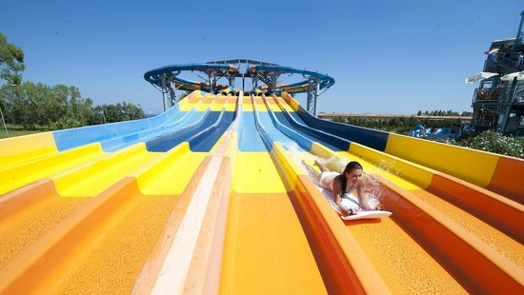
-Acqua Park_Odissea_2000-Rossano_Italie

Slide 21
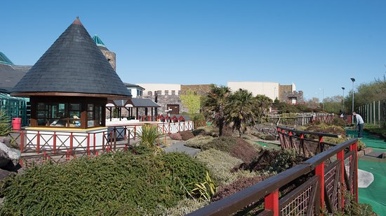
Aqua_Dome-Tralee_Irlande

Slide 22
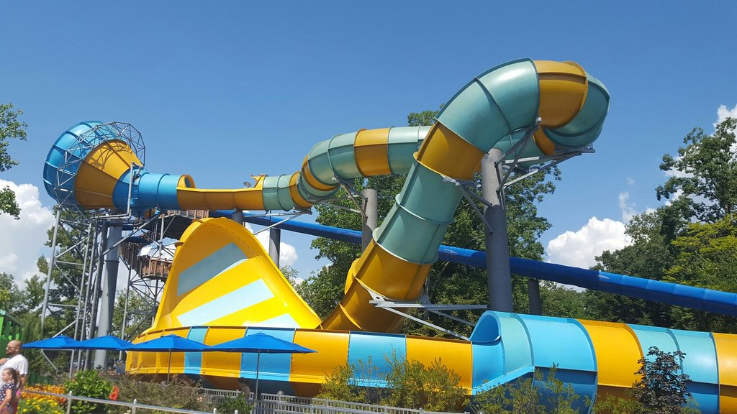
Water_Country_USA-Williamsburg_Virginia.

Slide 23
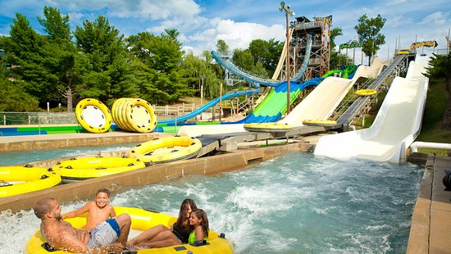
-Noah_s_Ark_Water_Park-Wisconsin_Dells_Wisconsin.

Slide 24
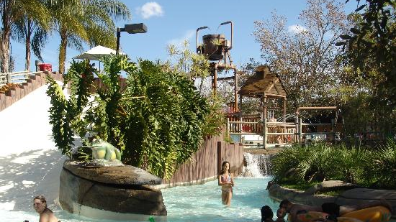
-Hot_Park-Rio_Quente_State_of_Goias.

Slide 25
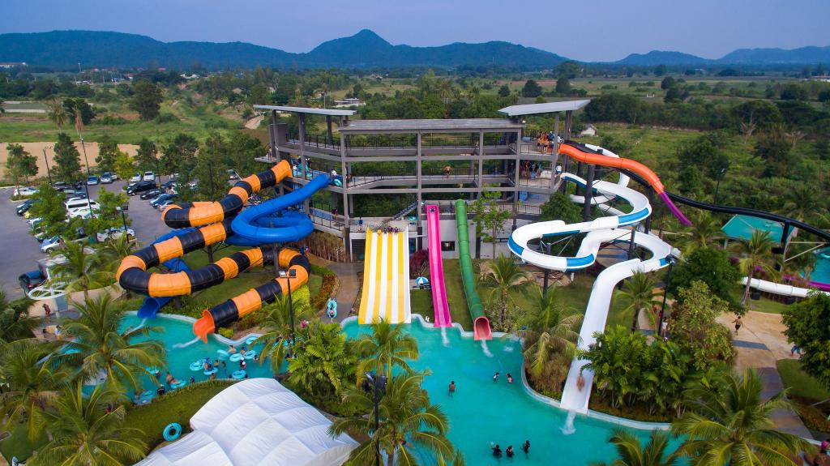
FIN
Auteur : H.Karaagopyan
Photos : Web
Musique : La Banda della Musica - VIVA LA BANDA
Black_Mountain_Water_Park-Hua_Hin_Prachuap_Khiri_Khan_Province.
3201

