Slide 1


Brenda Lee
I m Sorry

Slide 2
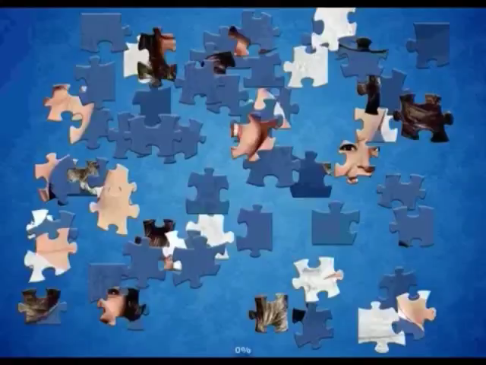
relancer
Quitter

