Slide 1



100 PHOTO DU MONDE
Lake Fryxellsee, Antarctica

Slide 2
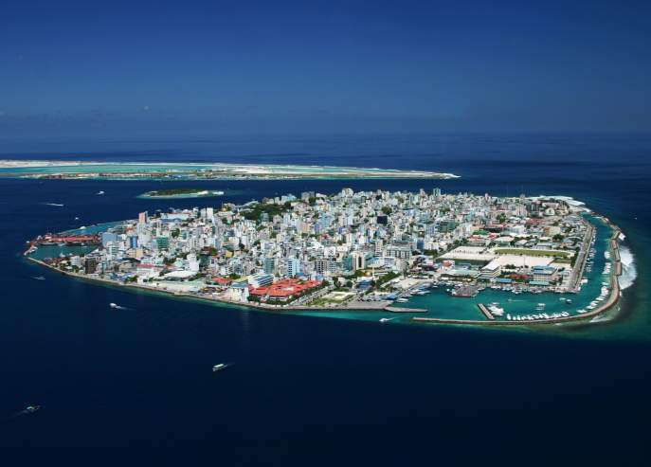
Male, Capital of Maldives

Slide 3
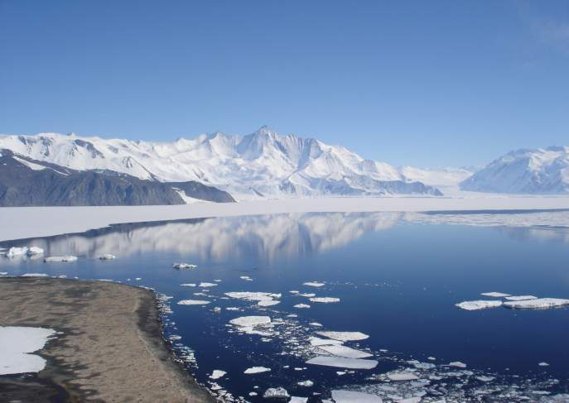
Mt. Herschel, Antarctica

Slide 4
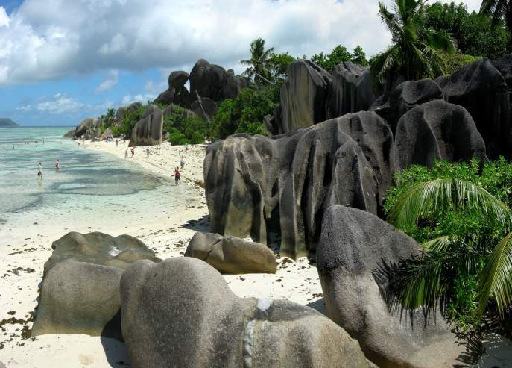
Seychelles

Slide 5
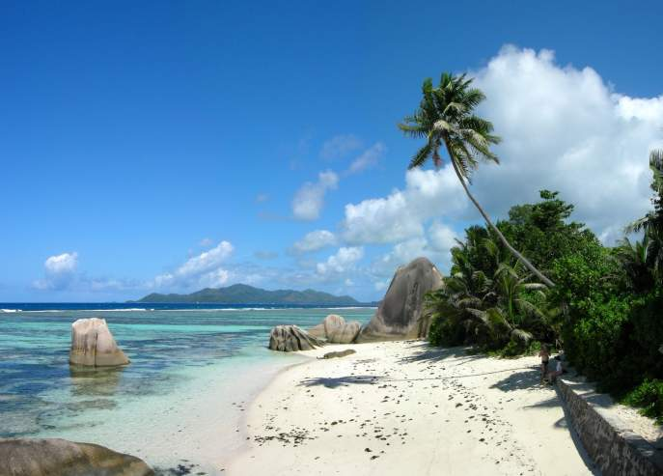
Seychelles

Slide 6
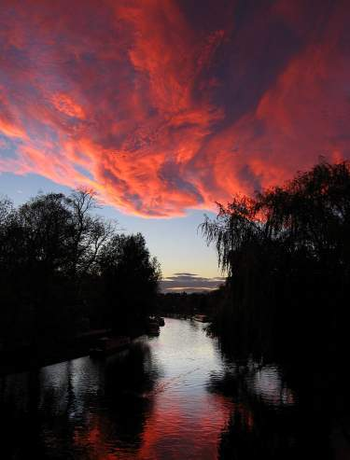
Cambridge Sunset

Slide 7
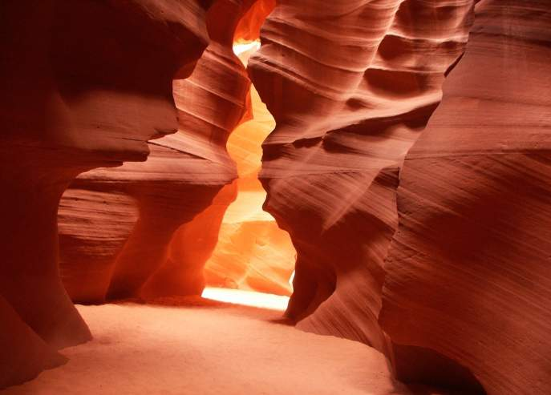
Antelope Canyon, Arizona
North America

Slide 8
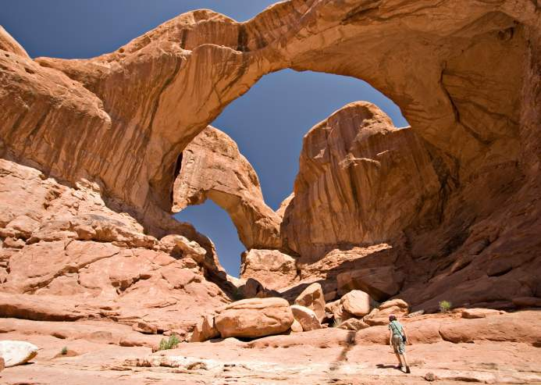
Arches NP, Utah

Slide 9
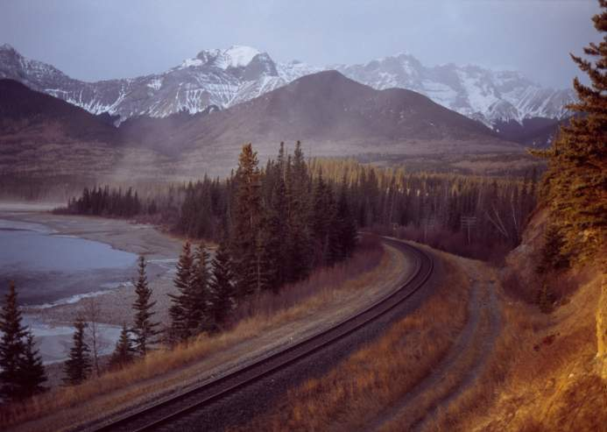
Athabasca Rail at Brule Lake, Canada

Slide 10
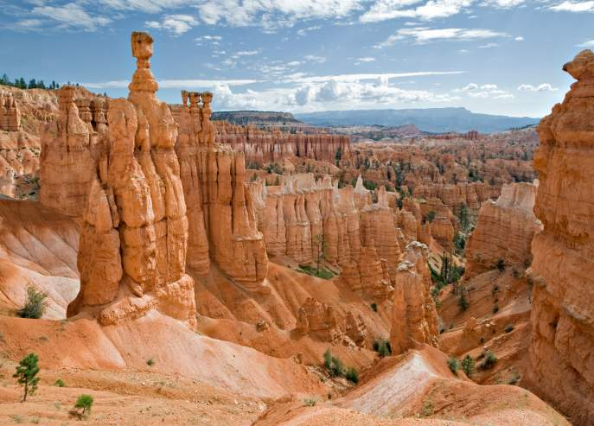
Bryce Canyon, Utah

Slide 11
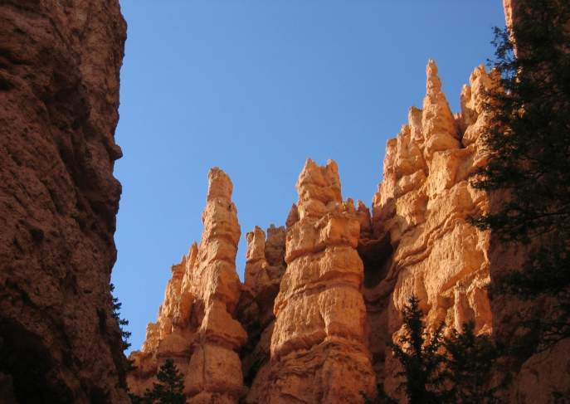
Bryce Canyon, Utah

Slide 12
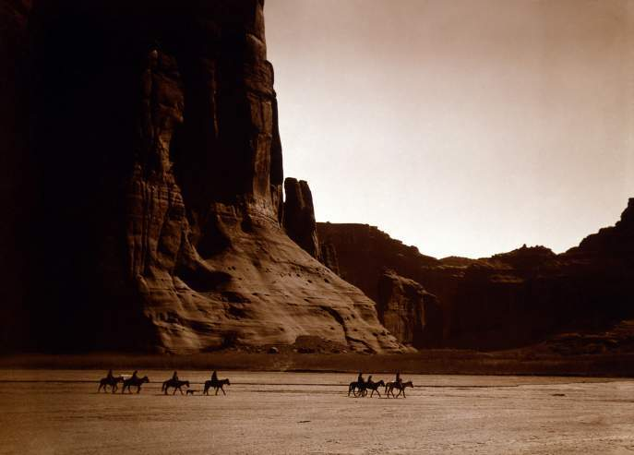
Canyon de Chelly, Navajo, Arizona

Slide 13
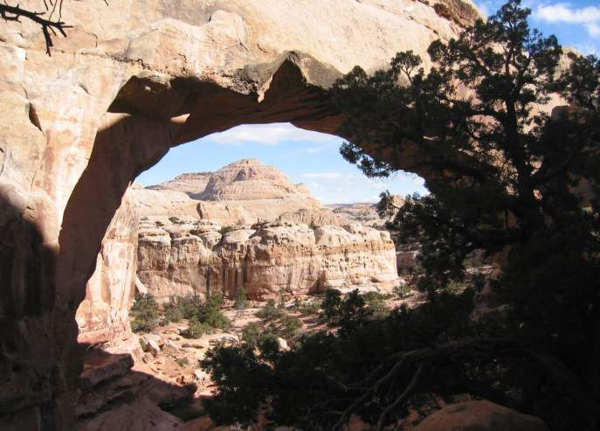
Capitol Reef, Hickman Bridge, Utah

Slide 14
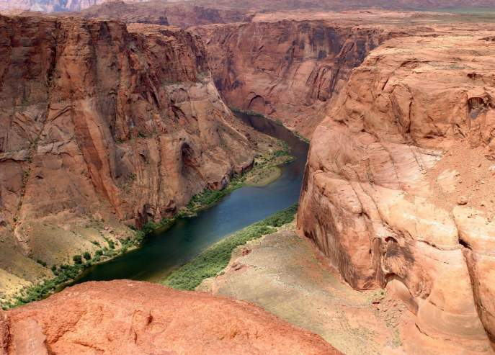
Colorado River

Slide 15
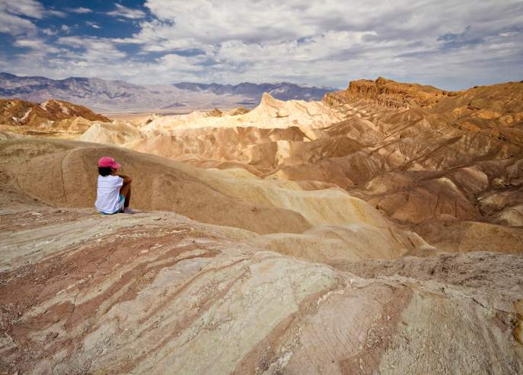
Death valley, California

Slide 16
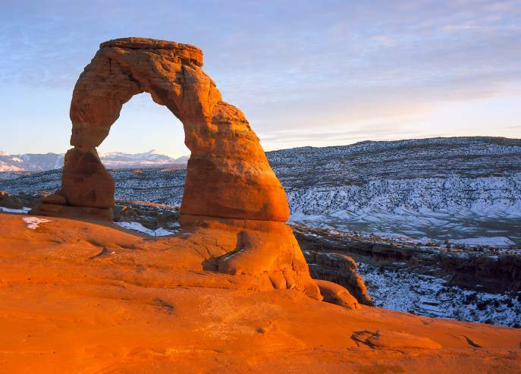
Delicate Arch, Utah

Slide 17
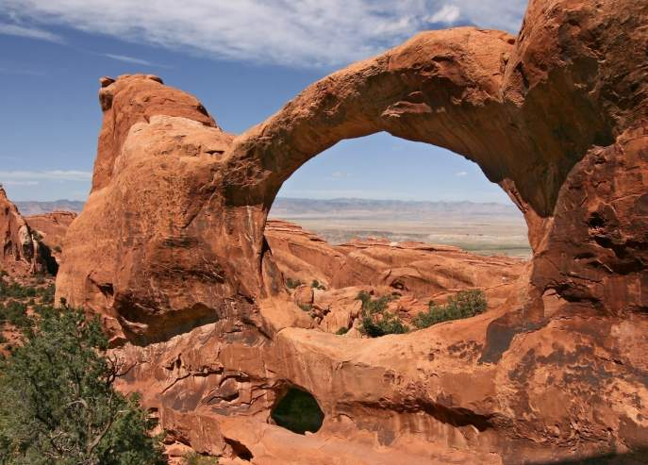
Double-O-Arch, Arches NP, Utah

Slide 18
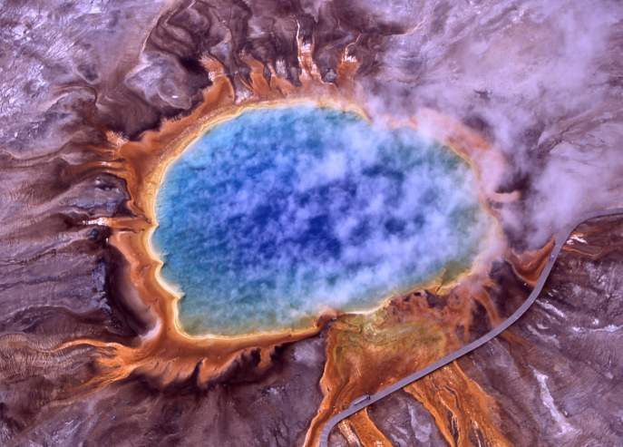
Grand Prismatic Spring, Yellowstone NP

Slide 19
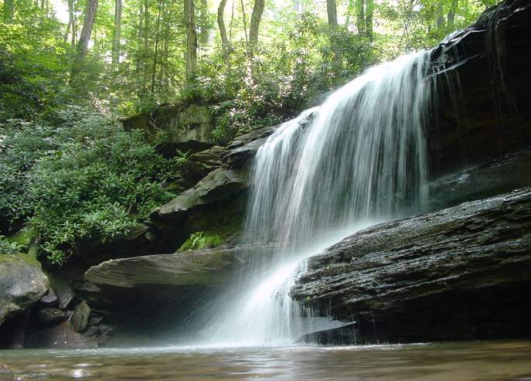
Jonathan Run Falls, Pennsylvania

Slide 20
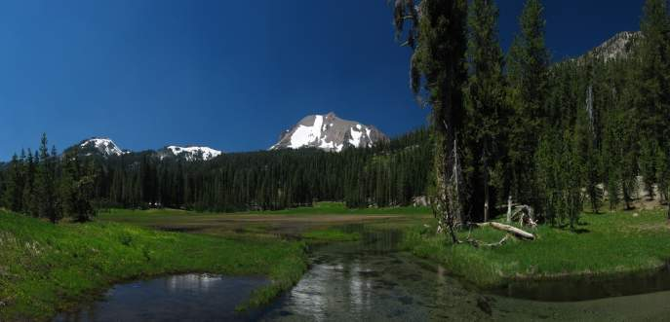
Lassen NP, Kings Creek, California

Slide 21
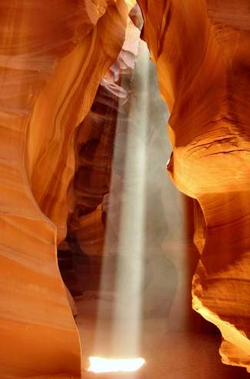
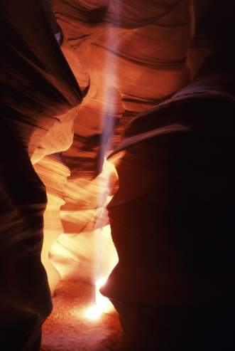
Antelope Canyon, Arizona
Antelope Canyon, Arizona

Slide 22
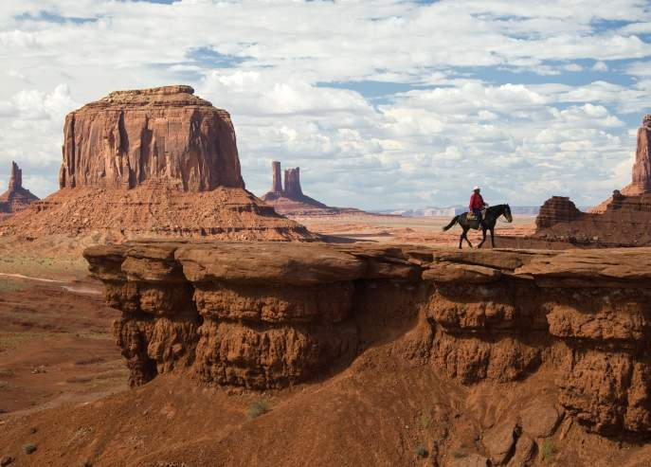
Monument Valley, Arizona

Slide 23
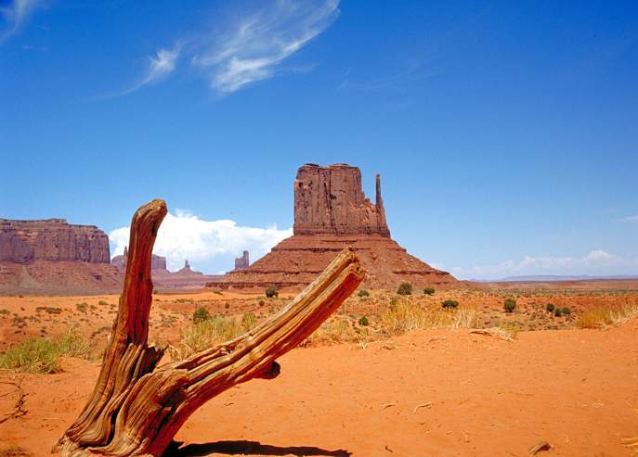
Monument Valley, Utah/Arizona

Slide 24
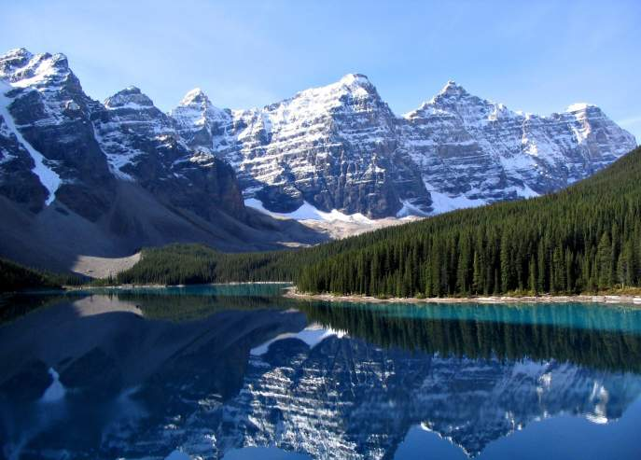
Moraine Lake, Banff NP, Canada

Slide 25
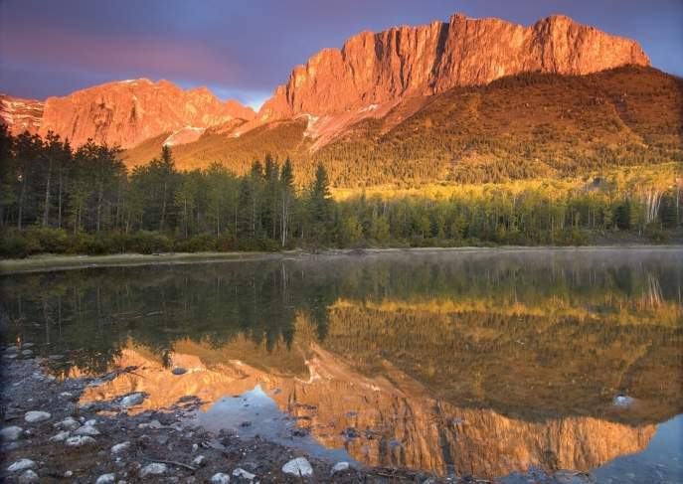
Mt. Yamuska, Alberta, Canada

Slide 26
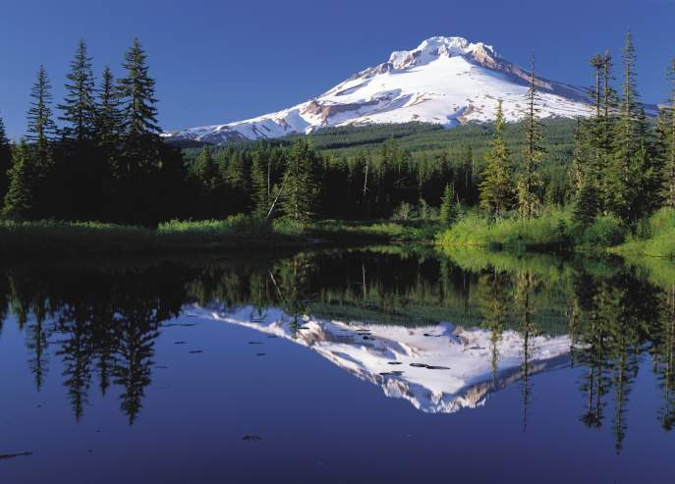
Mt. Hood & Trillium Lake, Oregon

Slide 27
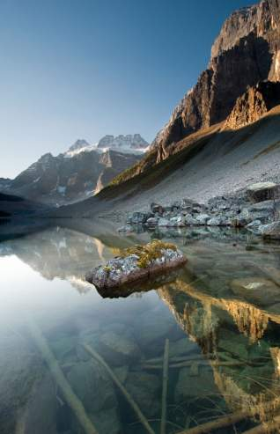
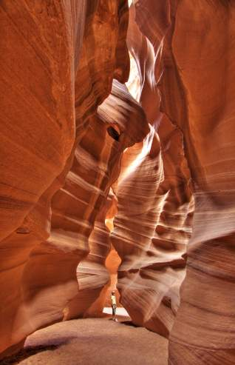
Antelope Canyon, Arizona
Consolation Lake, Banff NP, Canada

Slide 28
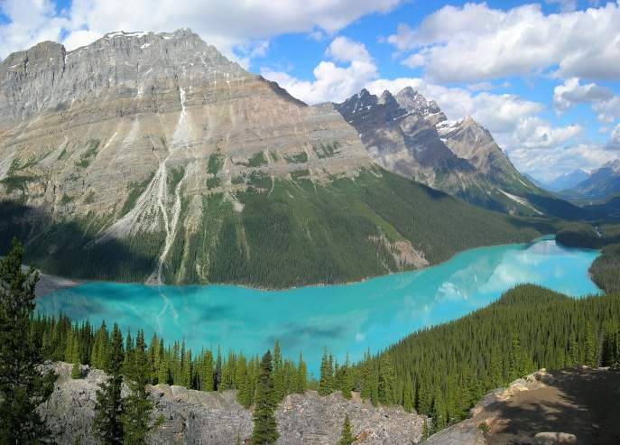
Peyto Lake, Banff NP, Canada

Slide 29
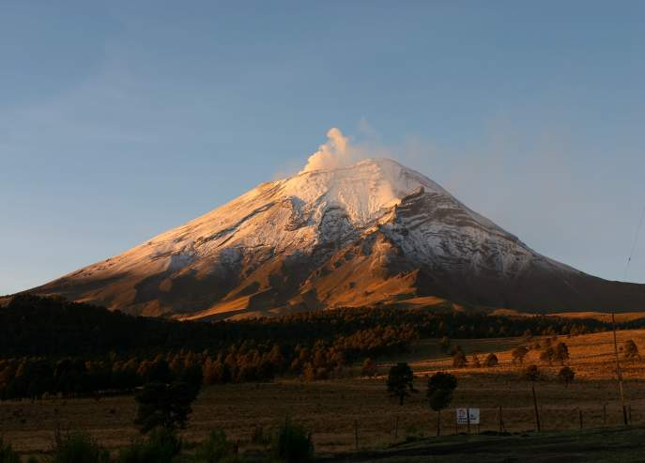
Mt. Popocatepetl, Mexico

Slide 30
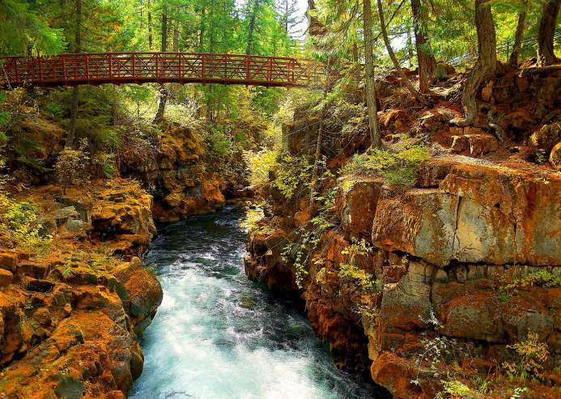
Rogue River, Oregon

Slide 31
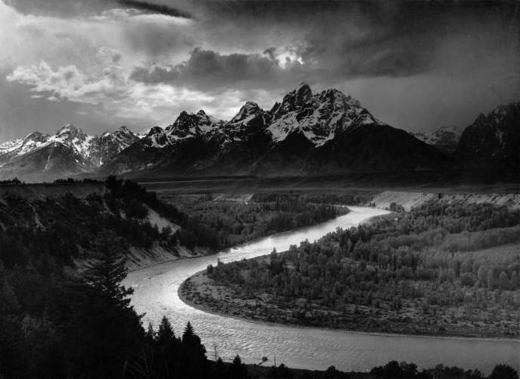
The Grand Tetons NP, Wyoming

Slide 32
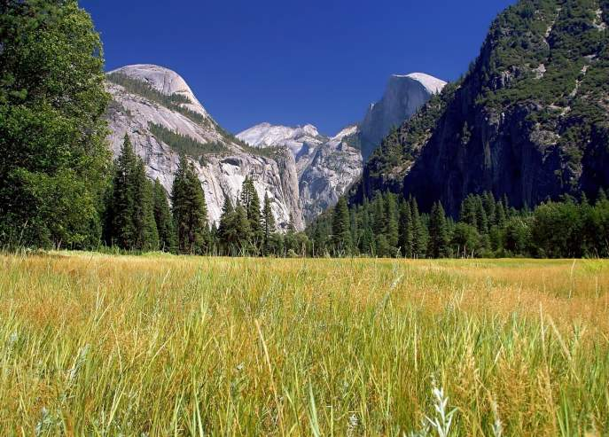
Yosemite NP

Slide 33
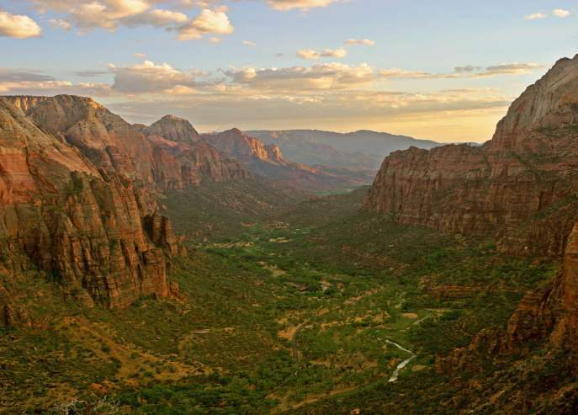
Zion Canyon, Utah

Slide 34
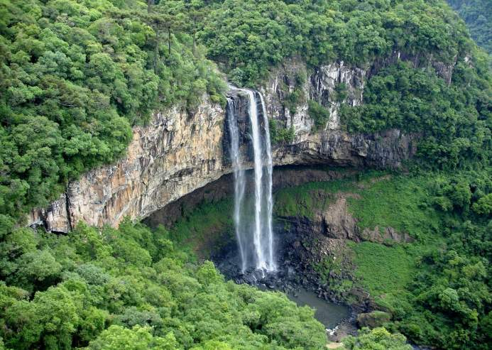
Cascata Caracol, Brazil
South America

Slide 35
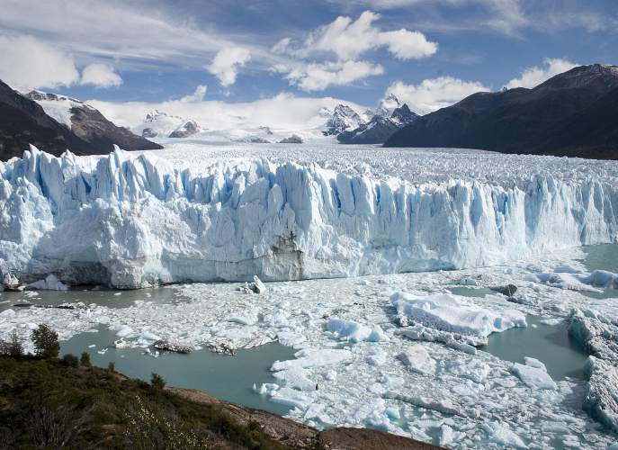
Perito Moreno Glacier, Patagonia, Argentina

Slide 36
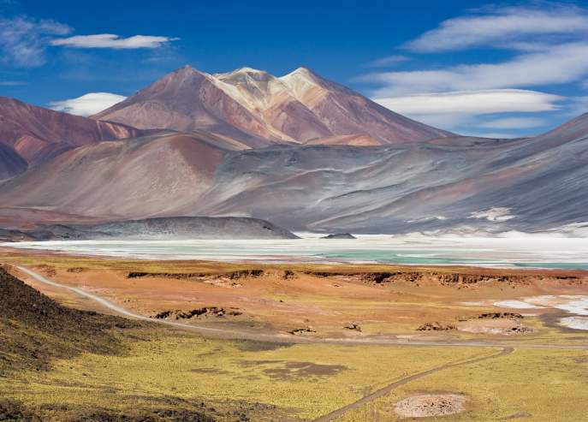
Miscanti Lagoon, San Pedro de Atacama, Chile

Slide 37
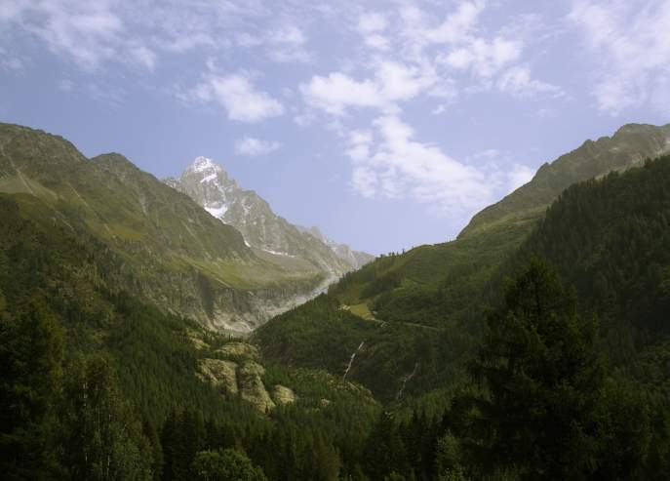
Argentina

Slide 38
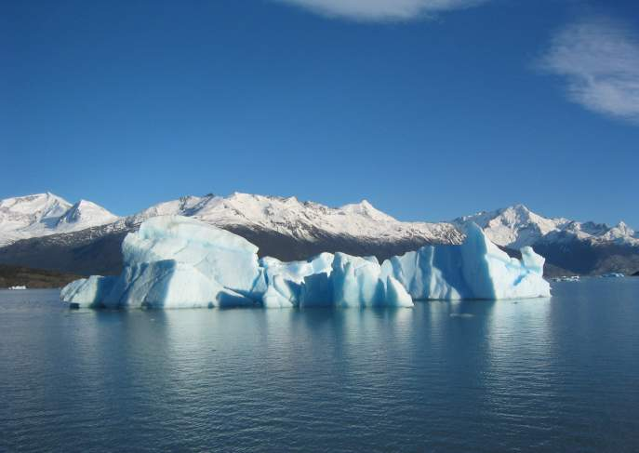
Glacial Iceberg, Argentina

Slide 39
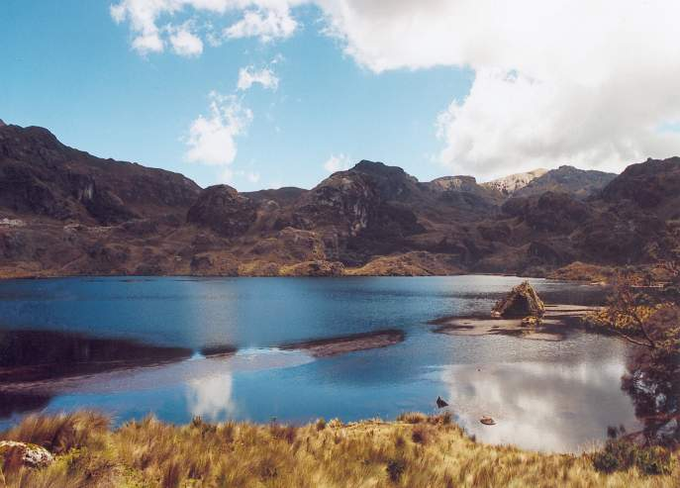
Ecuador Cajas NP

Slide 40
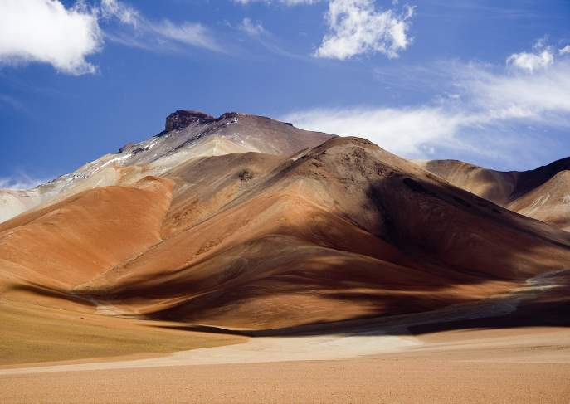
Altiplano, Bolivia

Slide 41
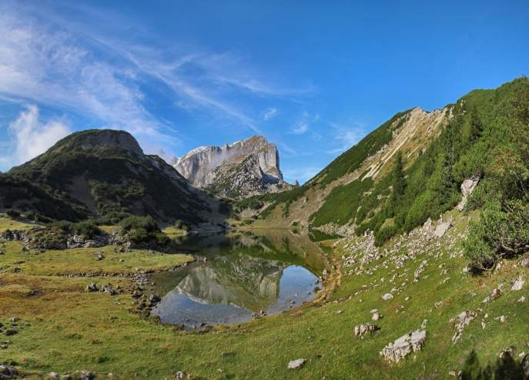
Zireiner See Rofanspitze, Austria

Slide 42
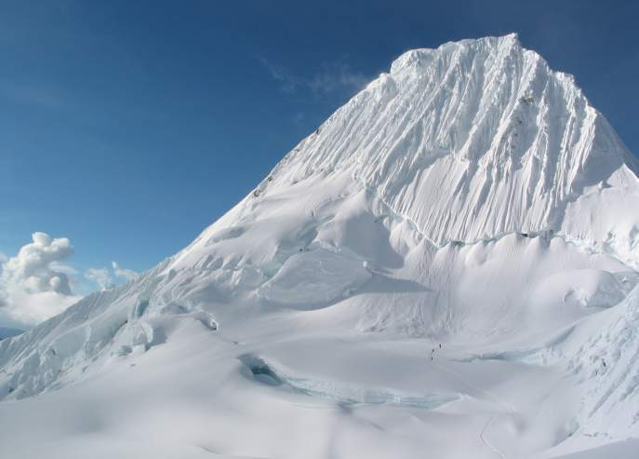
Alpamayo, Andes, Peru

Slide 43
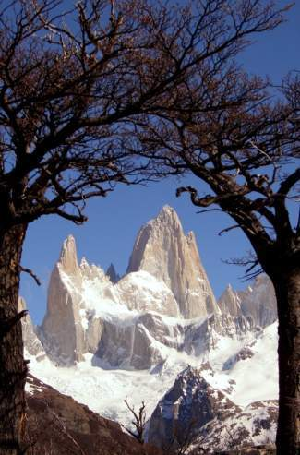
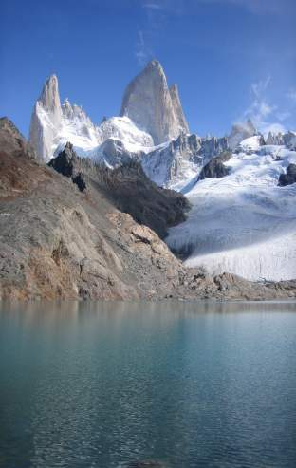
Fitz Roy Mountain, Argentina
Fitz Roy Mountain, Argentina

Slide 44
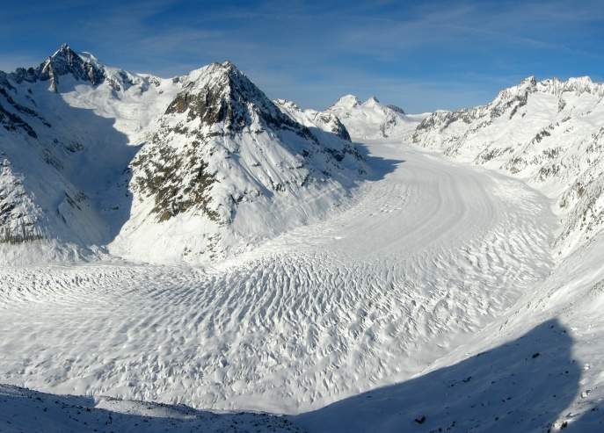
Aletschgletscher Eggishorn, Switzerland
Europe

Slide 45
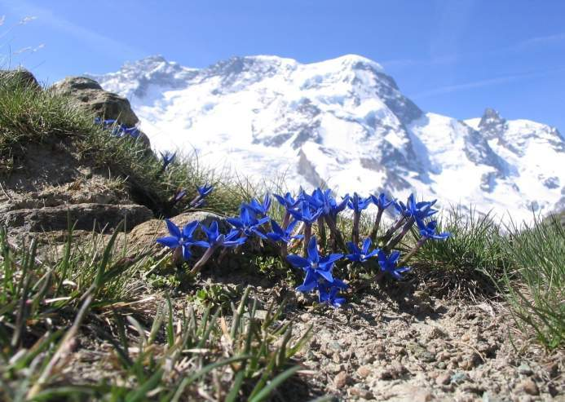
Breithorn Enzion, Swiss Alps

Slide 46
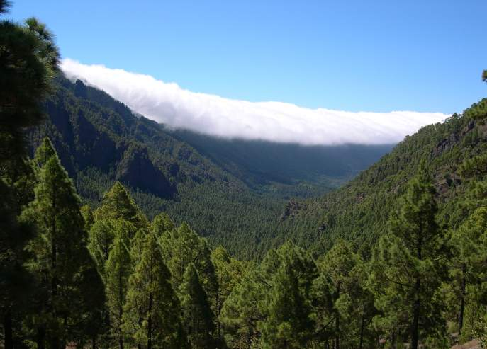
Caldera de Taburiente, La Palma, Spain

Slide 47
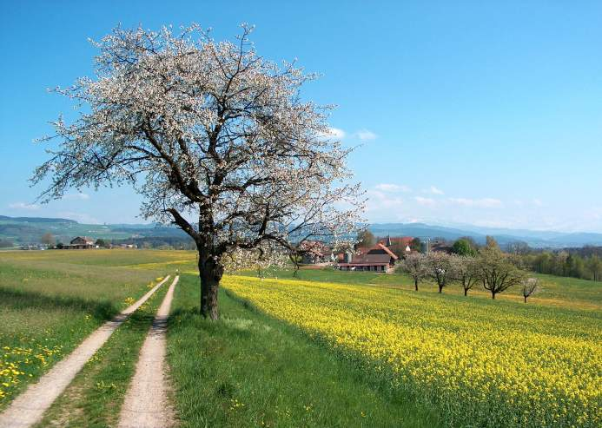
Chlingslandsch Aaretal, Switzerland

Slide 48
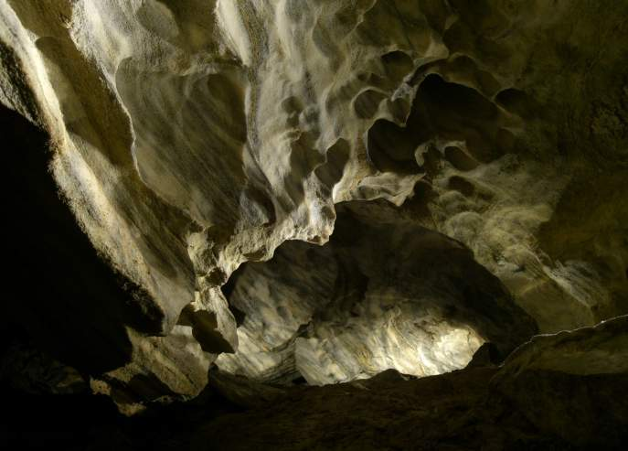
Chynov’s Cave, Czech Republic

Slide 49

Entle Buch, Switzerland

Slide 50

Eyjafjallajokull, Iceland

Slide 51


Oexarafoss, Iceland
Mullerthal Waterfalls, Luxembourg

Slide 52

Freudenberg, Switzerland

Slide 53

Geysir Strokkur Eruption, Iceland

Slide 54

Gothafoss Winter, Iceland

Slide 55

Hard Schleienloecher, Austria

Slide 56

Jokulsarlon Lake, Iceland

Slide 57

Karandila, Bulgaria

Slide 58

Sunnig Grat Summit, Switzerland

Slide 59

Langaa Egeskov Rimfrost, Denmark

Slide 60

Las Medulas, Leon, Spain

Slide 61

Lauterbrunnen Valley, Switzerland

Slide 62

Leirhnjukur, Iceland

Slide 63

Loch Lomond, Scotland

Slide 64
Mittlist Gfaell, Switzerland

Slide 65

Mont Blanc

Slide 66


Field Hemois, Belgium
Matterhorn & Riffelsee

Slide 67

Mont Brocken, Germany

Slide 68

Mislivny Bozy Dar Lake, Czech Republic

Slide 69

Nuna Island, Greenland

Slide 70

Oberfallenberg, Austria

Slide 71

Paijanne, Finnland

Slide 72

Piz Roseg, Italy/Switzerland

Slide 73

Porto Covo, Portugal

Slide 74

Rapfeld, Germany

Slide 75

Ribnisko Jezero, Slovenia

Slide 76

Schwarzsee, Austria

Slide 77

Seebodenalp Foggy Zuger See, Switzerland

Slide 78

Seebruecke Prerow, Germany

Slide 79

Tagus River, Toledo, Spain

Slide 80

Tresco, Scilly Islands, UK

Slide 81


Cliffs of Moher, Ireland
Dettifoss, Iceland

Slide 82

Ulvikfjord Mountains, Norway

Slide 83

Vallon Moy, France

Slide 84

Venediger, Austria

Slide 85

Stromboli Eruption, Italy

Slide 86

Namibian Desert
Africa

Slide 87

Sossusvlei Dune, Namibia

Slide 88

Tadrart, Algeria

Slide 89

Tadrart Acasus, Libya

Slide 90

Tadrart Acasus, Libya

Slide 91

Erb Chebbi, Morroco

Slide 92

Holang Bay, Vietnam
Asia

Slide 93

The Himalayas

Slide 94

Jiuzhaigou Pearl Waterfall, China

Slide 95

Kaindy Lake, Kazakhstan

Slide 96

Lipa Noi, Koh Samu, Thailand

Slide 97


Laila Peak, Pakistan
Trango Towers, Pakistan

Slide 98

Mt. Bromo, Java, Indonesia

Slide 99

Mt. Everest, Tibet

Slide 100

Rice Terraces, Yunnan, China

Slide 101

Mount Lushan, Jiangxi, China

Slide 102

Oceania
Champagne Pool-Wai-O-Tapu, New Zealand

Slide 103

Hopetown Waterfall, Australia

Slide 104

Loch Ard Gorge, Australia

Slide 105

McMillan’s Lookout, Australia

Slide 106



Nullamunjie Olive Grove, Australia

