Slide 1
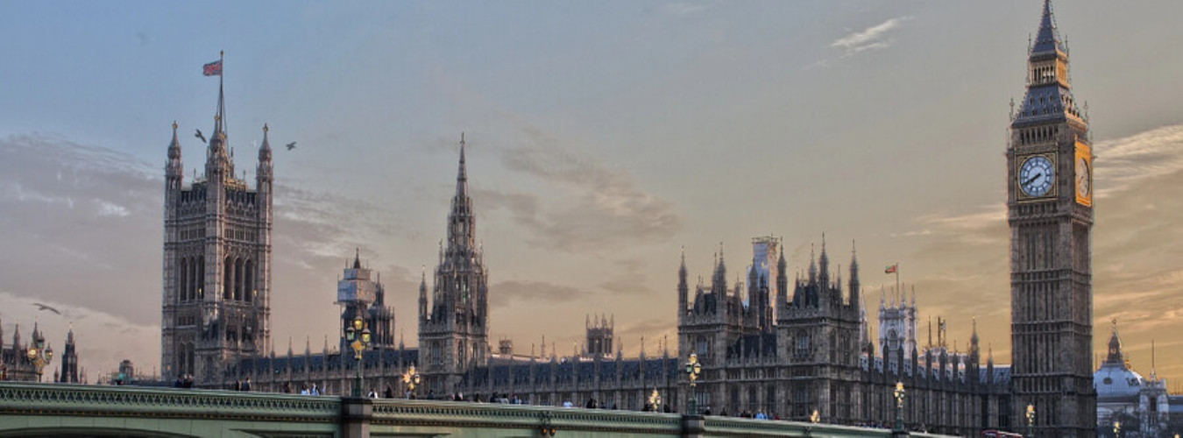
Quelques paysages d’Angleterre
Musique : Best Relax Music
Création du diaporama © Apex

Slide 2
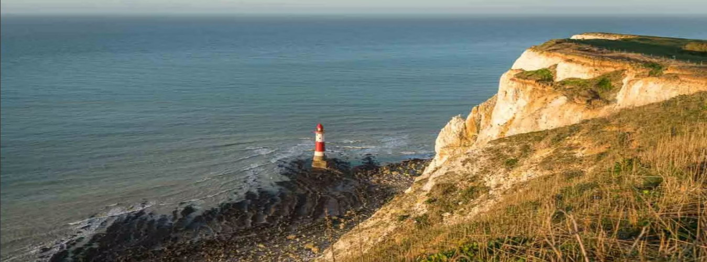

Beachy Head & les Seven Sisters (Sussex)

Slide 3
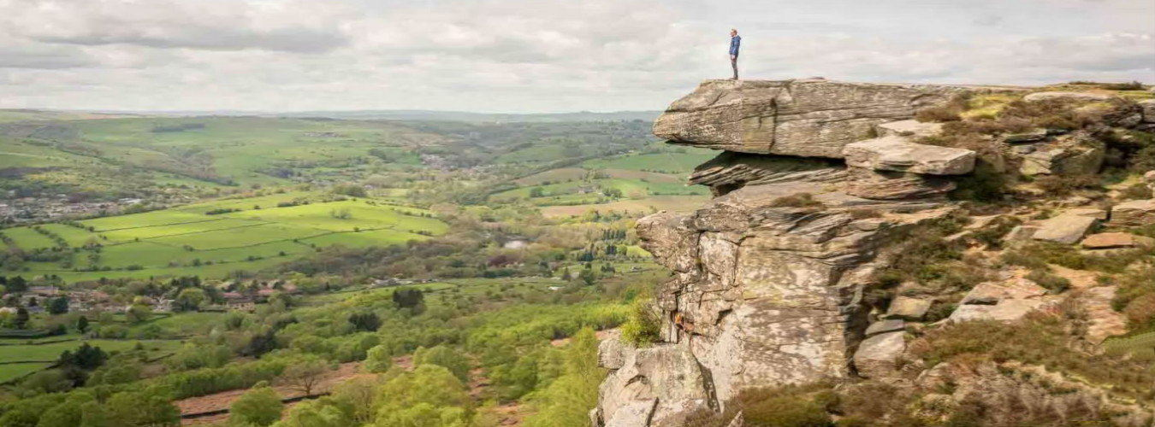

Curbar Edge (Peak District)

Slide 4
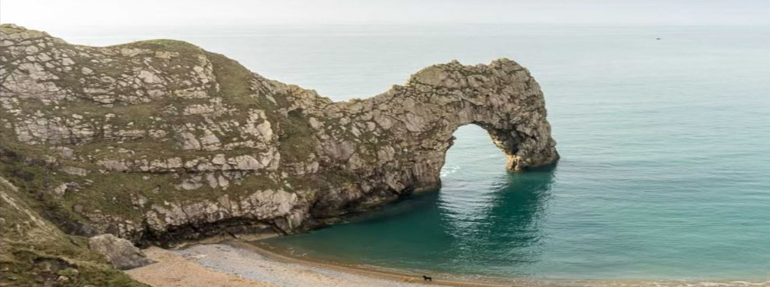
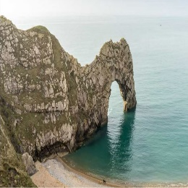
Durdle Door (Dorset)

Slide 5
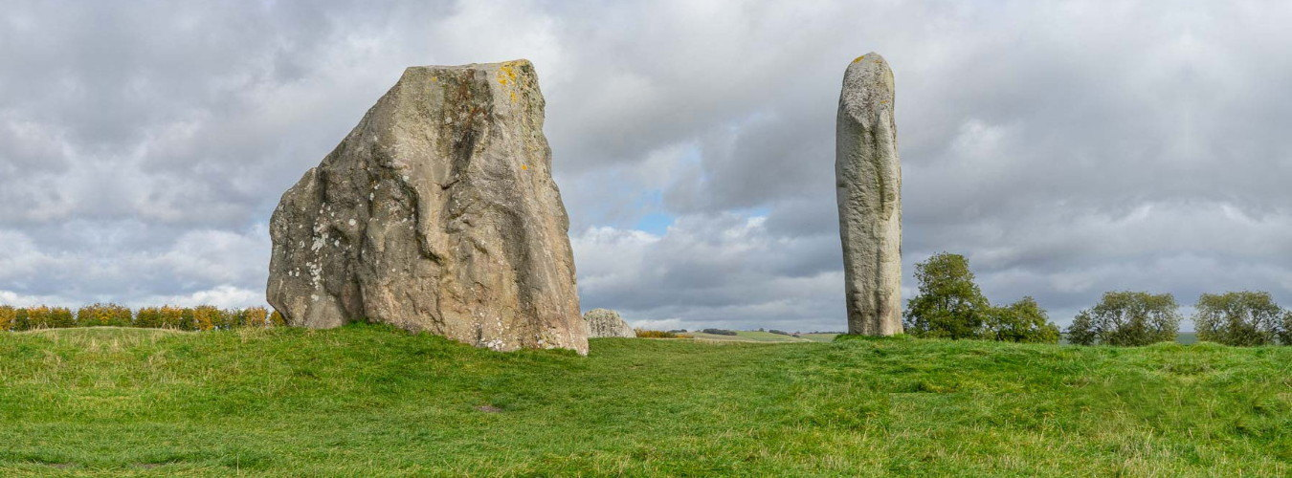


Avebury (Wiltshire)

Slide 6
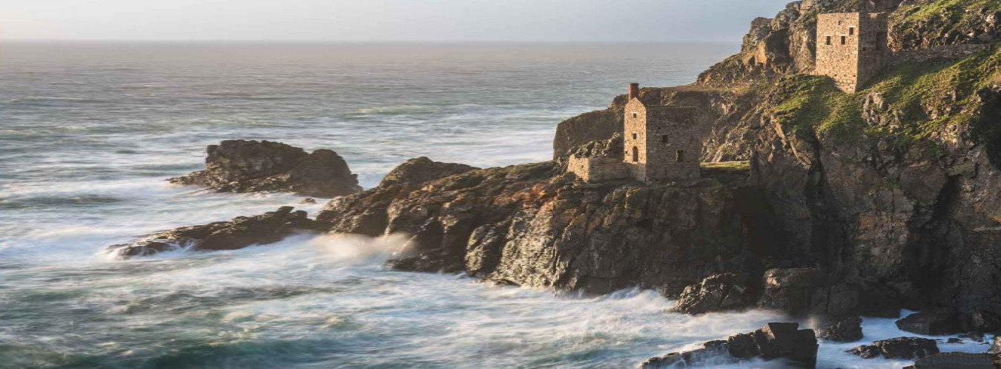

Botallack Mine (Cornouailles)

Slide 7
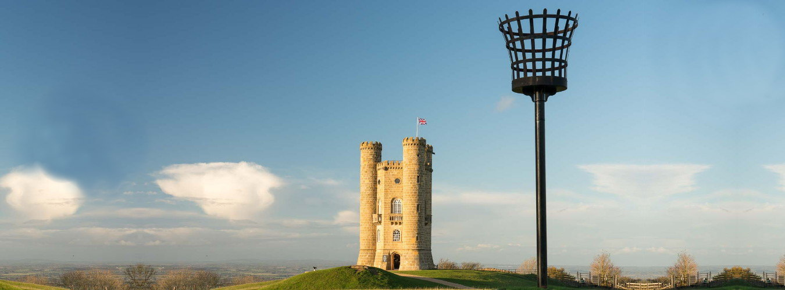
Broadway Tower (Cotswolds)

Slide 8
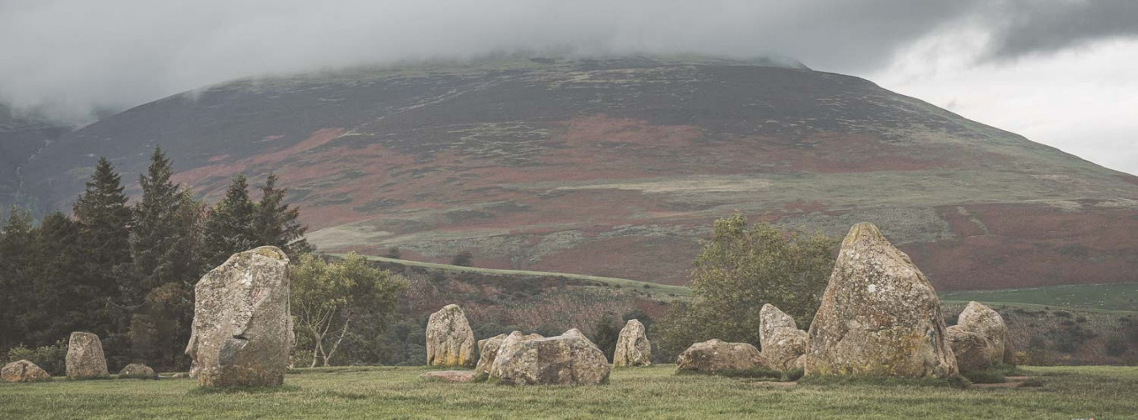

Castlerigg Stone Circle (Lake District)

Slide 9
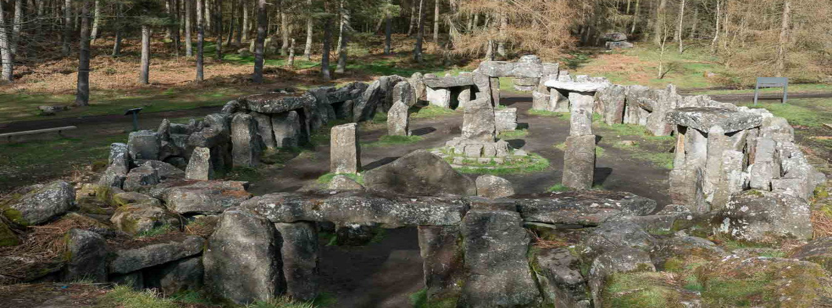

Druid's Temple (Yorkshire Dales)

Slide 10
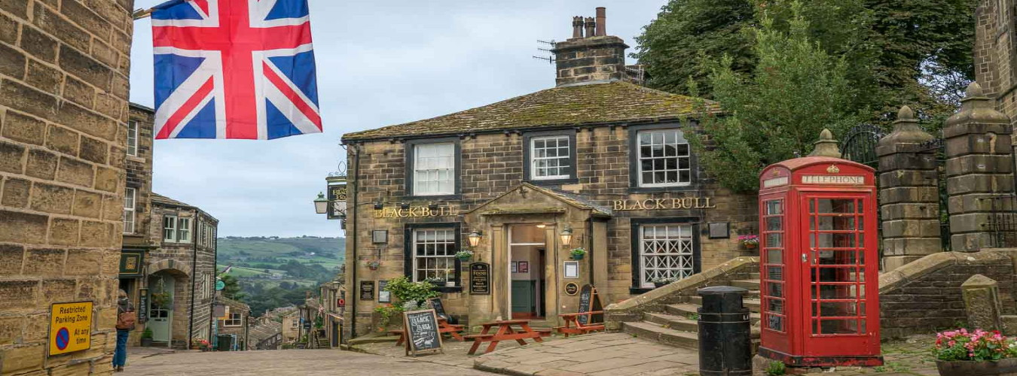

Haworth (Yorkshire)

Slide 11
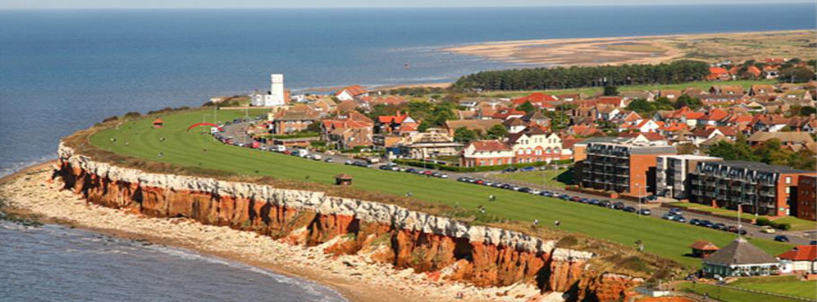
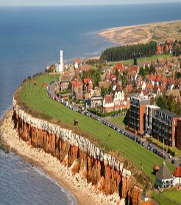


Hunstanton (Norfolk)

Slide 12
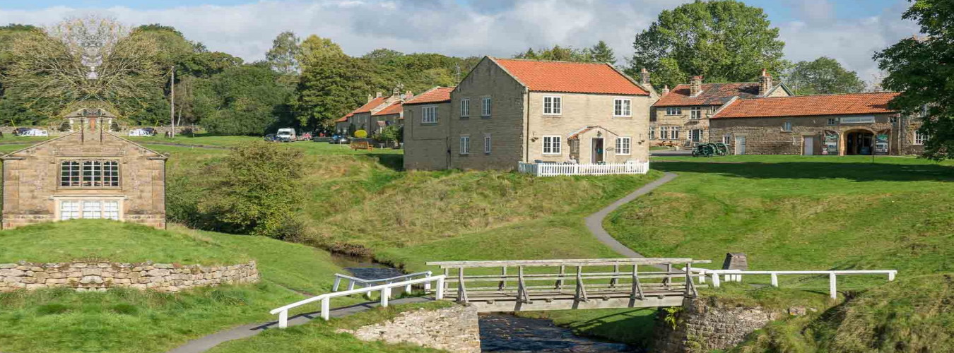

Hutton-le-Hole (North York Moors)

Slide 13
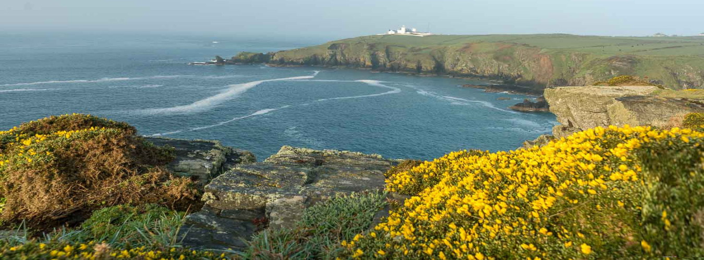
The Cape Lizard (Cornouailles)

Slide 14
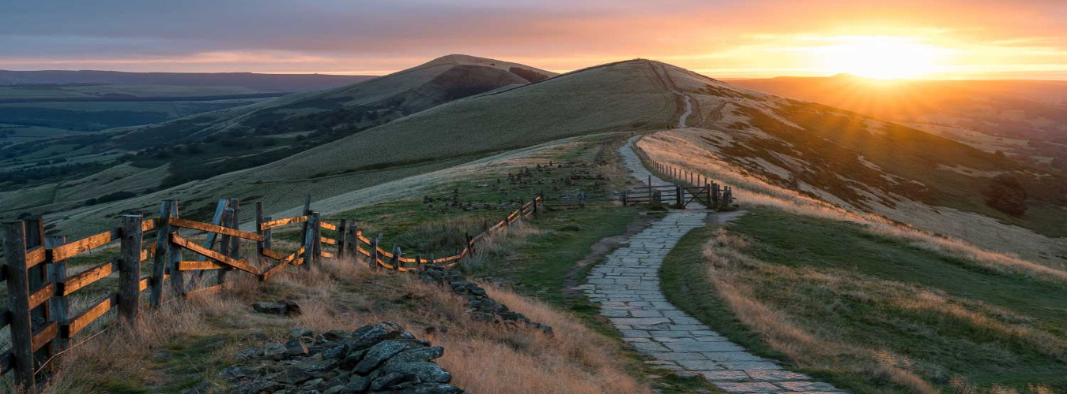



Mam Tor (Peak District)

Slide 15
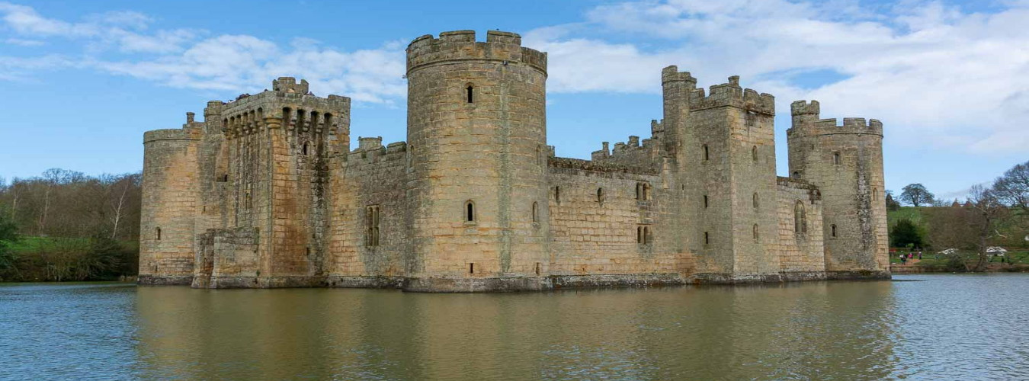

The castel of Bodiam (Sussex)

Slide 16
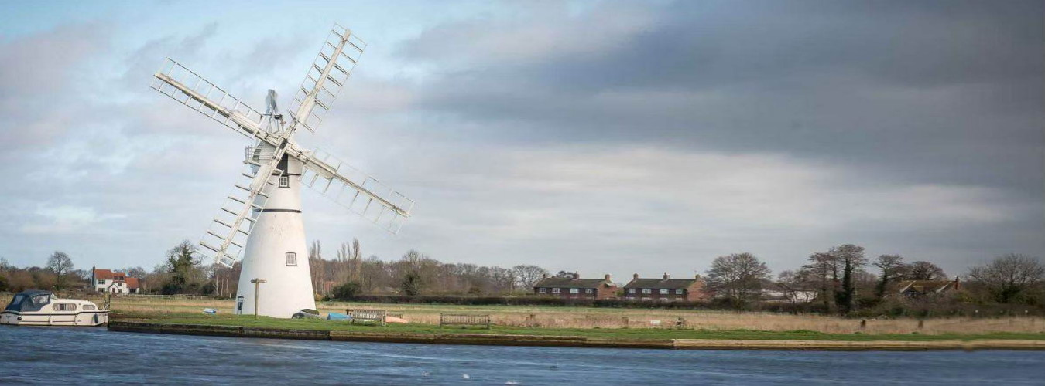
National Park of Broads (Norfolk)

Slide 17
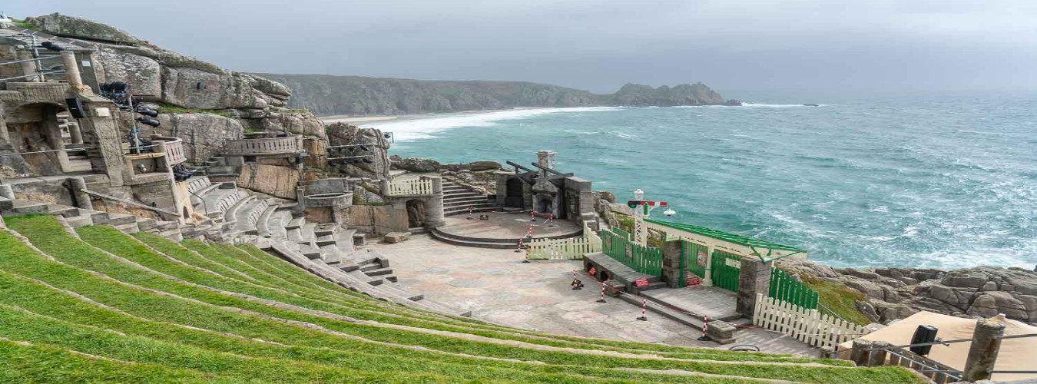
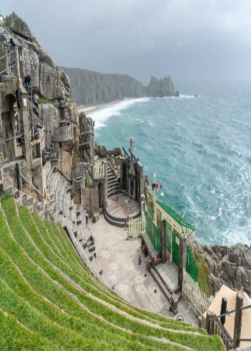
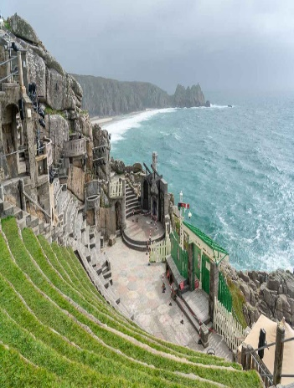
The theater of Minack (Cornouailles)

Slide 18
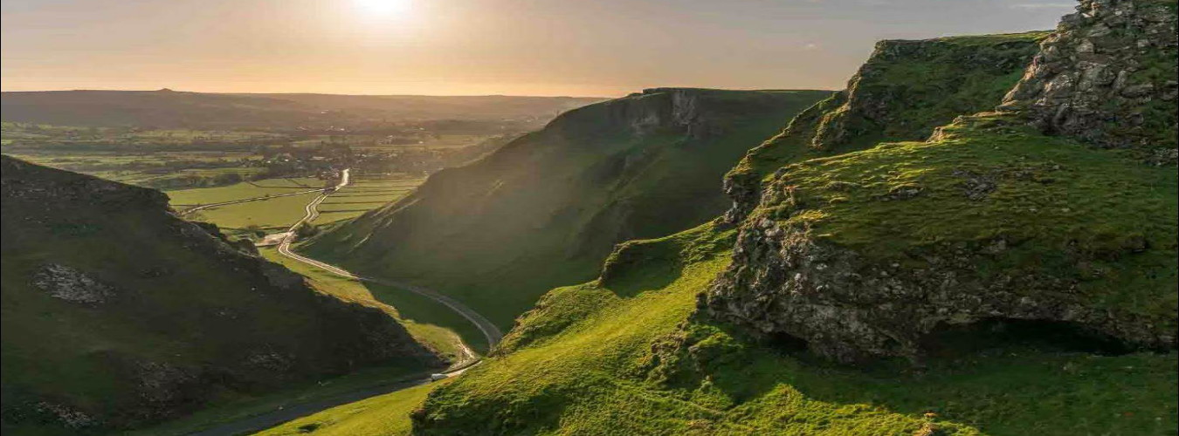



Winnats Pass (Peak District)

Slide 19
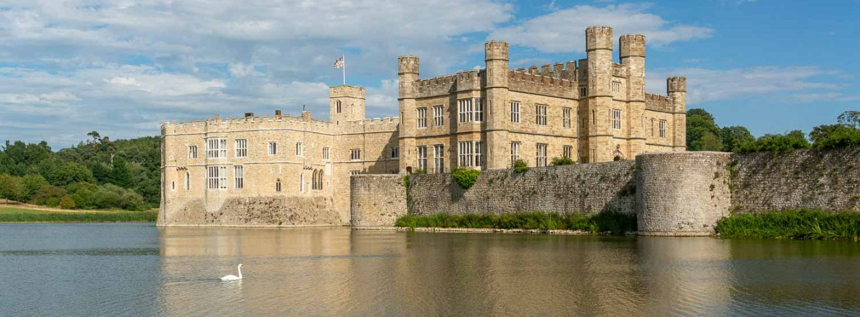


Leeds Castle (Kent)

Slide 20
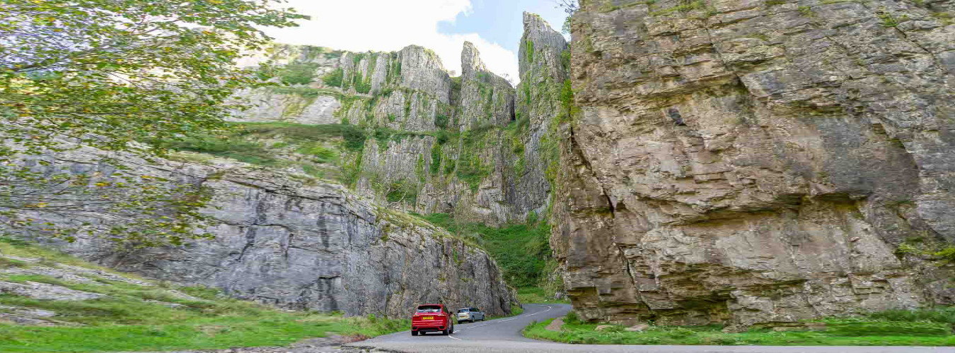
The Gorges of Cheddar (Somerset)

Slide 21
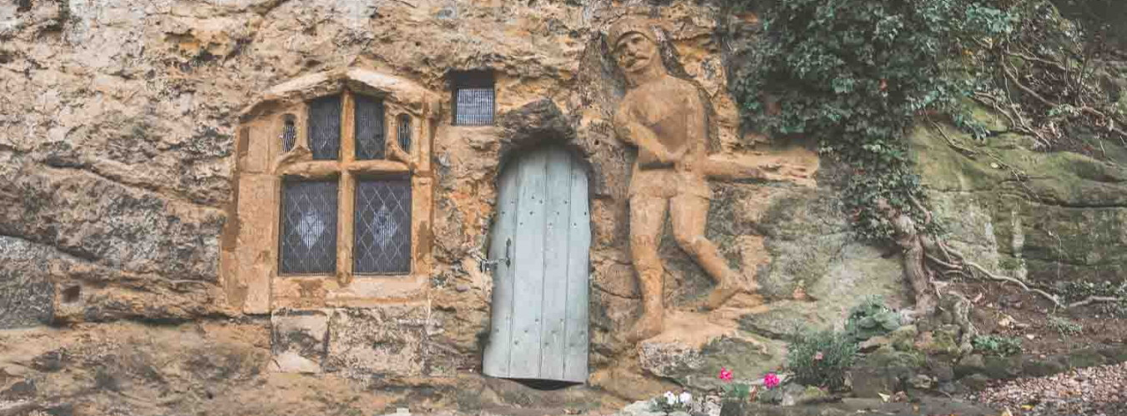

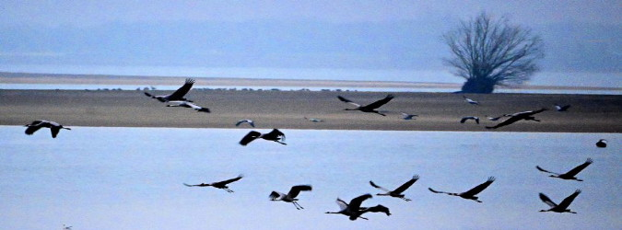
Our Lady of the Crag (Yorkshire Dales)

Slide 22
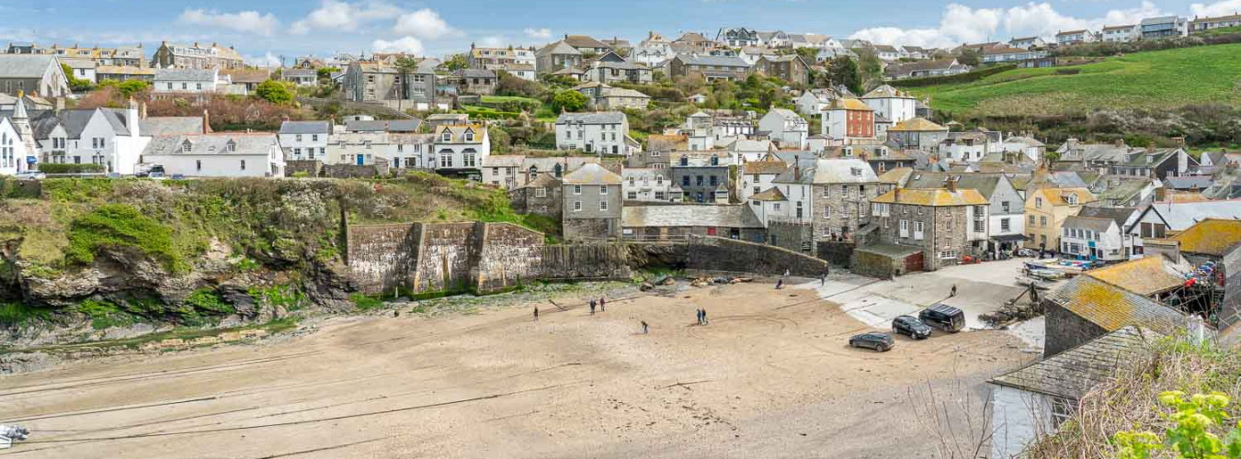


Port Isaac (Cornouailles)

Slide 23
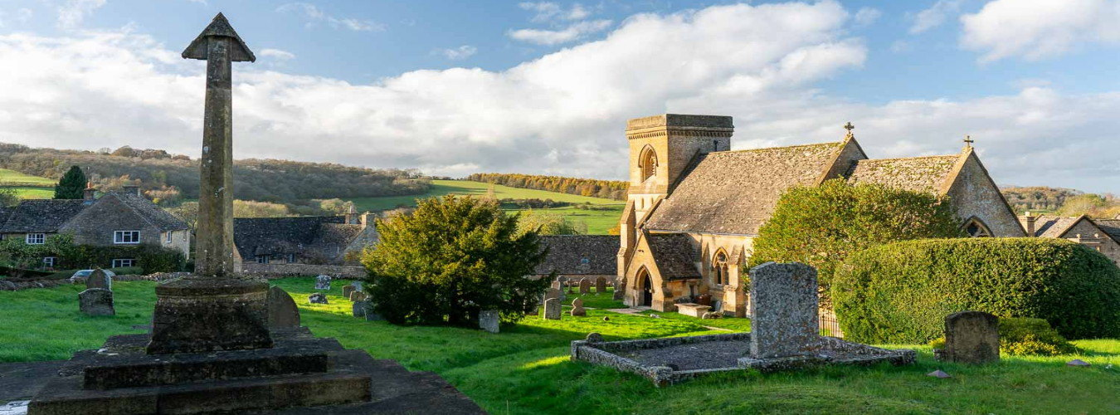




Snowshill (Cotswolds)

Slide 24
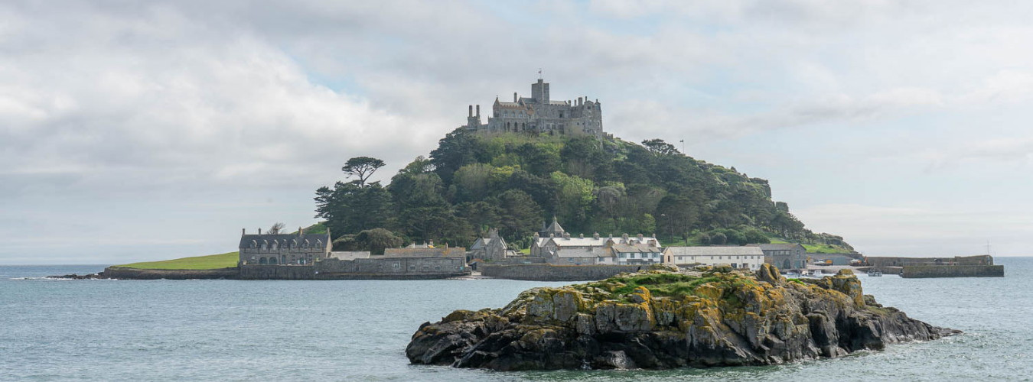
St Michael's Mount (Cornouailles)

Slide 25
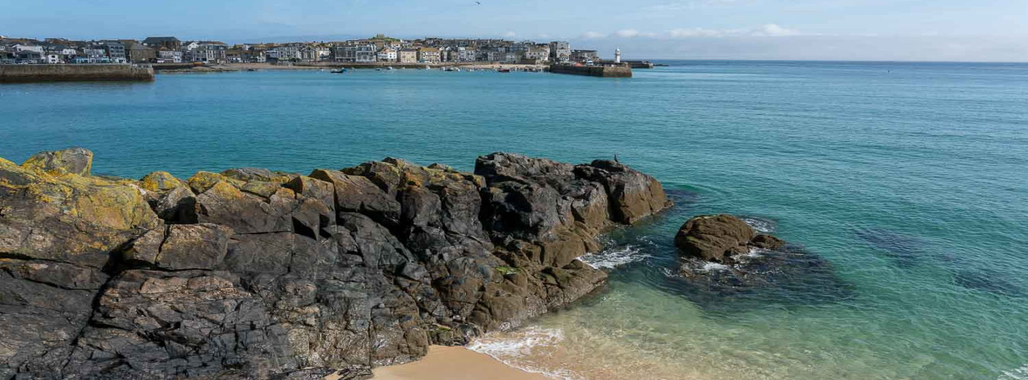



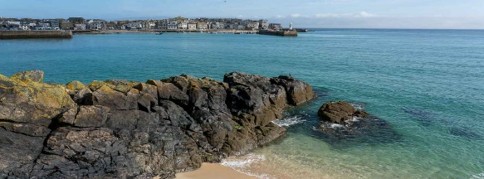


St Ives (Cornouailles)

Slide 26
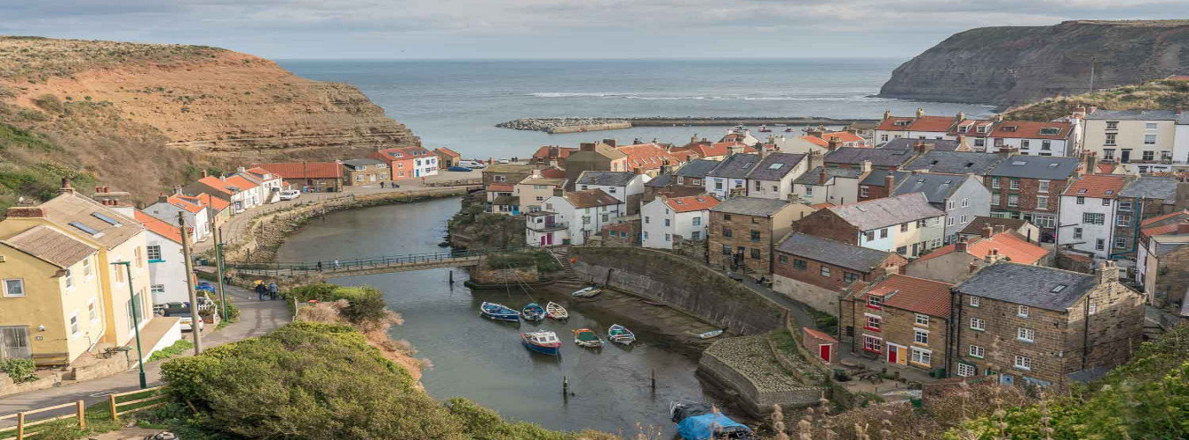
Staithes (North York Moors)

Slide 27
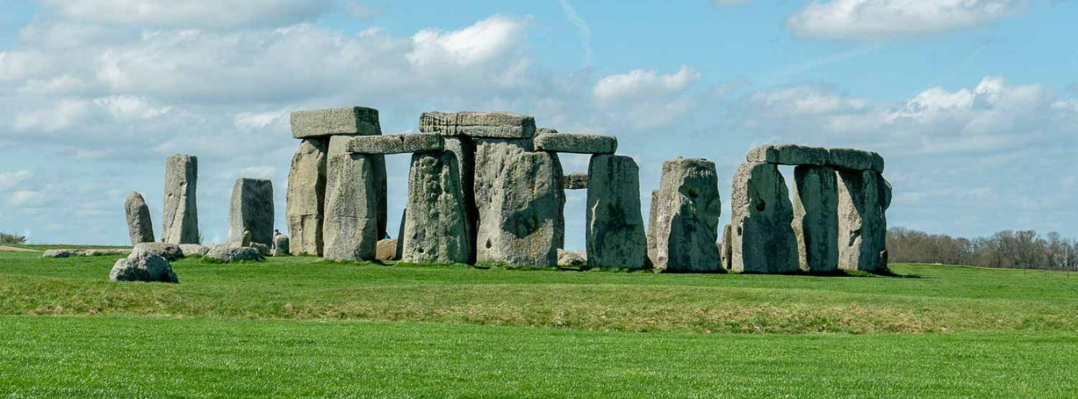
Stonehenge (Wiltshire)

Slide 28
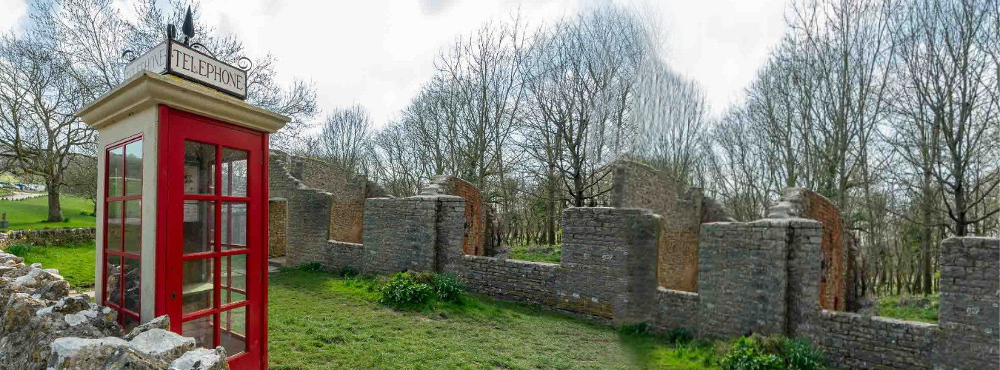




Tyneham (Dorset)

Slide 29
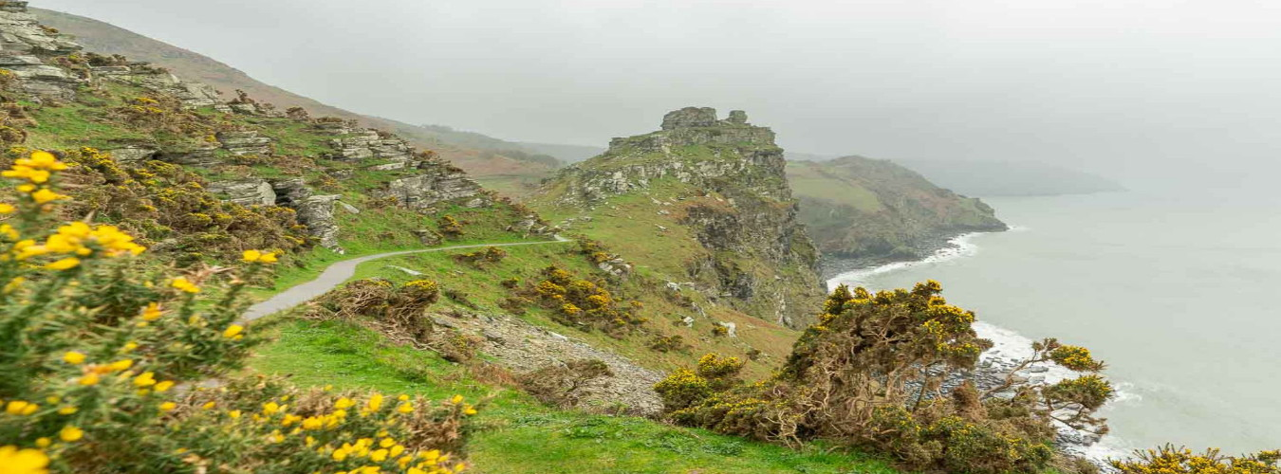

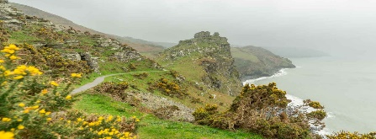

The Valley of Rocks (Exmoor)

Slide 30
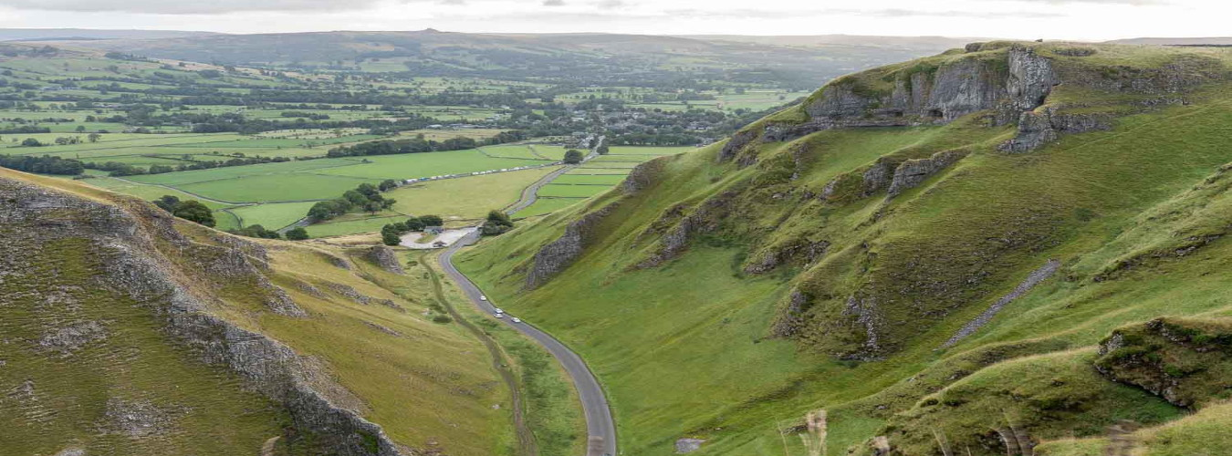

Winnats Pass (Peak District)

Slide 31
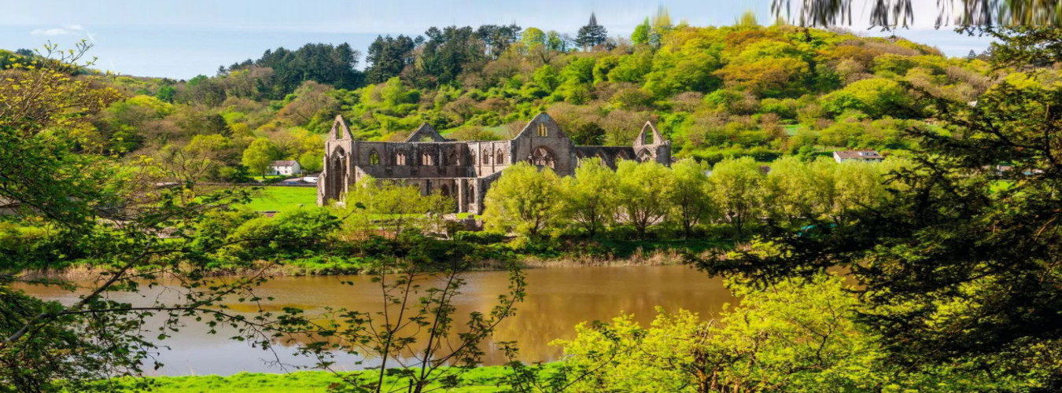
Tintern Abbey on the River Wye

Slide 32




F I N
Touche Esc pour quitter

