Slide 1

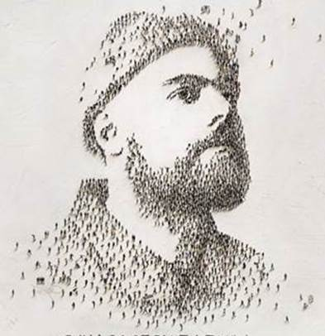

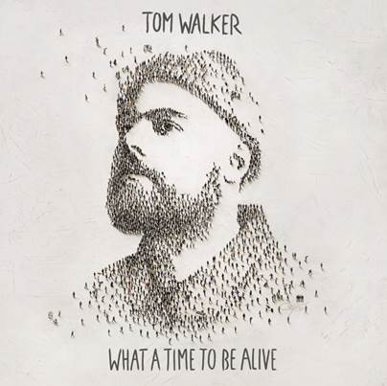




Slide 2

01. Angels
02. Leave a Light On
03. Not Giving In
04. How Can You Sleep at Night ?
05. Now You're Gone (feat. Zara Larsson)
06. My Way
07. Blessings
08. Cry Out
09. Dominoes
10. Fade Away
11. Just You and I
12. The Show
13. Just You and I (Acoustic)
14. Walk AloneAbigail Breslin - Love Is Strange

Slide 3














































