Slide 1

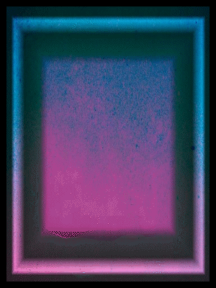


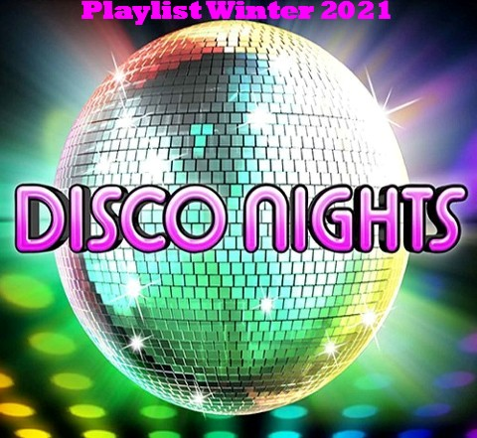




Slide 2
01 - Patrick Hernandez - Born To Be Alive
02 - Sylvester - You Make Me Feel
03 - Tina Charles - I Love To Love
04 - Thelma Houston - Don't Leave Me This Way
05 - Amii Stewart - Knock On Wood
06 - Barry White - You're The First, The Last, My Everything
07 - Imagination - Just An Illusion
08 - Sabrina - Boys Boys Boys
09 - Bee Gees - Tragedy
10 - Stacy Lattisaw - Jump to the Beat
11 - Rubettes - Juke Box Juve
12 - Soft Cell - Trainted Love
13 - ABBA - Waterloo
14 - Bobby King - If You Don't Want My Love
15 - George Benson - Give Me the Night
16 - Bee Gees - You Should Be Dancing
17 - Rose Royce - Is It Love You're After
18 - Tony Esposito - Kalimba de luna
19 - Eartha Kitt - This is my life
20 - The Pointer Sisters - I'm So Excited
21 - Billy Ocean - Love Really Hurts Without You
22 - Gibson Brothers - Que Sera Mi Vida
23 - The Hues Corporation - Rock the Boat
24 - Village People - Y.M.C.A
25 - Eruption - One Way Ticket

Slide 3













