Slide 1




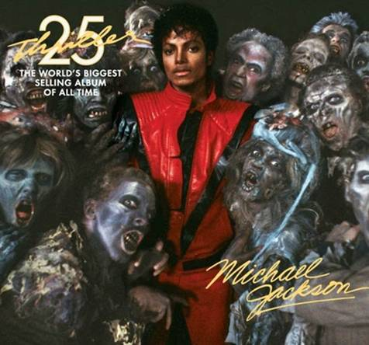



Slide 2

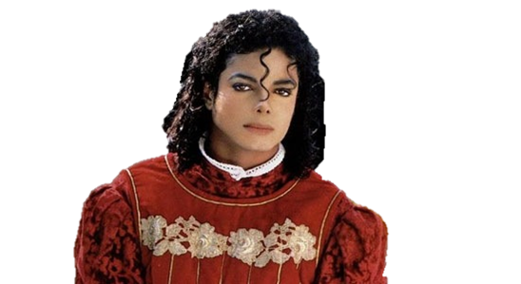
01. Michael Jackson - Wanna Be Startin' Somethin' (6:02)
02. Michael Jackson - Baby Be Mine (4:20)
03. Michael Jackson,Paul McCartney - The Girl Is Mine (3:42)
04. Michael Jackson - Thriller (5:57)
05. Michael Jackson - Beat It (Single Version) (4:18)
06. Michael Jackson - Billie Jean (Single Version) (4:54)
07. Michael Jackson - Human Nature (4:06)
08. Michael Jackson - P.Y.T. (Pretty Young Thing) (3:59)
09. Michael Jackson - The Lady in My Life (4:59)
10. Vincent Price - Vincent Price Excerpt From "Thriller" Voice-Over Session (Thriller 25th Anniversary Voice-Over Session) (0:24)
11. Michael Jackson,will.i.am - The Girl Is Mine 2008 with will.i.am (Thriller 25th Anniversary Remix) (3:10)
12. Michael Jackson,will.i.am - P.Y.T. (Pretty Young Thing) 2008 with will.i.am (Thriller 25th Anniversary Remix feat. willi.i.am) (4:21)
13. Michael Jackson,Akon - Wanna Be Startin' Somethin' 2008 with Akon (Thriller 25th Anniversary Remix) (4:14)
14. Michael Jackson,Fergie - Beat It 2008 (Thriller 25th Anniversary Remix feat. Fergie) (4:11)
15. Michael Jackson,Kanye West - Billie Jean 2008 Kanye West Mix (Thriller 25th Anniversary Remix) (4:36)

Slide 3

16. Michael Jackson - For All Time (4:04)
17. Quincy Jones - Voice-Over Intro Quincy Jones Interview #1 / Quincy Jones Interview #1 (2:18)
18. Michael Jackson - Someone in the Dark (4:48)
19. Quincy Jones - Voice-Over Intro Quincy Jones Interview #2/Quincy Jones Interview #2 / Voice-Over Intro Billie Jean (Demo) (2:04)
20. Michael Jackson - Billie Jean (Home Demo from 1981) (2:20)
21. Quincy Jones - Quincy Jones Interview #3 (3:10)
22. Rod Temperton - Voice-Over Intro Rod Temperton Interview #1 / Rod Temperton Interview #1 (4:03)
23. Quincy Jones - Quincy Jones Interview #4 (1:32)
24. Michael Jackson,Rod Temperton,Vincent Price - Voice-Over Intro / Voice-Over Session from Thriller (2:52)
25. Rod Temperton - Voice-Over Intro Rod Temperton Interview #2 / Rod Temperton Interview #2 (1:56)
26. Quincy Jones - Quincy Jones Interview #5 (2:02)
27. Michael Jackson - Carousel (1:49)
28. Quincy Jones - Voice-Over Intro Quincy Jones Interview #6 / Quincy Jones Interview #6 (1:18)
29. Michael Jackson - Billie Jean (Underground Mix) (6:40)
30. Michael Jackson - Thriller (Instrumental) (5:58)

Slide 4






































