Slide 1




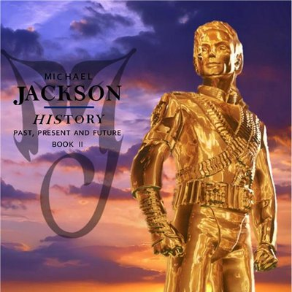



Slide 2

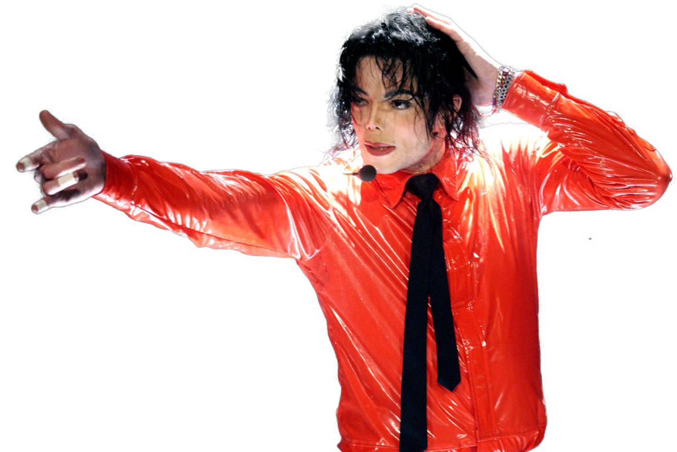
01. Scream
02. They Don't Care About Us
03. Stranger in Moscow
04. This Time Around
05. Earth Song
06. D.S.
07. Money
08. Come Together
09. You Are Not Alone
10. Childhood (Theme from Free Willy 2)
11. Tabloid Junkie
12. 2 Bad
13. History
14. Little Susie Pie Jesu
15. Smile

Slide 3






























