Slide 1





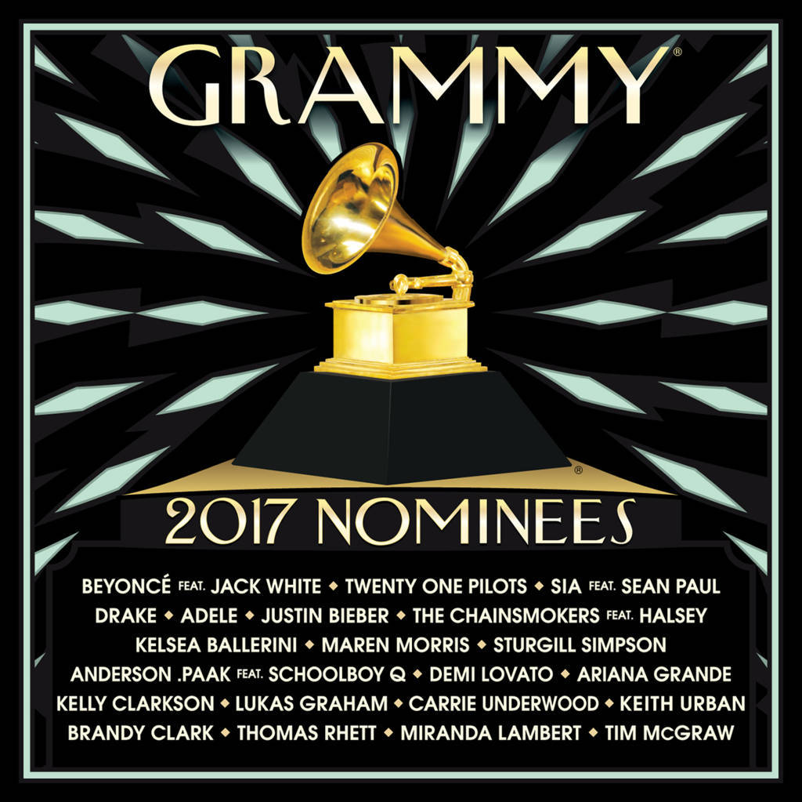



Slide 2


01. Beyonce - Don't Hurt Yourself (Feat. Jack White) 03:53
02. Twenty One Pilots - Stressed Out 03:22
03. Sia - Cheap Thrills (Feat. Sean Paul) 03:42
04. Drake - Hotline Bling 04:16
05. Adele - Hello 04:54
06. Justin Bieber - Love Yourself 03:54
07. The Chainsmokers - Closer (Feat. Halsey) 04:04
08. Kelsea Ballerini - Peter Pan 03:17
09. Maren Morris - My Church 03:15
10. Sturgill Simpson - Brace For Impact (Live A Little) 05:48
11. Anderson Paak - Am I Wrong (Feat. Schoolboy Q) 04:15
12. Demi Lovato - Confident 03:24
13. Ariana Grande - Dangerous Woman 03:52
14. Kelly Clarkson - Piece By Piece (Idol Version) 03:29
15. Lukas Graham - 7 Years 03:56
16. Carrie Underwood - Church Bells 03:11
17. Keith Urban - Blue Ain't Your Color 03:50
18. Brandy Clark - Love Can Go To Hell 03:56
19. Thomas Rhett - Die A Happy Man 03:45
20. Miranda Lambert - Vice 03:57
21. Tim Mcgraw - Humble And Kind 04:16

Slide 3











