Slide 1




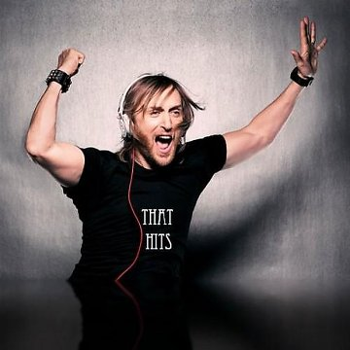




Slide 2


01. David Guetta Feat. Sia - Titanium
02. David Guetta Feat. Estelle - One Love
03. David Guetta & Chris Willis with Steve Angello & Sebastian Ingrosso - Everytime We Touch
04. David Guetta Feat Sia - She Wolf (Falling to Pieces)
05. David Guetta Feat. Chris Willis - Stay
06. David Guetta Feat. Ne-Yo & Akon - Play Hard
07. David Guetta Feat. Kid Cudi - Memories
08. David Guetta Feat. Usher - Without You
09. David Guetta Feat. Cozi - Baby When The Light
10. David Guetta Feat. Chris Willis - Love is Gone
11. David Guetta Feat. Nicki Minaj - Turn Me On
12. David Guetta Feat. Chris Willis - Just A Little More Love
13. David Guetta Feat. JD Davis - The World Is Mine
14. David Guetta Feat. Snoop Dogg - Wet
15. David Getta vs. The Egg - Love Don't Let Me Go (Walking Away)
16. David Guetta Feat. Akon - Sexy Bitch
17. David Guetta Feat. Taio Cruz - Little Bad Girl
18. David Guetta Feat. Skylar Grey - She Shot Me Down
19. David Guetta Feat. Kelly Rowland - When Love Takes Over
20. David Guetta & Chris Willis Vs. Tocadisco - Tomorrow Can't Wait
21. David Guetta Feat. Fergie and LMFAO - Gettin' Over You
22. David Guetta Feat. Chris Willis And Mone - Money
23. David Guetta Feat. Tara McDonald - Delirious

Slide 3
















































