Slide 1





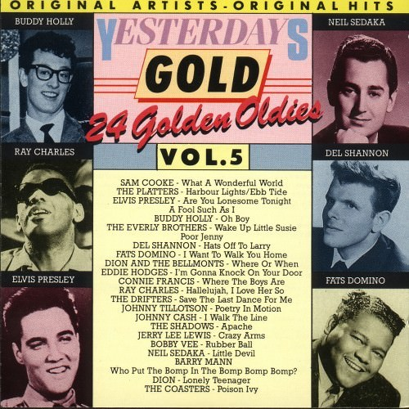



Slide 2

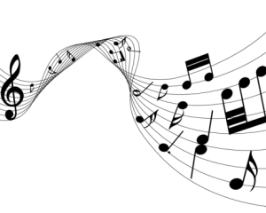
01 What A Wonderful World - Sam Cooke
02 Harbor Lights - Platters
03 Are You Lonesome Tonight - Elvis Presley
04 Oh Boy - Buddy Holly
05 Wake Up Little Susie - Everly Brothers
06 Hats Off To Larry - Del Shannon
07 I Want To Walk You Home - Fats Domino
08 Where Or When - Dion & The Belmonts
09 I'm Gonna Knock On Your Door - Eddie Hodges
10 Where The Boys Are - Connie Francis
11 Hallelujah, I Love Her So - Ray Charls
12 Save The Last Dance For Me - Drifters
13 Poetry In Motion - Johnny Tillotson
14 Poor Jenny - Everly Brothers
15 I Walk The Line - Johnny Cash
16 Apache - Shadows
17 A Fool Such As I - Elvis Presley
18 Crazy Arms - Jerry Lee Lewis
19 Rubber Ball - Bobby Vee
20 Ebb Tide - Platters
21 Little Devil - Neil Sedaka
22 Who Put The Bomp - Barry Mann
23 Lonely Teenager - Dion
24 Poison Ivy - Coasters

Slide 3



















































