Slide 1





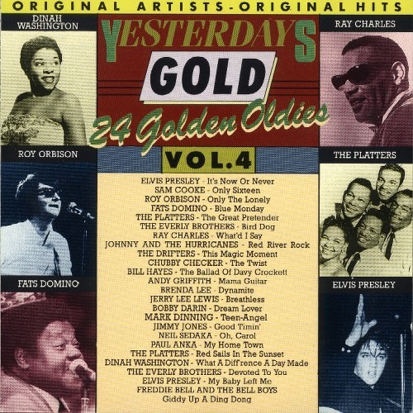
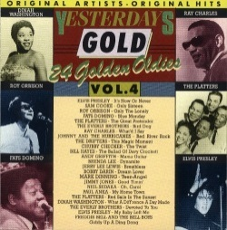


Slide 2

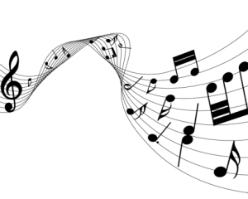
01 It's Now Or Never - Elvis Presley
02 Only Sixteen - Sam Cooke
03 Only The Lonely - Roy Orbison
04 Blue Monday - Fats Domino
05 The Great Pretender - Platters
06 Bird Dog - Everly Brothers
07 What'd I Say - Ray Charles
08 Red River Rock - Johnny & The Hurricanes
09 This Magic Moment - Drifters
10 The Twist - Chubby Checker
11 The Ballad Of Davy Crockett - Bill Hayes
12 Mama Guitar - Andy Griffith
13 Dynamite - Brenda Lee
14 Breathless - Jerry Lee Lewis
15 Dream Lover - Bobby Darin
16 Teen Angel - Mark Dinning
17 Good Timin' - Jimmy Jones
18 Oh Carol - Neil Sedaka
19 My Home Town - Paul Anka
20 Red Sails In The Sunset - Platters
21 What A Difference A Day Made - Dinah Washington
22 Devoted To You - Everly Brothers
23 My Baby Left Me - Elvis Presly
24 Giddy Up A Ding Dong - Freddie Bell & The Bell Boys

Slide 3















































