Slide 1





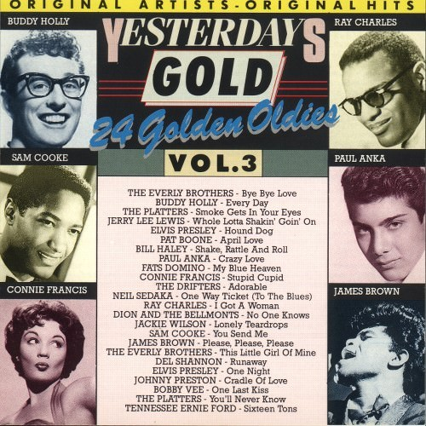



Slide 2

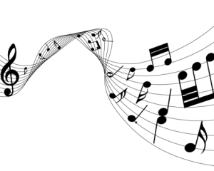
01 Bye Bye Love - Everly Brothers
02 Every Day - Buddy Holly
03 Smoke Gets In Your Eyes - Platters
04 Whole Lotta Shakin' Goin' On - Jerry Lee Lewis
05 Hound Dog - Elvis Presley
06 April Love - Pat Boone
07 Shake, Rattle And Roll - Bill Haley
08 Crazy Love - Paul Anka
09 My Blue Heaven - Fats Domino
10 Stupid Cupid - Connie Francis
11 Adorable - Drifters
12 One Way Ticket - Neil Sedaka
13 I Got A Woman - Ray Charles
14 No One Knows - Dion & The Belmonts
15 Lonely Teardrops - Jackie Wilson
16 You Send Me - Sam Cooke
17 Please, Please, Please - James Brown
18 This Little Girl Of Mine - Everly Brothers
19 Runaway - Del Shannon
20 One Night - Elvis Presley
21 Cradle Of Love - Johnny Preston
22 One Last Kiss - Bobby Vee
23 You'll Never Know - Platters
24 Sixteen Tons - Tennessee Ernie Ford

Slide 3











































