Slide 1





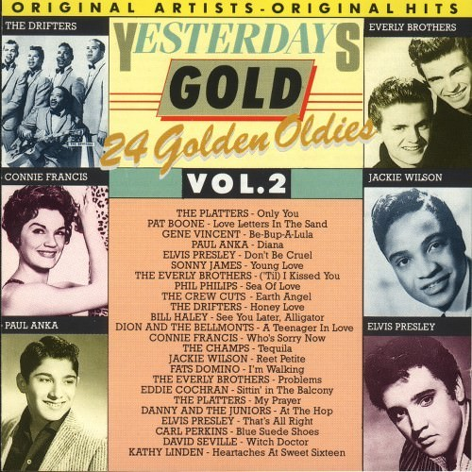
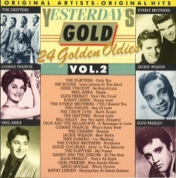


Slide 2

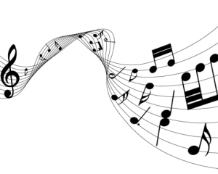
01 Only You - Platters
02 Love Letters In The Sand - Pat Boone
03 Be-Bop-A-Lula - Gene Vincent
04 Diana - Paul Anka
05 Don't Be Cruel - Elvis Presley
06 Young Love - Sonny James
07 'Til I Kissed You - Everly Brothers
08 Sea Of Love - Phil Philips
09 Earth Angel - Crew Cuts
10 Honey Love - Drifters
11 See You Later, Alligator - Bill Haley & The Comets
12 A Teenager In Love - Dion & The Belmonts
13 Who's Sorry Now - Connie Francis
14 Tequila - Champs
15 Reet Petite - Jackie Wilson
16 I'm Walking - Fats Domino
17 Problems - Everly Brothers
18 Sittin' In The Balcony - Eddie Cochran
19 My Prayer - Platters
20 At The Hop - Danny & The Juniors
21 That's All Right - Elvis Presley
22 Blue Suede Shoes - Carl Perkins
23 Witch Doctor - David Seville
24 Heartaches At Sweet Sixteen - Kathy Linden

Slide 3



















































