Slide 1





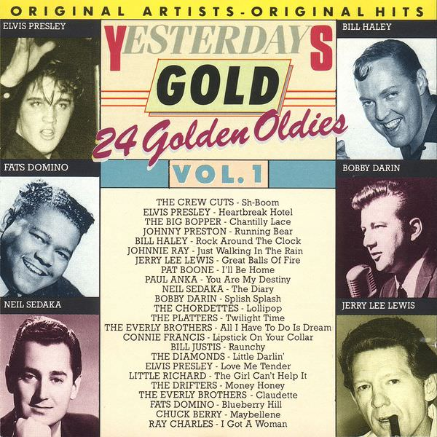
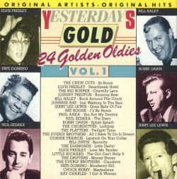


Slide 2


01 Sh-boom - Crew Cuts
02 Heartbreak Hotel - Elvis Presley
03 Chantilly Lace - Big Bopper
04 Running Bear - Johnny Preston
05 Rock Around The Clock - Bill Haley
06 Just Walking In The Rain - Johnnie Ray
07 Great Balls Of Fire - Jerry Lee Lewis
08 I'll Be Home - Pat Boone
09 You Are My Destiny - Paul Anka
10 The Diary - Neil Sedaka
11 Splish Splash - Bobby Darin
12 Lollipop - Chordettes
13 Twilight Time - Platters
14 All I Have To Do Is Dream - Everly Brothers
15 Lipstick On Your Collar - Connie Francis
16 Raunchy - Bill Justis
17 Little Darlin' - Diamonds
18 Love Me Tender - Elvis Presley
19 The Girl Can't Help It - Little Richard
20 Money Honey - Drifters
21 Claudette - Everly Brothers
22 Blueberry Hill - Fats Domino
23 Maybellene - Chuck Berry
24 I Got A Woman - Ray Charles

Slide 3



















































