Slide 1






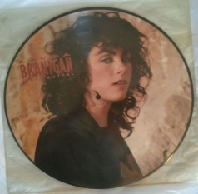


Slide 2

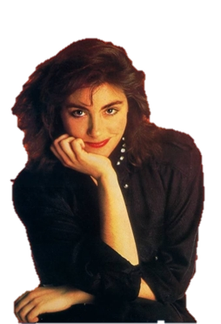
o1. Self Control (Classic Summer Mix)
o2. Ti Amo
o3. The Lucky One
o4. Spanish Eddie
o5. Shadow Of Love
o6. Will You Still Love Me Tomorrow
o7. How Am I Supposed To Live Without You
o8. I Found Someone
o9. Gloria
1o. Shattered Glass
11. Moonlight On Water
12. Solitaire
13. Maybe Tonight
14. Power Of Love
15. The Best Was Yet To Come
16. Self Control

Slide 3
















































