Slide 1





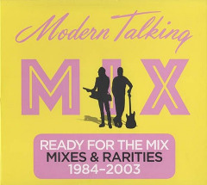


Slide 2

01 – You’re My Heart, You’re My Soul (Modern Talking Mix ’98)
02 – You Are Not Alone feat. Eric Singleton (Video Version)
03 – Sexy Sexy Lover feat. Eric Singleton (Rap Version)
04 – China In Her Eyes (Vocal Version)
05 – Don’t Take Away My Heart (New Vocal Version)
06 – Win The Race (Radio Edit)
07 – Last Exit To Brooklyn (Radio Edit)
08 – Ready For The Victory (Alternative Radio Version)
09 – Juliet
10 – TV Makes The Superstar (Extended)
11 – Space Mix ’98 feat. Eric Singleton (Long Version)

Slide 3






































