Slide 1




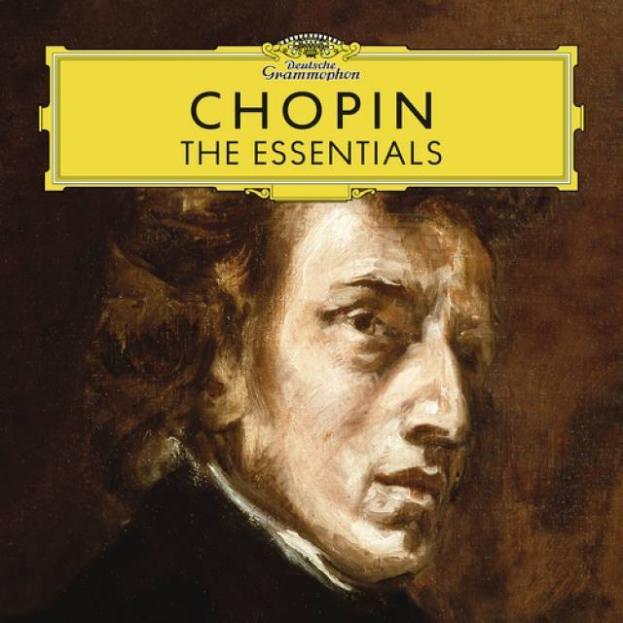

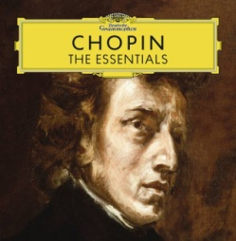


Slide 2


01. Chopin Waltz No.6 In D Flat, Op.64 No.1 -Minute – Molto vivace
02. Chopin Waltz No.2 In A Flat, Op.34 No.1 – Valse brillante
03. Chopin 24 Preludes, Op.28 – 15. In D Flat Major
04. Chopin 12 Etudes, Op.10 – No.12 In C Minor
05. Chopin Piano Sonata No.3 In B Minor, Op.58 – 4. Finale (Presto non tanto)
06. Chopin Impromptu No.4 In C Sharp Minor, Op.66 Fantaisie-Impromptu
07. Chopin Berceuse In D Flat, Op.57 – Andante
08. Chopin Piano Concerto No.1 In E Minor, Op.11 – 2. Romance (Larghetto) (Live At Philharmonie 2010)
09. Chopin Nocturne No.9 In B, Op.32 No.1
10. Chopin Mazurka No.49 In A Minor, Op.68 No.2 – Lento
11. Chopin Ballade No.2 In F, Op.38
12. Chopin 12 Etudes, Op.25 – No. 6 In G Sharp Minor
13. Chopin Polonaise No.6 In A Flat, Op.53 -Heroic
14. Chopin 12 Etudes, Op.10 – No. 3. In E Tristesse
15. Chopin 24 Preludes, Op.28 – 3. In G Major
16. Chopin Scherzo No.3 In C Sharp Minor, Op.39
17. Chopin Waltz No.7 In C Sharp Minor, Op.64 No.2
18. Chopin Waltz No.14 In E Minor, Op.Posth. – Waltz No.14 In E Minor, Op.Posth.
19. Chopin Mazurka No.5 In B Flat, Op.7 No.1 – Vivace
20. Chopin Polonaise No.3 In A, Op.40 No.1 – Military
21. Chopin Mazurka No.19 In B Minor, Op.30 No.2 – Allegretto
22. Chopin Piano Sonata No.2 In B-Flat Minor, Op.35 – 3. Marche funebre (Lento)
23. Chopin Nocturne No.2 In E Flat, Op.9 No.2
24. Chopin Mazurka No.13 In A Minor Op.17 No.4
25. Chopin Impromptu No.1 In A Flat, Op.29

Slide 3


















