Slide 1




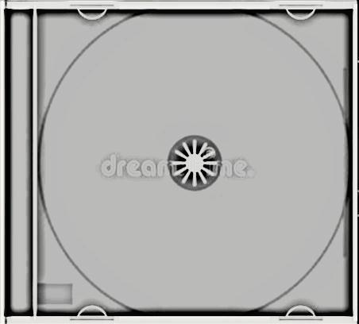





Slide 2

01 - mozart - marriage of figaro overture
02 - mozart - clarinet concerto adagio
03 - mozart - mass in c minor kyrie
04 - mozart - piano concerto no. 21 andante
05 - mozart - symphony no. 41 'jupiter' molto allegro
06 - mozart - the magic flute der holle rache
07 - mozart - piano sonata no. 11 rondo alla turca
08 - mozart - flute and harp concerto andantino
09 - mozart - serenade for winds k. 361 menuetto
10 - mozart - clarinet quintet larghetto
11 - mozart - violin concerto no. 5 tempi di minuetto

Slide 3













