Slide 1






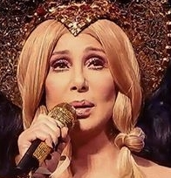


Slide 2

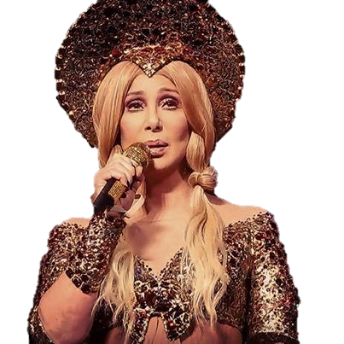
01. Runnin
02. Runaway
03. Love And Understanding
04. All or Nothing
05. (This Is) A Song For The Lonely
06. The Power
07. Song For the Lonely
08. Sisters Of Mercy
09. Love Hurts
10. Julie
11. Holdin' Out For Love
12. Alive Again
13. The Music's No Good Without You
14. Still
15. Save Up All Your Tears
16. Prisoner
17. Never Should've Started
18. I Still Haven't Found What I'm Looking For
19. Believe

Slide 3

































