Slide 1






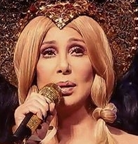


Slide 2

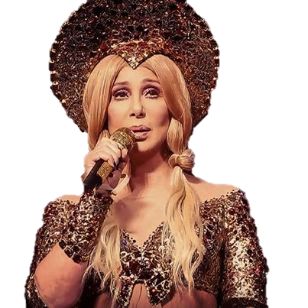
01. Dov'e l'Amore
02. All I Really Want to Do
03. Strong Enough
04. Rain, Rain
05. Mirror Image
06. I'll Never Stop Loving You
07. Could've Been You
08. Bang Bang (My Baby Shot Me Down)
09. 88 Degrees
10. (The Fall) Kurt's Blues
11. We All Fly Home
12. I Found Someone
13. Fires Of Eden
14. Boys & Girls
15. Born With The Hunger
16. All Or Nothing
17. A Different Kind Of Love Song
18. Take It From The Boys
19. Shoppin'

Slide 3

































