Slide 1






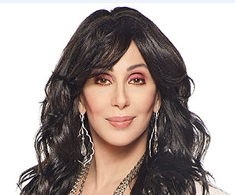


Slide 2

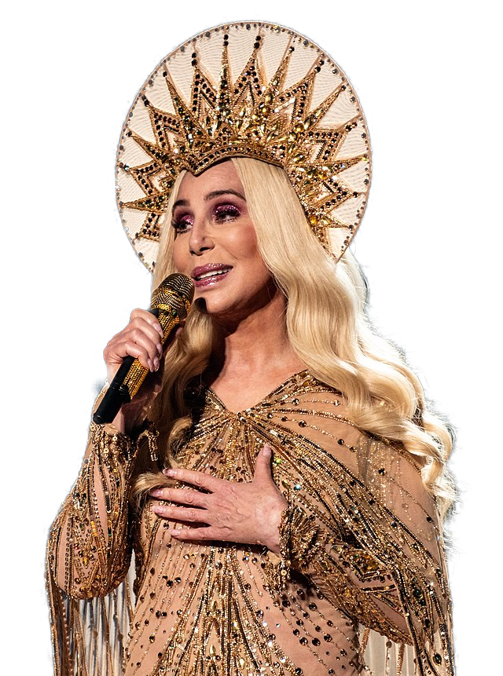
01. Believe (Live)
02. If I Could Turn Back Time
03. Strong Enough
04. The Shoop Shoop Song (It's In His Kiss)
05. Heart of Stone
06. Just Like Jesse James
07. When The Money's Gone
08. The Shoop Shoop Song (It's In His Kiss)
09. After All
10. You Take It All
11. Who You Gonna Believe
12. The Way of Love
13. When Lovers Become Strangers
14. We All Sleep Alone
15. Take Me Home
16. Love One Another
17. Classified 1A
18. When Love Calls Your Name
19. Real Love
20. Our Lady Of San Francisco

Slide 3










































