Slide 1



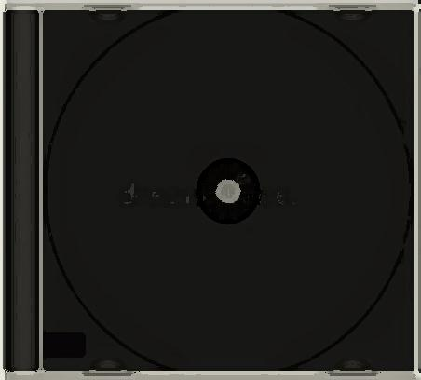
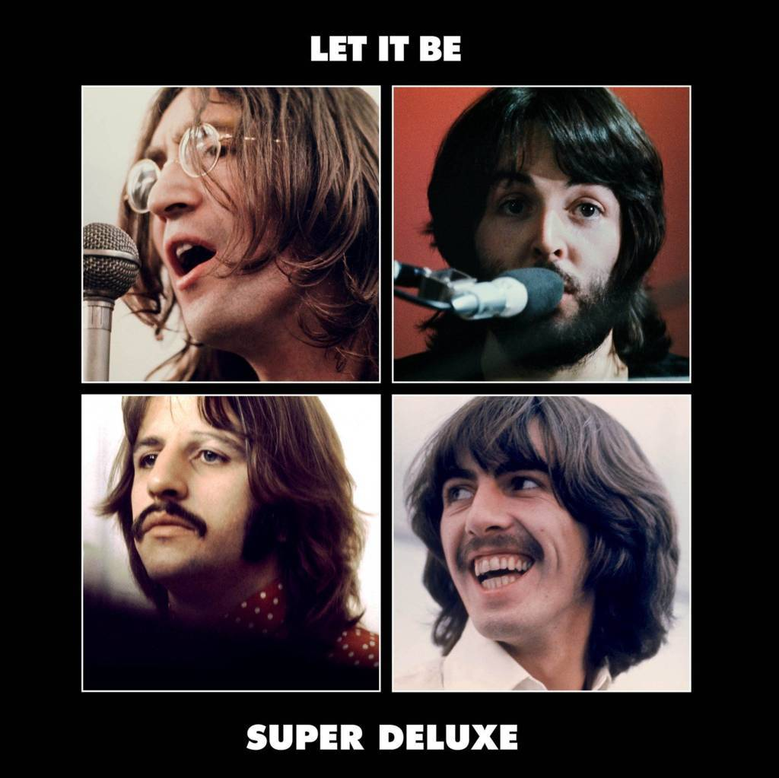




Slide 2
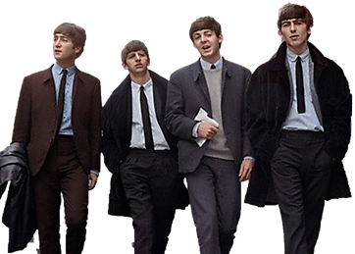
01. Morning Camera Two Of Us (Take 4)
02. Dig A Pony (2021 Mix)
03. Don’t Let Me Down (Single Version 2021 Mix)
04. I Me Mine (Rehearsal Mono)
05. She Came In Through The Bathroom Window (Rehearsal)
06. Let It Be (2021 Mix)
07. For You Blue (1969 Glyn Johns Mix)
08. Teddy Boy (1969 Glyn Johns Mix)
09. One After 909 (2021 Mix)
10. The Long And Winding Road (2021 Mix)
11. One After 909 (Take 3)
12. Let It Be (1969 Glyn Johns Mix)
13. The Long And Winding Road (1969 Glyn Johns Mix)
14. Something (Rehearsal Mono)
15. Octopus’s Garden (Rehearsal Mono)
16. Dig A Pony (Take 14)
17. Two Of Us (1969 Glyn Johns Mix)
18. The Walk (Jam)
19. Without A Song (Jam)

Slide 3


































