Slide 1



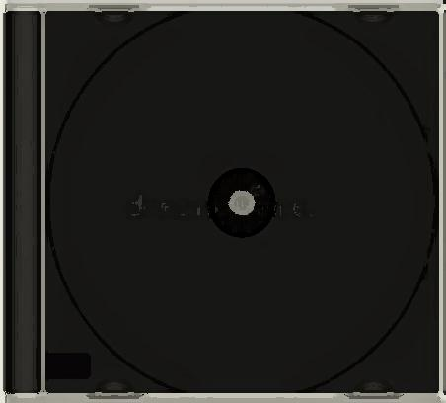
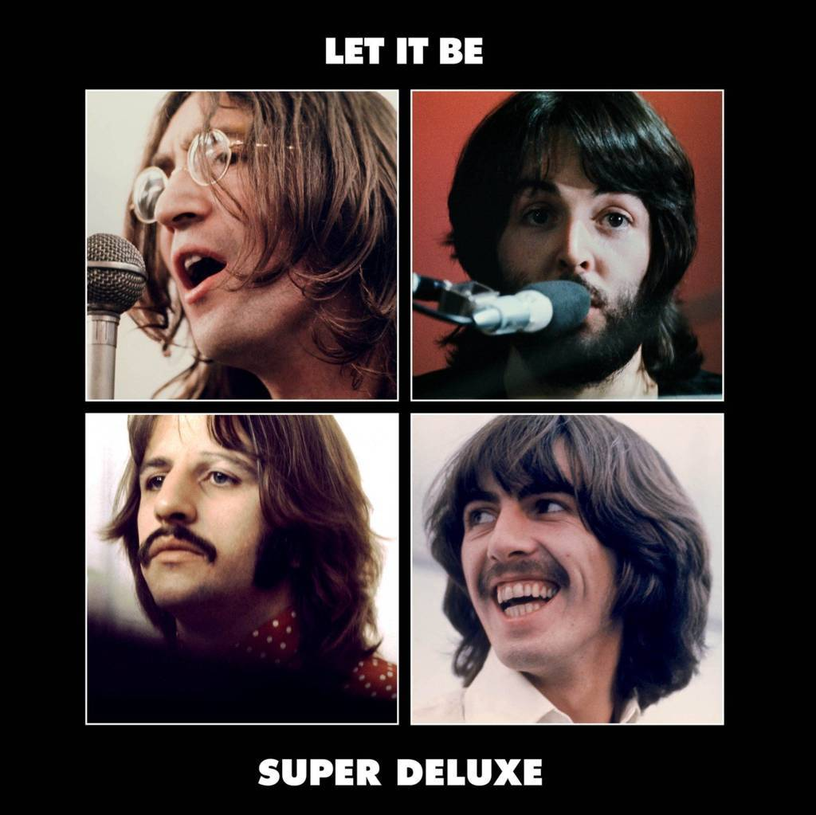




Slide 2
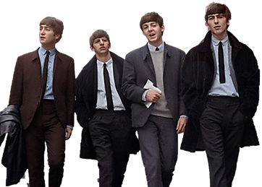
01. Across The Universe (1970 Glyn Johns Mix)
02. Concentrate On The Sound (Mono)
03. Can You Dig It
04. I Me Mine (2021 Mix)
05. I've Got A Feeling (1969 Glyn Johns Mix)
06. Let It Be Please Please Me Let It Be (Take 10)
07. Maggie Mae (2021 Mix)
08. Oh! Darling (Jam)
09. Get Back (Take 8)
10. Like Making An Album (Speech)
11. For You Blue (2021 Mix)
12. Get Back (2021 Mix)
13. The Long And Winding Road (Take 19)
14. Wake Up Little Susie I Me Mine (Take 11)
15. Gimme Some Truth (Rehearsal Mono)
16. Let It Be (Single Version 2021 Mix)
17. Dig A Pony (1969 Glyn Johns Mix)
18. For You Blue (Take 4)
19. Polythene Pam (Rehearsal Mono)

Slide 3












