Slide 1



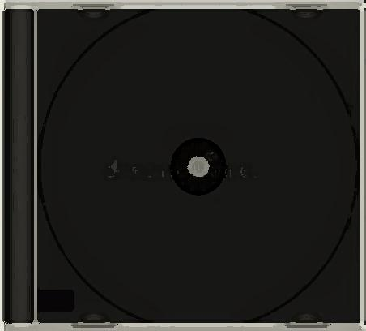
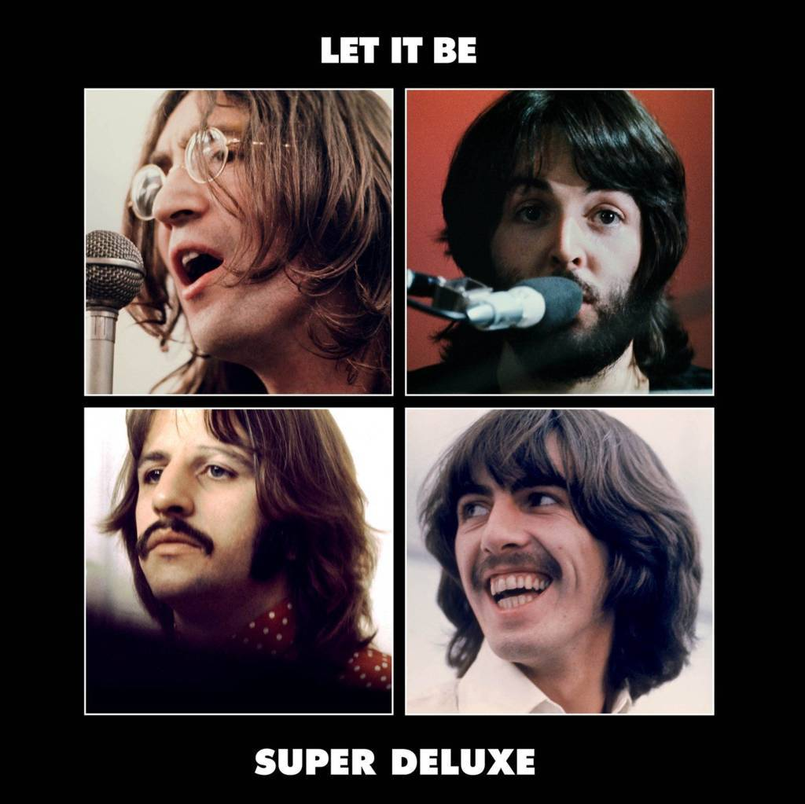




Slide 2
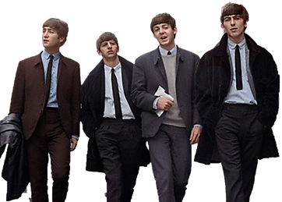
01. On The Day Shift Now All Things Must Pass (Rehearsals Mono)
02. I Me Mine (1970 Glyn Johns Mix)
03. Across The Universe (2021 Mix)
04. I Don't Know Why I'm Moaning (Speech Mono)
05. Dig It (2021 Mix)
06. Get Back (1969 Glyn Johns Mix)
07. I’ve Got A Feeling (Take 10)
08. I've Got A Feeling (2021 Mix)
09. Get Back (Take 19)
10. Maggie Mae (1969 Glyn Johns Mix)
11. Dig It (1969 Glyn Johns Mix)
12. Don’t Let Me Down (First Rooftop Performance)
13. Let It Be (Take 28)
14. Get Back (Reprise 1969 Glyn Johns Mix)
15. One After 909 (1969 Glyn Johns Mix)
16. Two Of Us (2021 Mix)
17. Maggie Mae Fancy My Chances With You (Mono)
18. Medley I’m Ready (aka Rocker) Save The Last Dance For Me Don’t Let Me Down (1969 Glyn Johns Mix)
19. Don't Let Me Down (1969 Glyn Johns Mix)

Slide 3


































