Slide 1



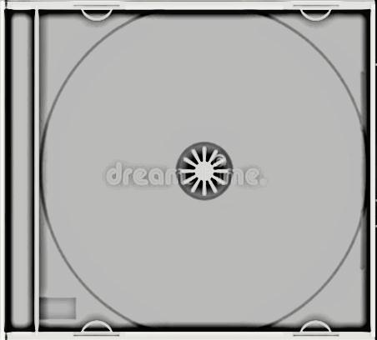






Slide 2
01 - Bronski Beat - Smalltown Boy
02 - Demis Roussos - Quand Je T'aime
03 - Foreigner - I Want to Know What Love Is
04 - George Benson - Give Me the Night
05 - Gold - Capitaine abandonné
06 - Jimmy Somerville - Comment te dire adieu
07 - Koxo - Step by step
08 - Lio - Le banana split
09 - Madness - One Step Beyond
10 - Miami Sound Machine - Conga!
11 - Monte Kristo - The Girl of Lucifer
12 - Orchestral Manoeuvres In The Dark - Enola Gay
13 - Propaganda - p_Machinery
14 - Rick Astley - Never Gonna Give You Up
15 - Samantha Fox - Nothing's Gonna Stop Me Now
16 - Stretch - Why Did You Do It_
17 - The Buggles - Video Killed The Radio Star
18 - Thierry Hazard - Le jerk
19 - Wham! - Wake Me Up Before You Go-Go
20 - Captain Sensible - Wot

Slide 3























































