Slide 1
Můry
Moths
Papillons de nuit

Slide 2
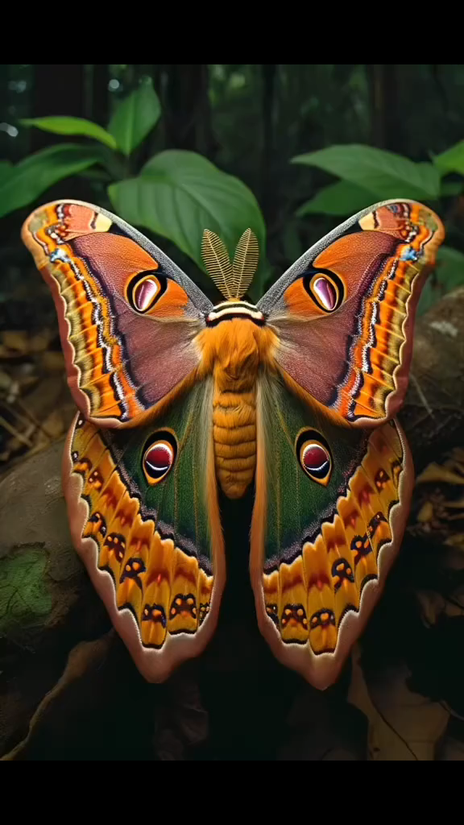
Start Begin Anfang Turn on Have down Spustit
Comienzo Comecar Początek Rajt Hasiera
www.yatata-blog.eu

