Slide 1



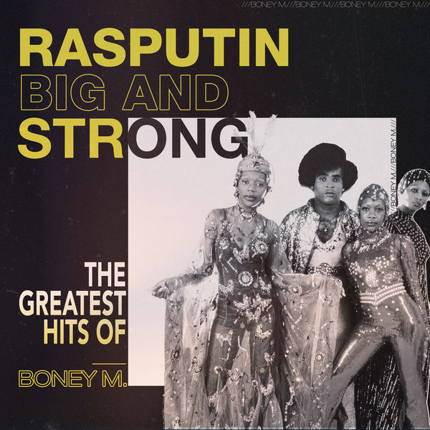

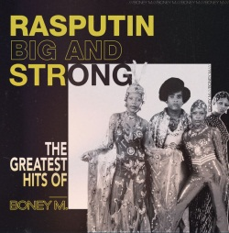



Slide 2
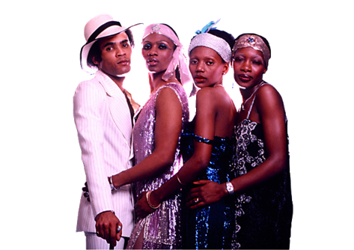
01. Rasputin (03:42)
02. Daddy Cool (03:29)
03. Sunny (04:01)
04. Ma Baker (04:35)
05. Barbra Streisand - Boney M. Mega Mashup-mix-medley
06. Bahama Mama (03:17)
07. Brown Girl In The Ring (04:02)
08. Gotta Go Home (03:46)
09. Happy Song (7" Version) (03:59)
10. Mega Mix (03:51)
11. Kalimba De Luna (04:13)
12. Belfast (03:27)
13. No Woman No Cry (04:18)
14. I See A Boat On The River (7" Version) (04:33)
15. Going Back West (03:09)
16. We Kill The World (don't Kill The World) (06:34)
17. Felicidad (margherita) (02:52)
18. Marilyn Monroe Vs Barbra Streisand (radio Mix) (03:12)
19. Painter Man (03:11)
20. Rasputin (7" Version) (04:26)

Slide 3




















































