Slide 1



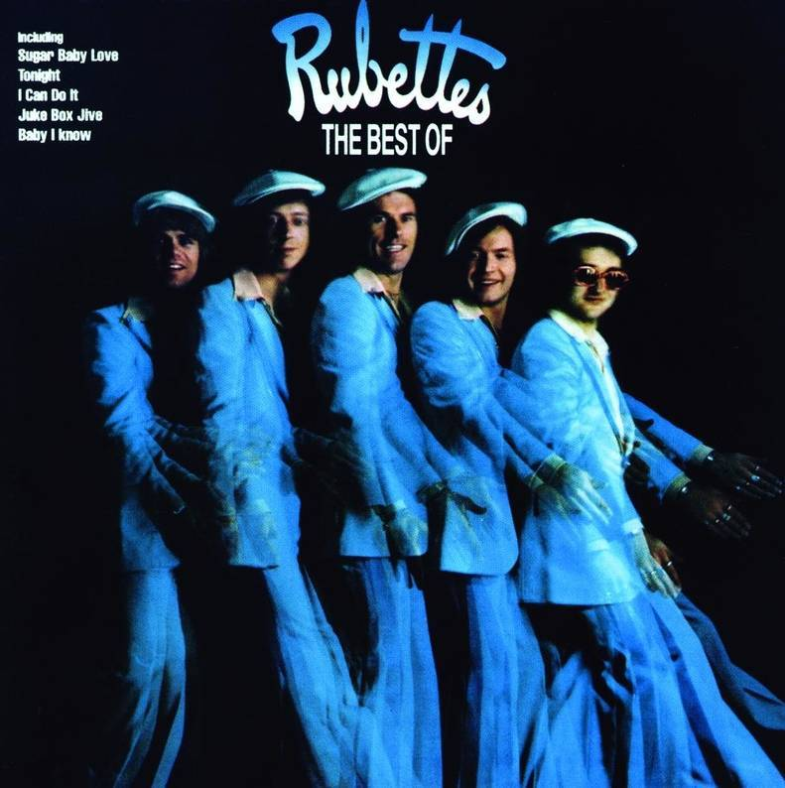

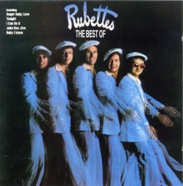



Slide 2
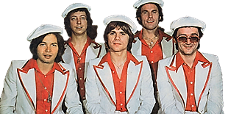
01 - Sugar Baby Love
02 - Baby I Know
03 - Under The Roof
04 - I'm Just Dreaming
05 - Little Darling
06 - Don't Do It Baby
07 - I Can Do It
08 - Juke Box Jive
09 - Julia
10 - Tonight
11 - Foe-De-O-Dee
12 - Ooh la la
13 - The Sha Na Na Song
14 - You're The Reason Why
15 - New Way Of Loving You
16 - Be My Girl
17 - Alice In Wonderland
18 - You Gotta Laugh
19 - Keep On Dancing
20 - Little 69
21 - He'S In Town

Slide 3



















































