Slide 1

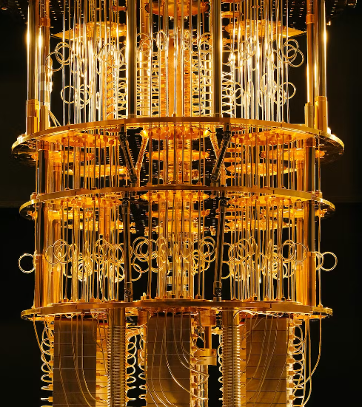
Quantum Computer
FROM ADITA & KARIM

Slide 2

Introduction
What does quantum computing mean?
How does a quantum computer achieve faster computation?
Will we ever have a quantum computer at home?
Will quantum computer revolutionize our daily life?

Slide 3
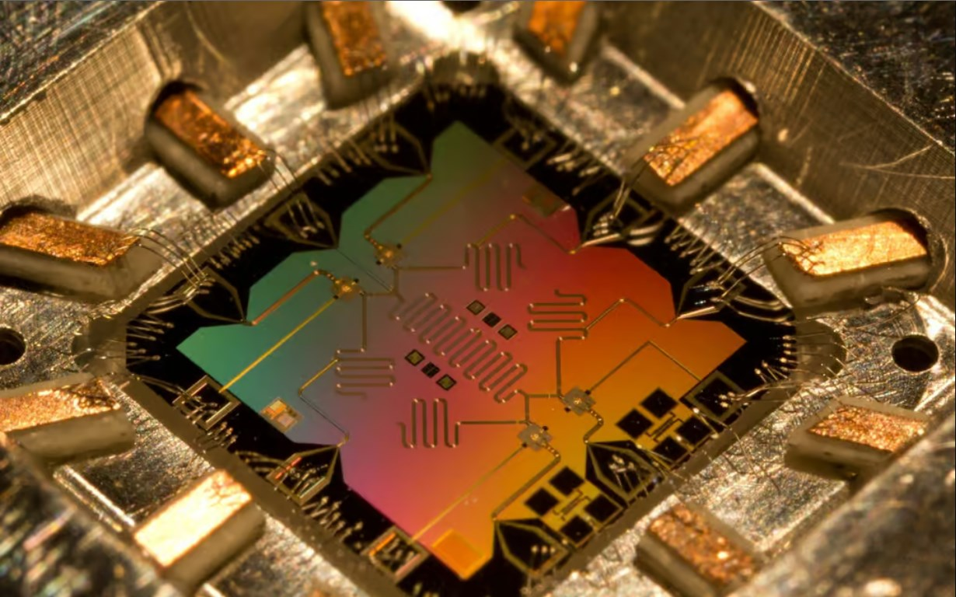

Slide 4
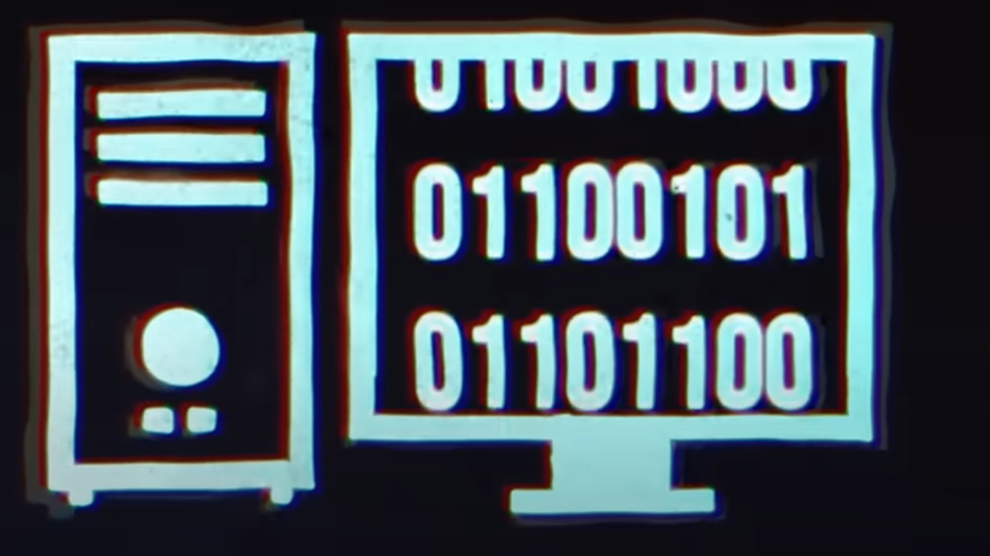
Binary code
0 1 0 1 1 0 1 0 1 0 1 0 1 0 1 1 0

Slide 5

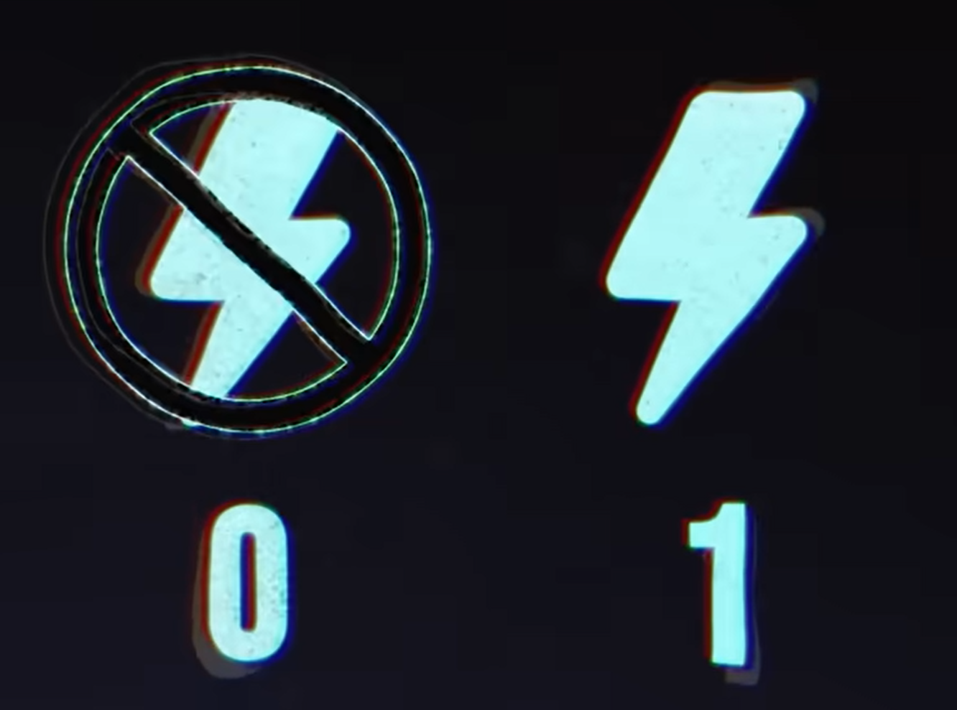

Slide 6
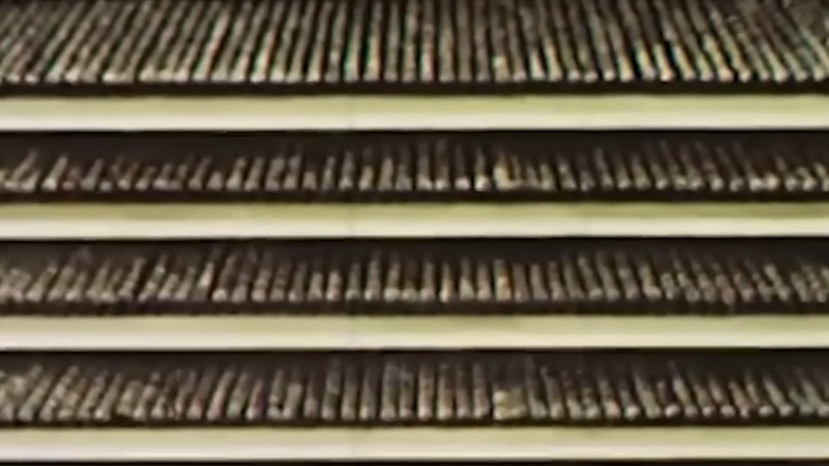
Superposition

Slide 7


