Slide 1

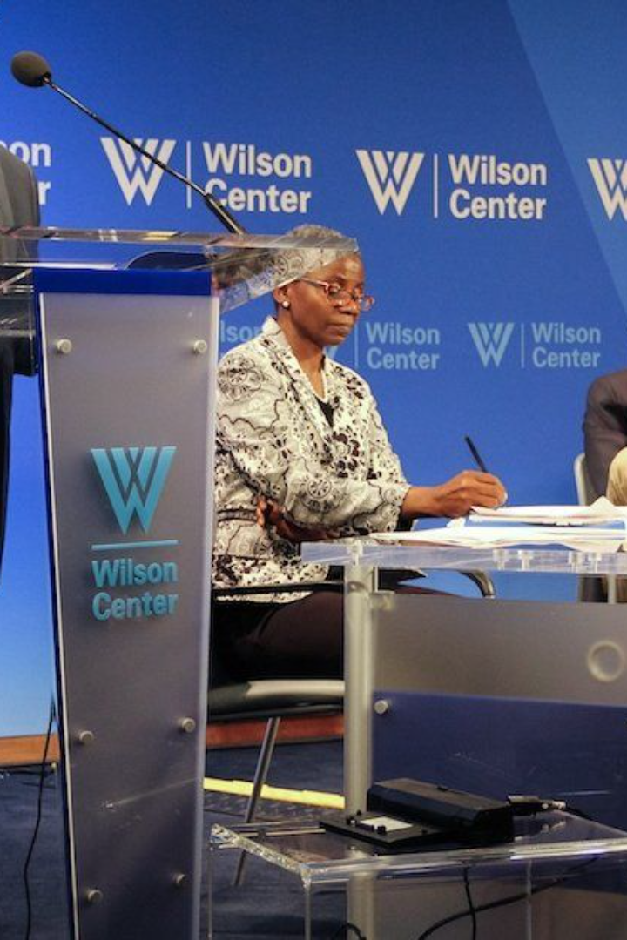
Introduction: The problem of corruption in Africa
Corruption is a pressing issue in Africa, affecting governance, business, and the daily lives of citizens. It leads to inefficient public services, hinders economic growth, and erodes trust in institutions.
SA
by Shalom AYITCHEHOU

Slide 2
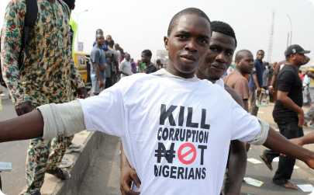
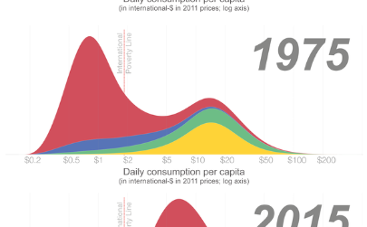
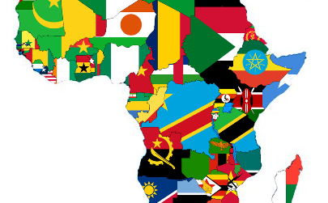
Understanding the causes of corruption
Political Influence
Economic Inequality
Lack of Transparency
Corruption in Africa is often fueled by political influence, where powerful individuals exploit their positions for personal gain.
Large income disparities contribute to corruption by creating an environment where bribery and favoritism prevail.
Inadequate transparency and accountability mechanisms provide fertile ground for corrupt practices to thrive.

Slide 3

The role of technology in reducing corruption
Transparent Processes
Real-time Monitoring
Digital Payments
Technology enables transparent, traceable processes, reducing opportunities for bribery and embezzlement.
Tools like data analytics and monitoring systems allow for real-time detection of irregularities and corrupt activities.
Digital payment systems minimize cash transactions, reducing the likelihood of under-the-table dealings.

Slide 4
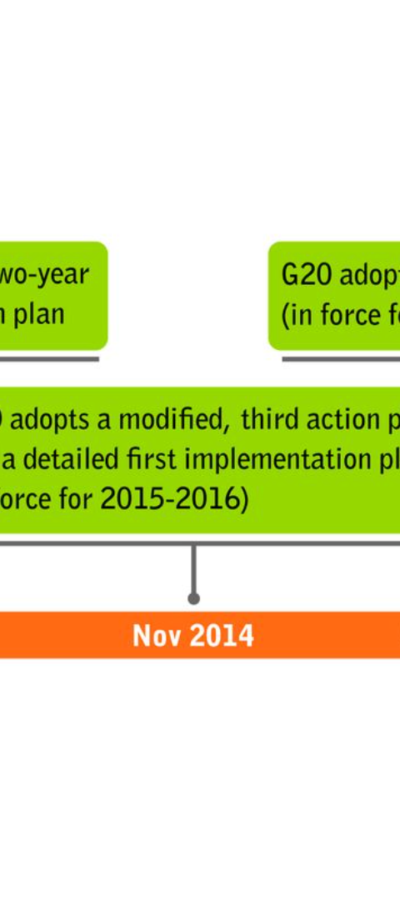
Case studies: Successful implementation of anti-corruption measures
1
Rwanda's Digital Governance
Rwanda's e-government initiatives have significantly reduced bureaucratic corruption and enhanced service delivery.
2
Kenya's Transparency Tools
Initiatives like the Huduma system have enhanced transparency and citizen engagement, reducing corrupt practices.
3
Botswana's Cybersecurity Measures
Strategic cybersecurity frameworks have bolstered protection against digital corruption threats and data breaches.

Slide 5

Challenges and limitations of using technology to combat corruption
1
Infrastructure Constraints
2
Technological Illiteracy
Remote areas often lack the necessary infrastructure for reliable digital interventions, posing challenges for implementation.
Certain demographics may struggle to adopt and adapt to digital systems due to limited technological literacy.
3
Data Privacy Concerns
Effective corruption-reducing technologies must carefully navigate data privacy laws and evolving cybersecurity threats.

Slide 6
Our tech solution to reduce it in Africa
Data Analytics & AI
Digital Incident Reporting
Secure E-procurement
Utilizing advanced data analysis and artificial intelligence to identify patterns indicative of corrupt practices.
Implementing secure electronic procurement systems, from tender advertisement to bid submission and evaluation.
Developing user-friendly platforms for citizens and employees to report corruption incidents digitally and anonymously.

Slide 7



Recommendations for implementing an IT-based anti-corruption system
Leverage Public-Private Partnerships
Education and Training
Ethical Hackathons
Conduct extensive training programs to equip public officials and citizens with the necessary skills to navigate and utilize new technologies.
Organize ethical hacking competitions to identify potential cybersecurity loopholes, fortifying the digital anti-corruption architecture.
Collaborate with tech firms and civil society to harness expertise and resources in designing and implementing anti-corruption systems.

Slide 8

Conclusion: The future of fighting corruption in Africa
Sustainable Governance
Citizen Empowerment
Building sustainable, technology-driven governance models to fortify Africa's resilience against corruption.
Empowering citizens to actively engage in anti-corruption efforts through accessible, user-friendly tech solutions.
International Collaboration
Encouraging international collaboration to share best practices and resources in utilizing IT to combat corruption.

