Slide 1

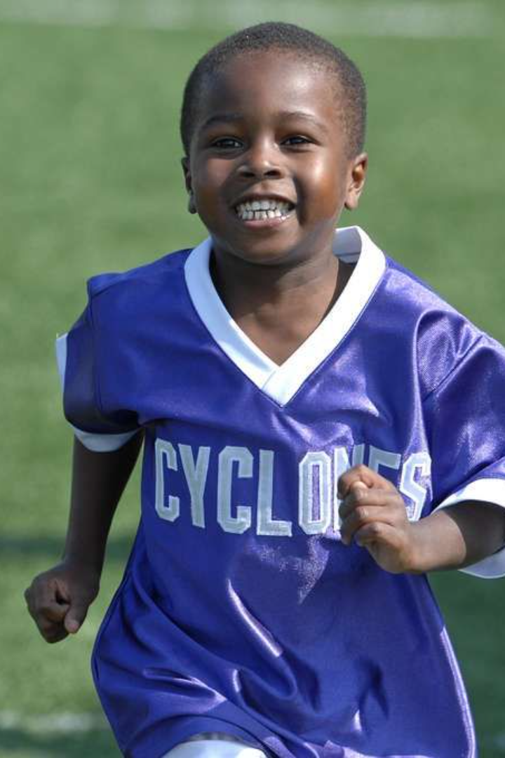
Developing a Tech Solution for African Sports Talent
In a continent rich with athletic potential, the need to uplift African sports talent presents an exciting opportunity for tech innovation. Our aim is to develop a comprehensive solution that not only identifies and nurtures talent but also contributes to economic growth and the future of African sports.
By AYITCHEHOU Shalom, KLOUE Fabrice and DJIDONOU Justin

Slide 2
Current Challenges in Developing African Sports Talent
Limited Resources
Talent Identification
Infrastructure Gaps
Many talented athletes lack access to proper equipment, training facilities, and coaching expertise.
Identifying and nurturing promising athletes can be a challenging and time-consuming process.
There are gaps in basic sports infrastructure, hindering the development of athletes to their full potential.

Slide 3

The Potential of Technology in Uplifting African Sports Talent
1
Data-Driven Training
Technology can provide valuable insights into an athlete's performance and help tailor training regimens for better results.
2
Talent Identification Solutions
With the use of AI and data analytics, technology can revolutionize talent identification and recruitment processes.
3
Advanced Infrastructure & Equipment
Innovative tech solutions can bridge the infrastructure gaps by integrating modern equipment and facilities.

Slide 4
Our Tech Solution: Overview and Key Features
Comprehensive Platform
Performance Tracking
Mobile App Integration
State-of-the-art tools for tracking and analyzing an athlete's performance and progress.
Our solution provides a holistic ecosystem for talent identification, training, and mentorship.
The platform includes a user-friendly mobile app for seamless access and engagement.

Slide 5

Benefits of Our Tech Solution for African Sports Talent
1
Enhanced Training Efficiency
2
Improved Talent Identification
3
Access to Mentorship
Optimized training regimens tailored to individual talents and needs.
Efficient and accurate identification of promising athletes across diverse regions.
Facilitating connections between athletes and experienced mentors for guidance and support.

Slide 6
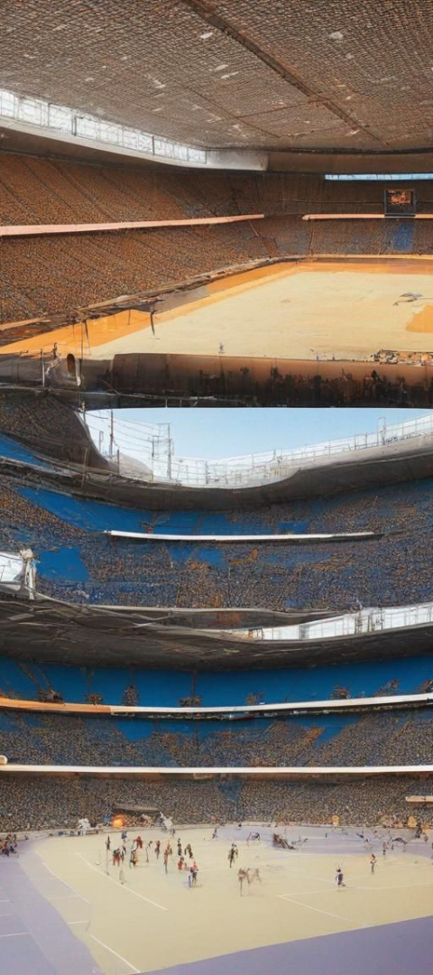
Economic Impact: How Our Solution Can Boost the Economy
Local Business Opportunities
Tourism and Infrastructure Growth
The development of sports talent can create avenues for local businesses to thrive through sponsorships and partnerships.
Successful sports events and facilities can attract tourism and drive infrastructure development.
National and International Recognition
A thriving sports industry can bring international recognition to the country and its athletes, fostering pride and economic opportunities.

Slide 7



Implementation Plan: Steps to Develop and Launch the Tech Solution
Research & Analysis
Development & Testing
Strategic Launch
Conduct in-depth research on existing systems and the specific requirements of African sports talent.
Strategize a robust launch plan to ensure effective implementation and integration with stakeholders.
Build and test advanced technology solutions that cater to the identified needs and challenges.

Slide 8

Conclusion: The Future of African Sports Talent and Our Role in It
1
Empowerment & Growth
By uplifting sports talent, we envision a future where African athletes achieve global recognition and success.
2
Community Collaboration
We aim to foster collaboration among athletes, coaches, communities, and businesses for collective growth and support.
3
Continued Innovation
Our commitment to continuous innovation ensures that the tech ecosystem evolves with the changing needs of African sports talent.

