Slide 1
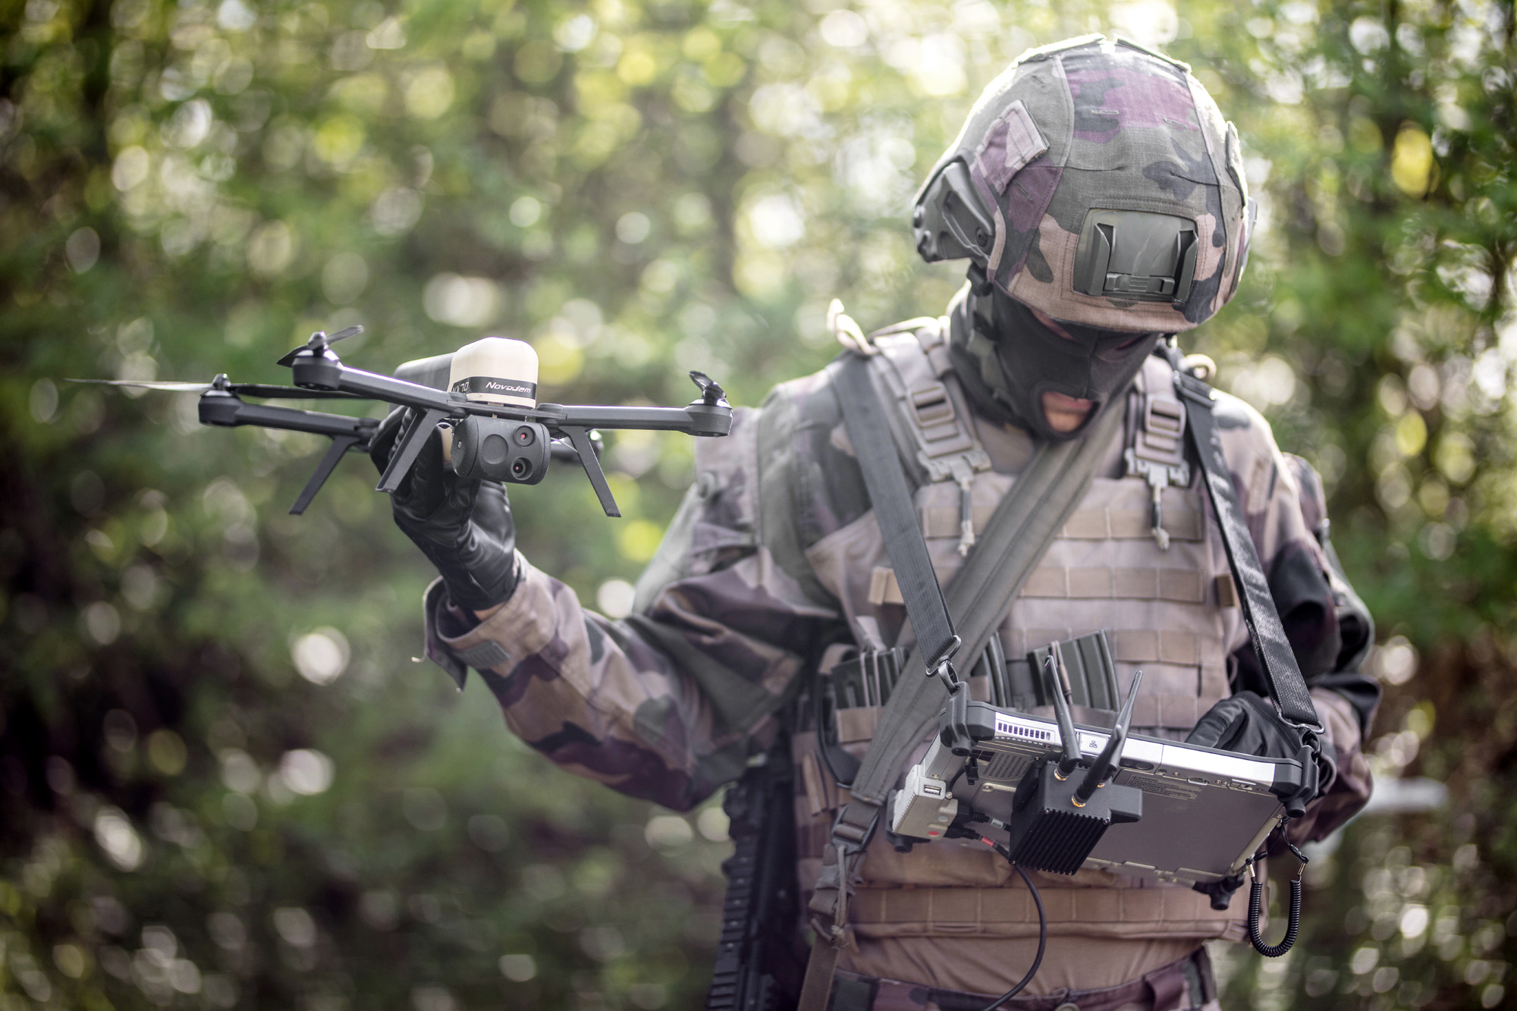

Slide 2
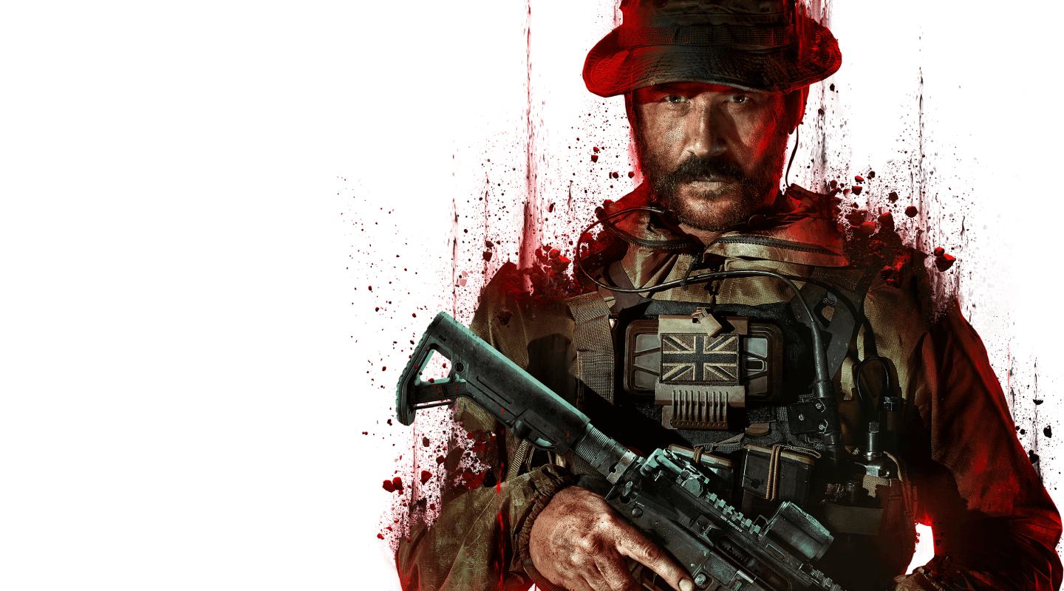
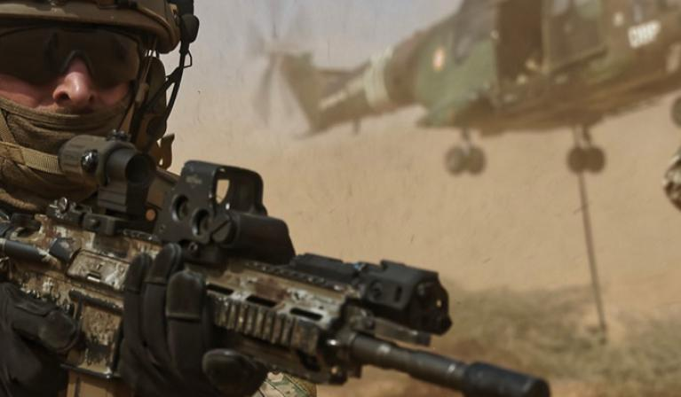
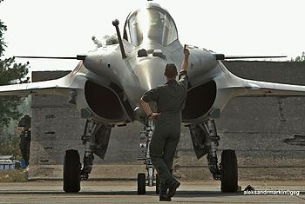
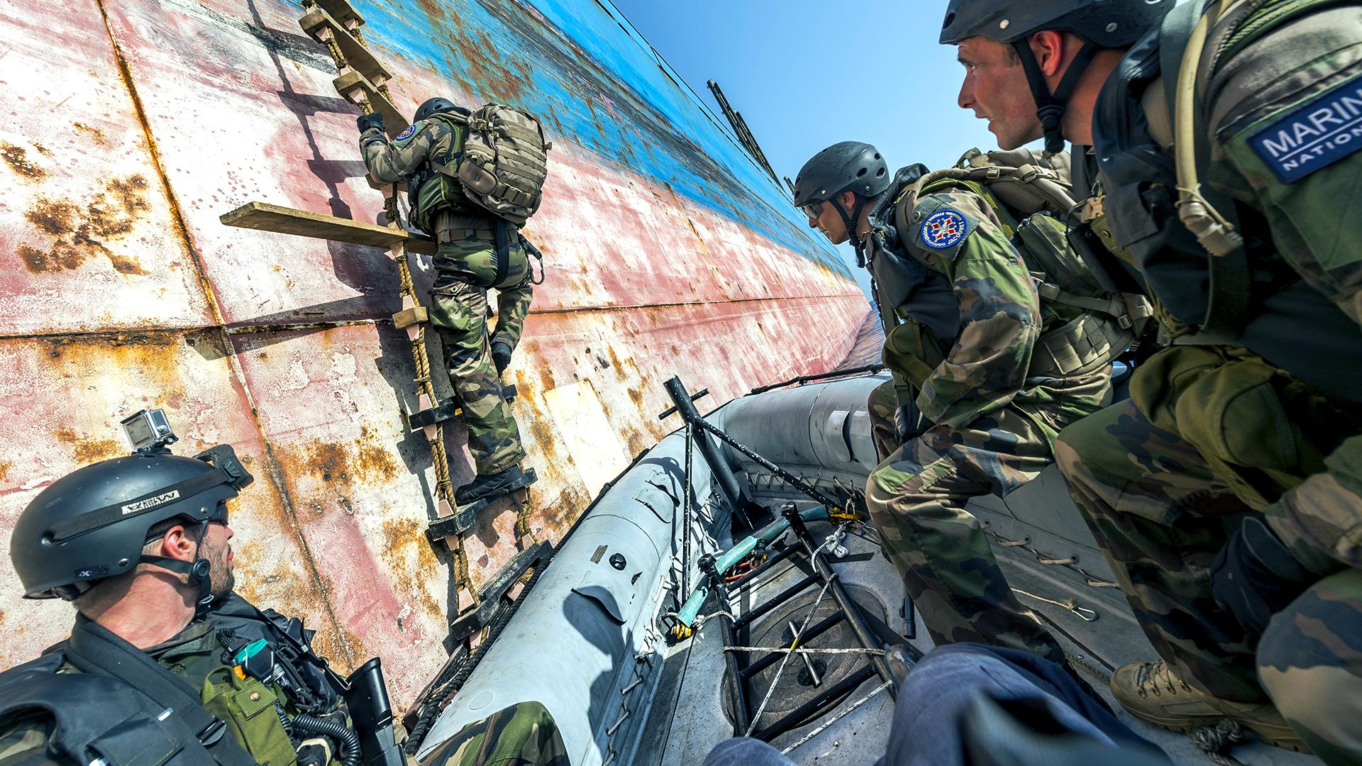
3 Types of Army
- Physically strongest
- Our most devoured soldiers with ambition
- The pros of sea hunting
- Dizzying operations
- Citizen protection and support operations
- Stronger than Poseidon
- Air safety

Slide 3
3 Types of Army
- Our most devoured soldiers with ambition
- Physically strongest
- The pros of sea hunting
- Citizen protection and support operations
- Dizzying operations
- Stronger than Poseidon
- Air safety

Slide 4
3 Types of Army
- Physically strongest
- Our most devoured soldiers with ambition
- Dizzying operations
- The pros of sea hunting
- Citizen protection and support operations
- Air safety
- Stronger than Poseidon

Slide 5
3 Types of Army
- The pros of sea hunting
- Our most devoured soldiers with ambition
- Physically strongest
- Stronger than Poseidon
- Dizzying operations
- Citizen protection and support operations
- Air safety

Slide 6
3 Types of Army
- Our most devoured soldiers with ambition
- Citizen protection and support operations

Slide 7
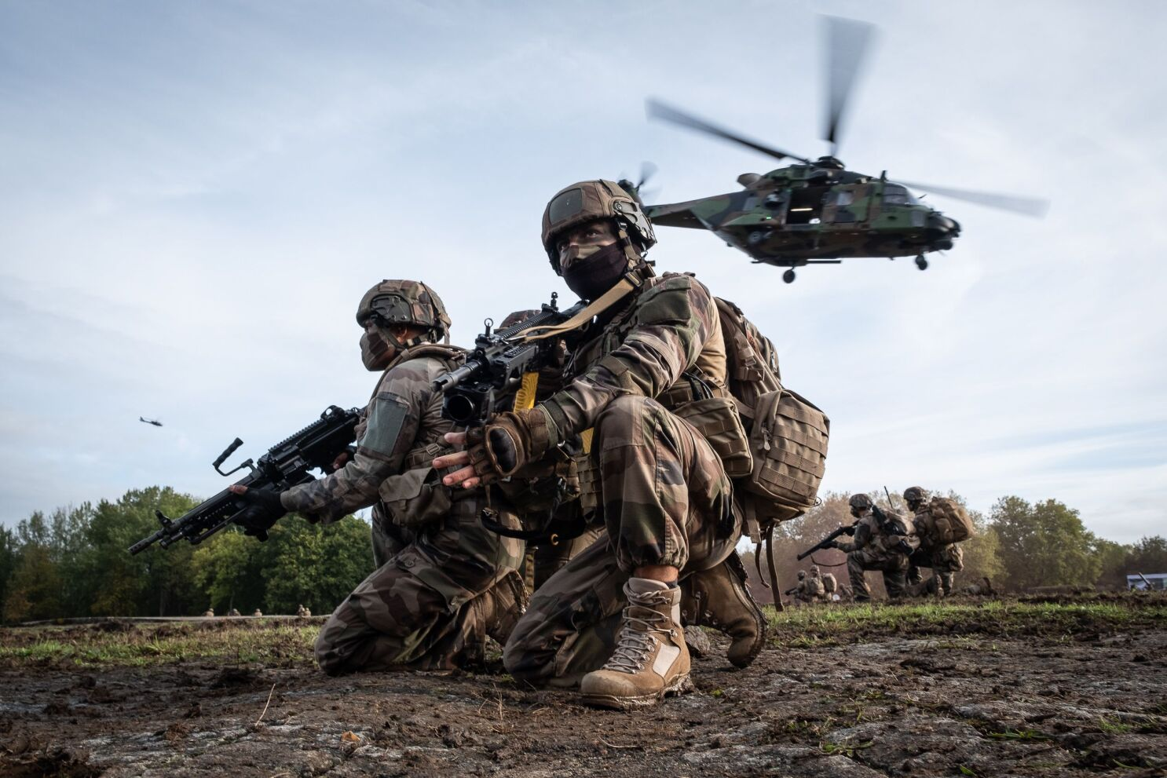

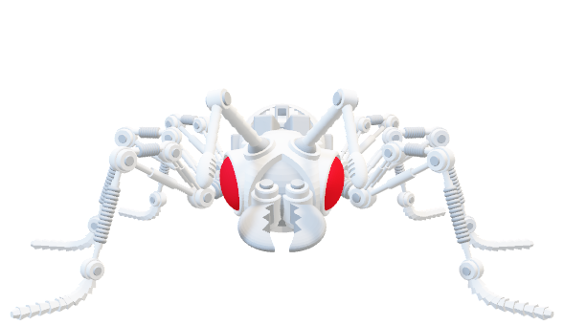
The Ant-E
01
- One of the smallest technologies to be used in the field

Slide 8
The Ant-E
01
02
- One of the smallest technologies to be used in the field
- Increase, optimize the quantity of information

Slide 9
The Ant-E
01
02
03
- One of the smallest technologies to be used in the field
- Increase, optimize the quantity of information
- Limit the loss of men during intelligence gathering

Slide 10
The Ant-E
01
02
03
04
- One of the smallest technologies to be used in the field
- Increase, optimize the quantity of information
- Limit the loss of men during intelligence gathering
- Absolutely fantastic
- Never forget why and for whom we do it

