Slide 1
Presentation
NAME AND SURNAME : Douae Belahrichi .
AGE : 18 .
NATIONALITY : moroccan .
TYPE OF BAC : Scientific baccalaureate .
YEAR OF BAC : 2023 .

Slide 2
3 ADJECTIVES DESCRIBE ME
-CALM
-SERIOUS
-friendly

Slide 3
3 objectives i’d like to achieve this year
-pass my year .
-Acquire technical and professional competencies .
-Improve my level in the main subjects.

Slide 4
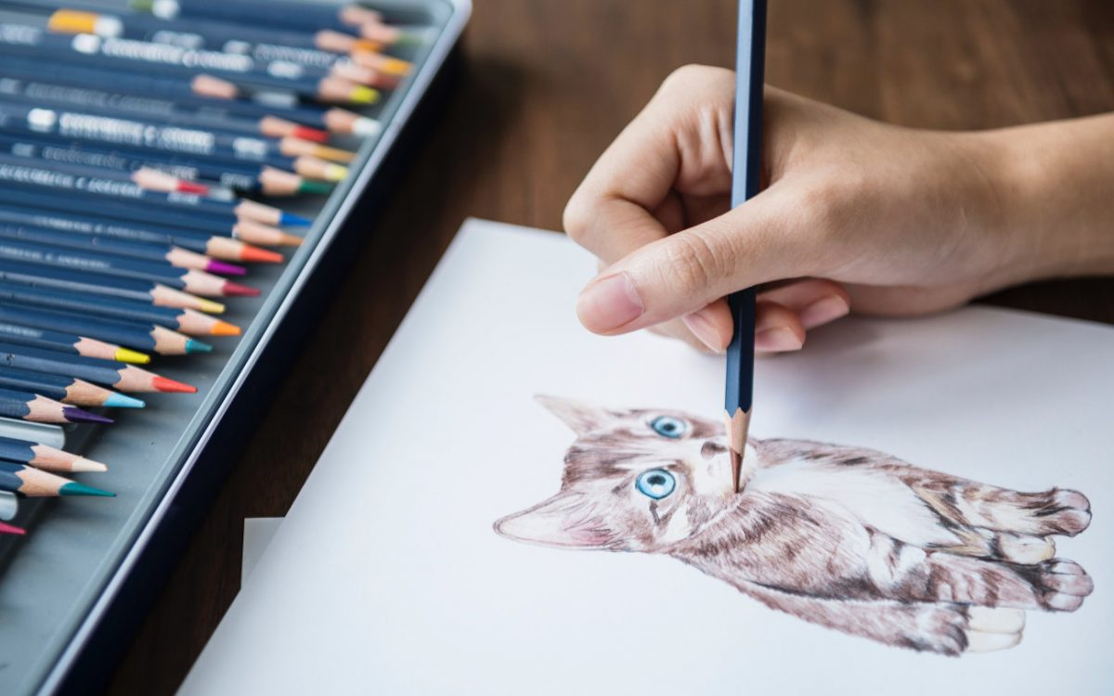

HOBBY:
Drawing .
DREAM : VSITING ALL THE MOST BEAUTIFUL CONTRIES IN THE WORLD .
Cette photo par Auteur inconnu est soumise à la licence CC BY-NC-ND

