Slide 1
Country music
with
Dick van Altena

Slide 2




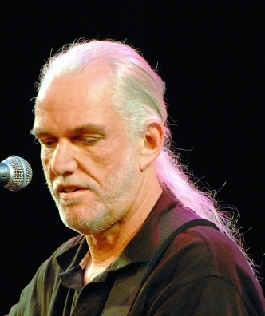

Country music with Dick van Altena
Lay down beside me
Footsteps to my door
Kiss the moon goodnight
I still miss someone
Salty winds
From now on
I will fly
presentation by y@t@t@
Singer and songs
www.yatata-blog.eu

