Slide 1
Country music
128

Slide 2
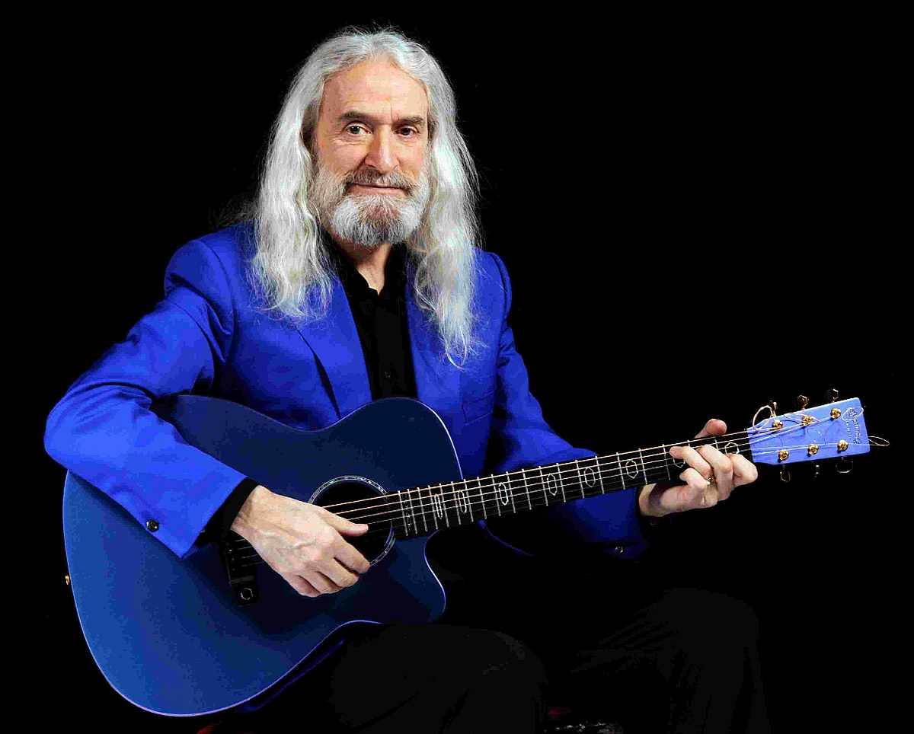





Presentation by y@t@t@
Country music 128
My heart would know
Angels with one wings
Close your eyes
I wish it was me
Part
of me
Mountains of Mourne
I all be missing you
What colour is the wind
Walking on my
memories
www.yatata-blog.eu

