Slide 1
Country music
93

Slide 2





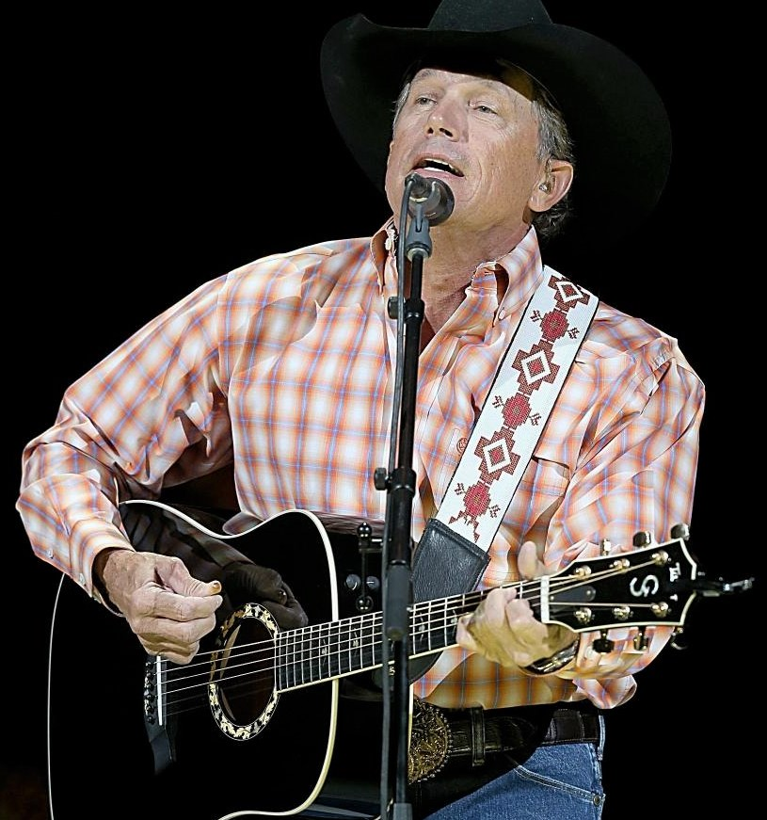

Country music 93
presentation by y@t@t@
500 miles
Drinking champagne
I'm drinking
Once when I was
Country bumpkin
Loving arms
Least we can do
It‘s time to pay
www.yatata-blog.eu

