Slide 1
Ricky King 2

Slide 2






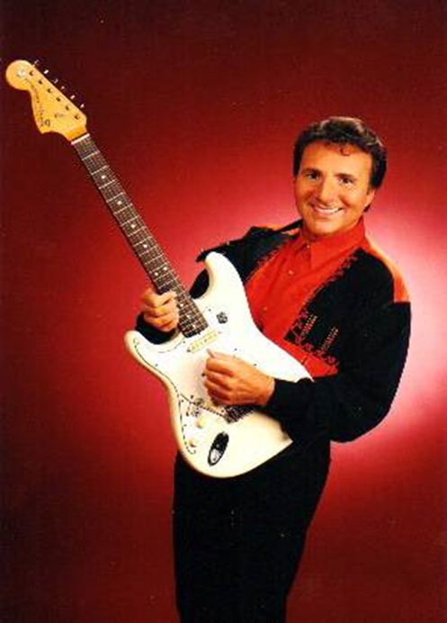






Silver
Sea
RICKY KING
Monkey
dance
2
Down by the
riverside
Zorba
Delilah
presentation by y@t@t@
Melody
dream
Pink
cadillac
Olé,Olá
www.yatata-blog.eu

