Slide 1
Basque songs
Chansons basques

Slide 2



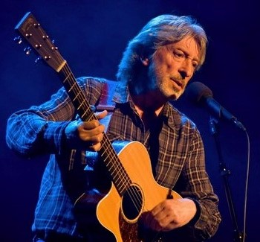


Melodies from the Basque Country
Euskal Herriko doinuak
Gu bizi bezainbat
As long as we live
Nahiago nuke I would rather
Ama eskual herri
Mother region town
Nere herriko neskatxa maite Love the girl of my village
Suaren bila
In search of fire
Udazken koloretan
In the colors of autumn
Itsasoari begira Looking out to sea
presentation by y@t@t@
Zuhaitzen denbora
Tree time
www.yatata-blog.eu

