Slide 1
Belles mélodies
2

Slide 2

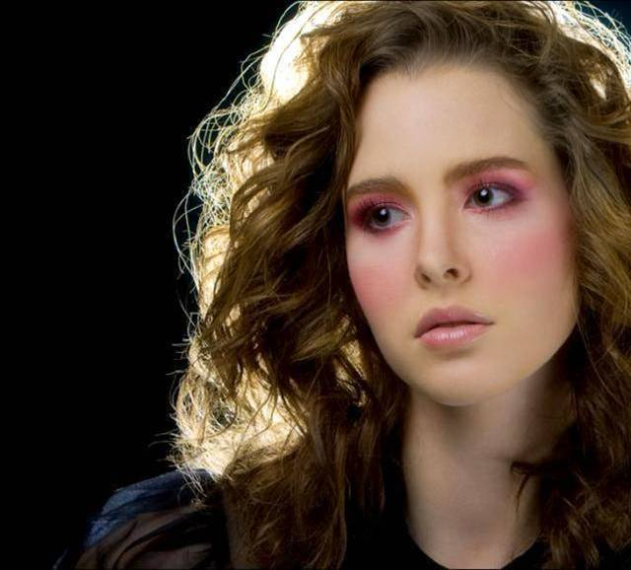








……..………....……………………………......
Belles
mélodies 2
yatata
yatata
All women are beautiful
In my heart, burn
a candle
…..….………....……………
....…..….………....………….
Why am I still whispering your name
presentation by y@t@t@
Without knowing
Seven carnations
Romantic
Mix
……..………....……………………………......
www.yatata-blog.eu

