Slide 1
Rolling Stones

Slide 2





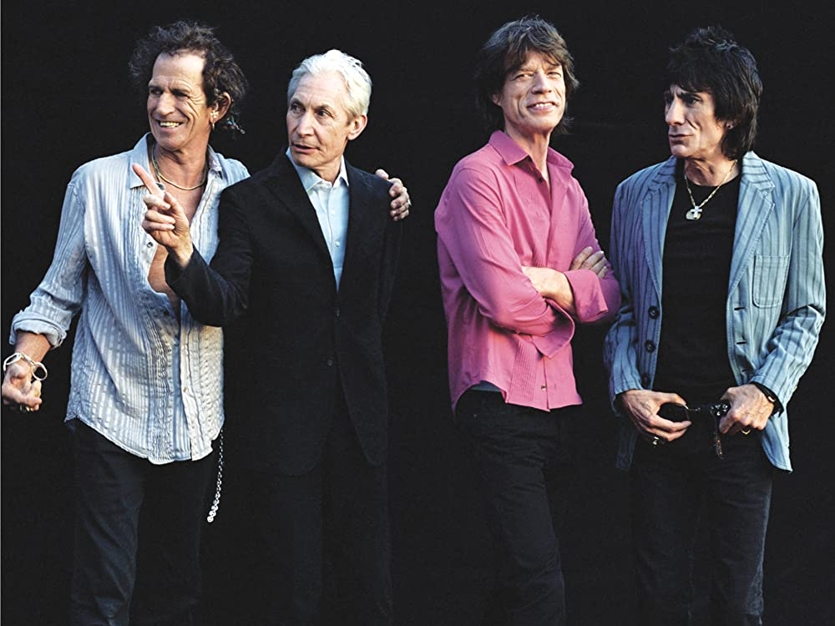

THE ROLLING STONES
yatata
yatata
Satisfaction
Angie
Ruby
tuesday
Lady
Jane
Doncha bother me
Mother‘s
little helper
presentation by y@t@t@
Paint it
black
www.yatata-blog.eu

