Slide 1
Romantické melodie
4

Slide 2



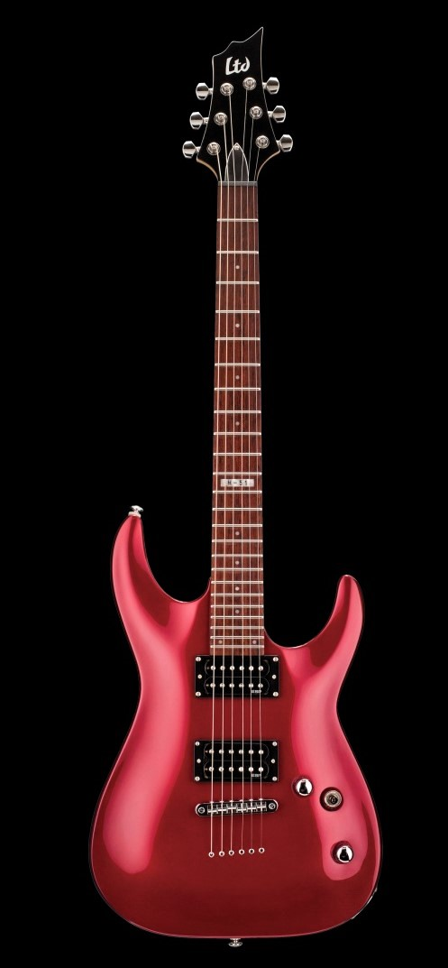





Romantické melodie 4
Morgen has
broken
Imagine
Sentimental
song
Tears on
heaven
Magic
quitar
Nostalgic
Scapes of my heart
presentation by y@t@t@
www.yatata-blog.eu

