Slide 1


Entertain, inspire, empower
Creating
quality content
for all
Marsupilami: Hoobadventure! (2021)
Microids

Slide 2
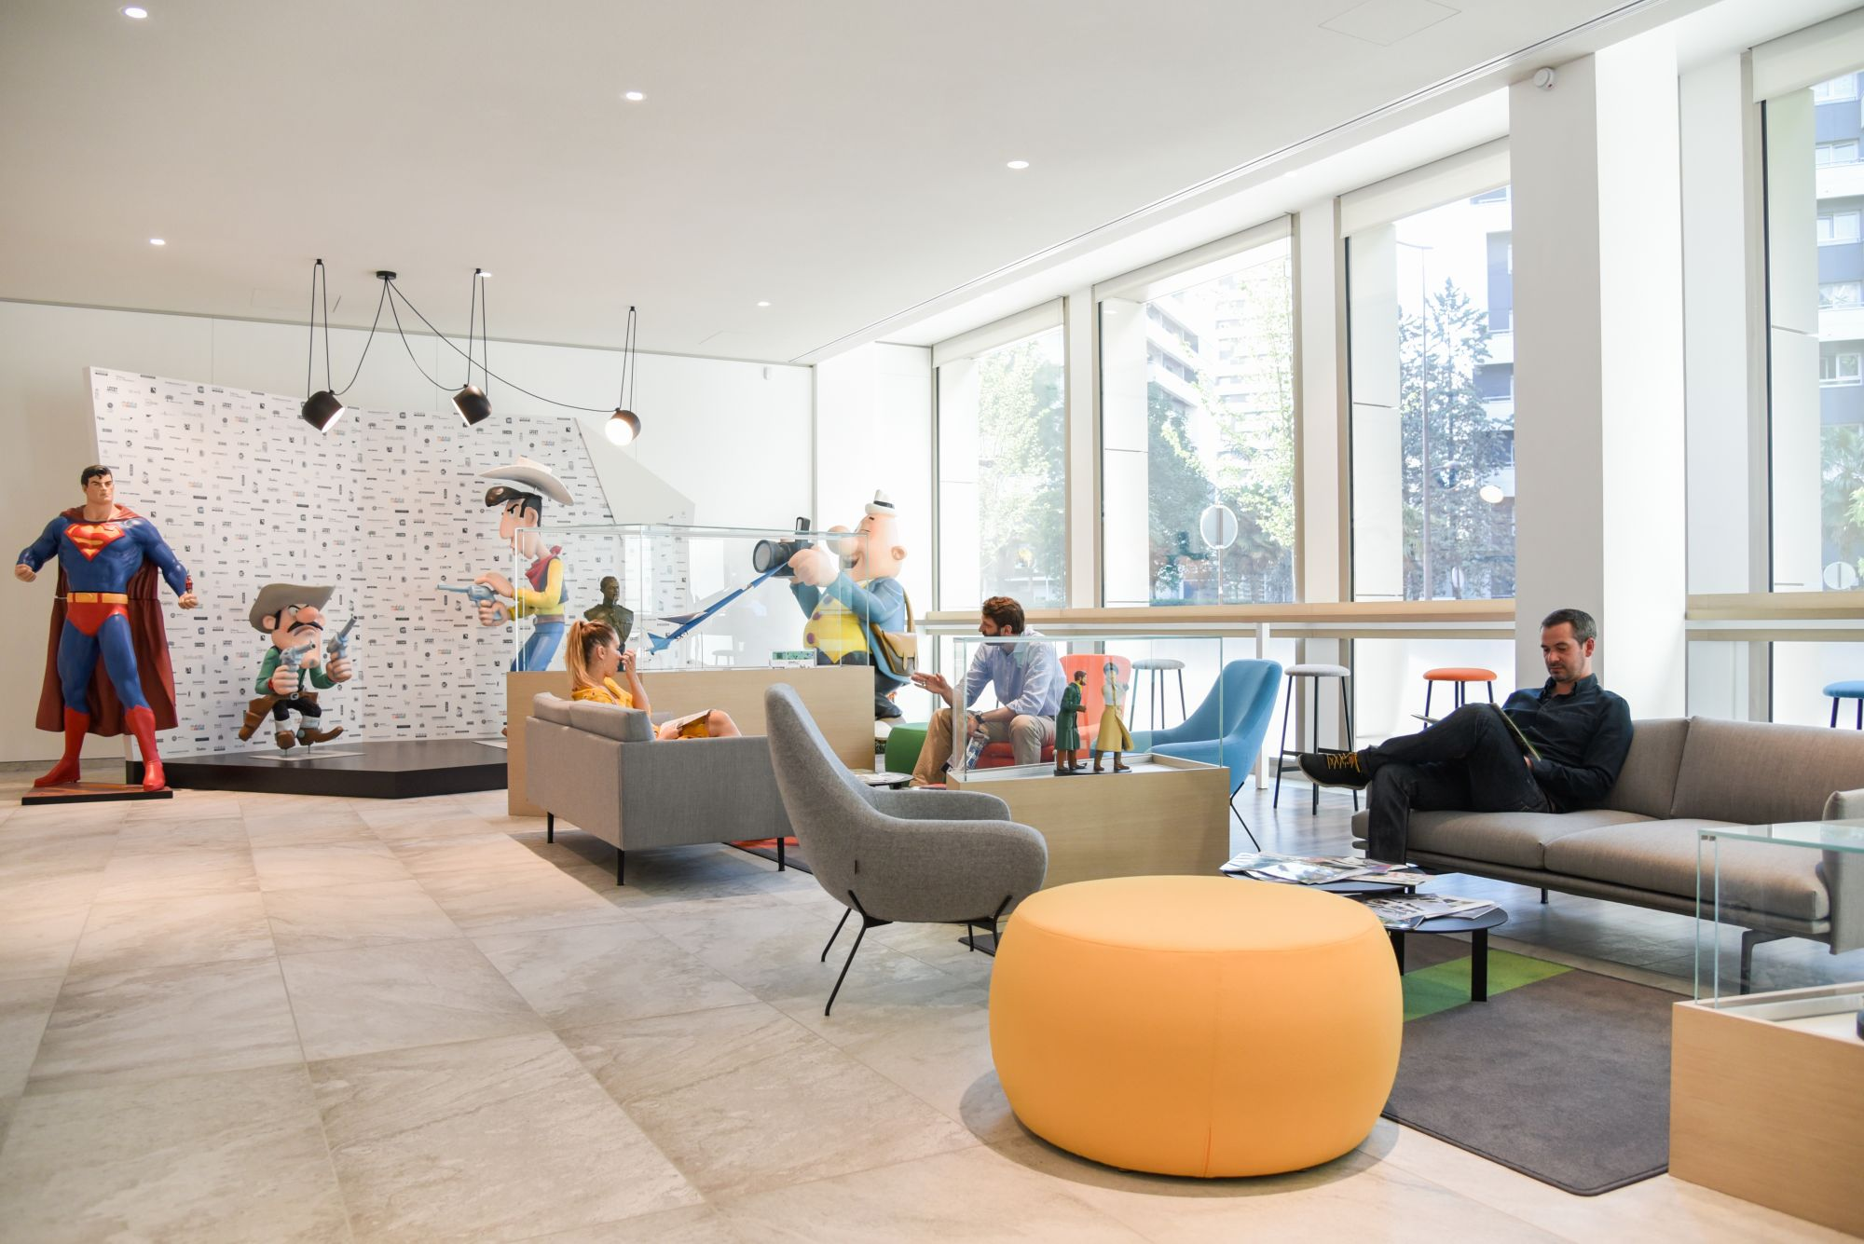
Let’s introduce
ourselves…

Slide 3

A European leader
in publishing, media & entertainment
85 companies worldwide, 1,800+ employees
#1 Independent Publishing, Media & Family Entertainment Company in Europe
$780 million turnover
4,000+ brands
#1 Comic and Graphic Novel publisher in Europe
#3 Book publisher in France
#1 Animation Catalogue in Europe, 3 animation studios
1 Video games publisher, 2 development studios
1 Theme park
Yakari, A Spectacular Journey (2019)
Ellipse Animation (Dargaud Media) - Belvision

Slide 4

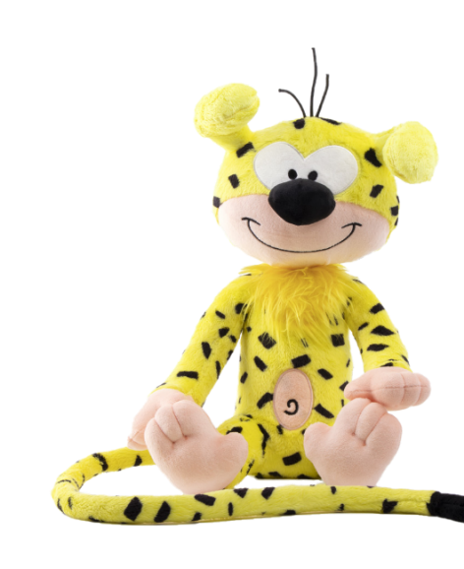

















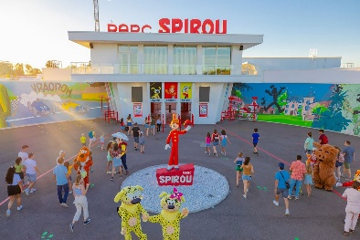
We are Storytellers
Blacksad: Under the Skin (2019)
Microids

Slide 5






360°
is a group policy
A strong and agile
brand management across media
Publishing
Audiovisual
Video games
Consumer products
Experiences
Lucky Luke: A Cowboy in Paris (2018)
Lucky Comics

Slide 6













IPs
Michel vaillant

Slide 7

IP Management
-112 titles since 1946
-300+ million copies sold worldwide
Translated in 35+ languages
The best-known pilot in comic books, since 1957
- 2023: 100th anniversaries of Jean Graton (author) & Le Mans 24 hours race
4 animated movies, 3 lives, 5 tv series
- 50 licensees around the world
20+ million copies sold worldwide
A movie by Luc Besson in 2003
- Theme park & television star
Plushes bestseller
- 3+ million comics sold
New tv serie in development

Slide 8

IP Management
3.6 million copies sold in France
420 k copis sold in French in 2022
200+ million copies published worldwide
3.5+ million copies sold in France
Yoshihiro Togashi, the most followed mangaka on twitter – 3+ million followers
250+ million manga sold worldwide
11 million video games sold worldwide
28,5 million manga sold in French
3,2 million manga sold in french in 2022
10+ million DVD/BRD sold in French
130+ licensees in Europe
310+ K copies sold in France in 2022

Slide 9



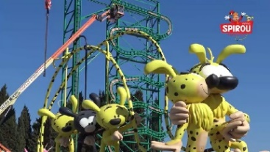




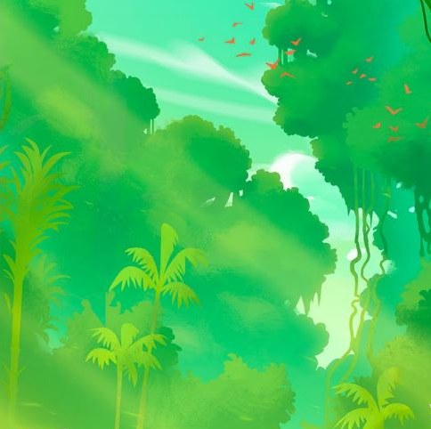
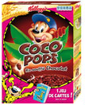



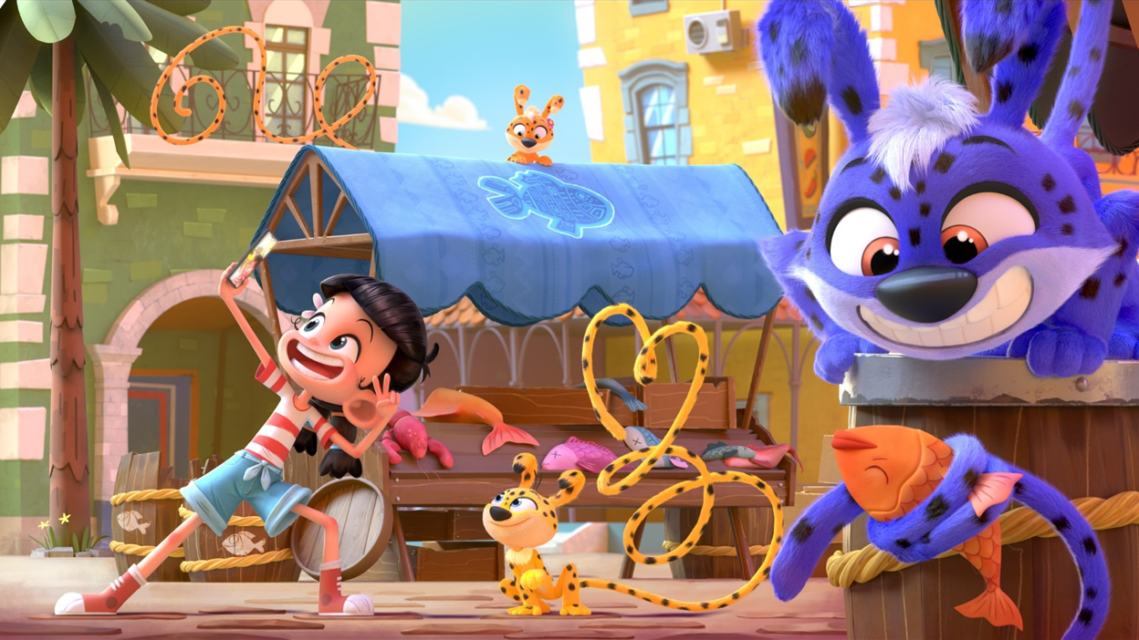





So we manage our own IPs…
Apparel
Theme parks
Licensed publishing
Merchandising
Comic books
LICENSING
PUBLISHING
Commercials
Events
DIGITAL
AUDIOVISUAL
New TV series
Video games
Digital platforms
Live-action film
TV

Slide 10























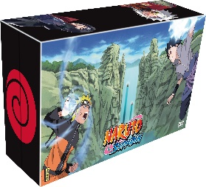


…as well as external ones
Fashion
Digital
Manga
Advertising campaign
PUBLISHING
Games
Licensed
publishing
Magazines
LICENSING
AUDIOVISUAL
Music
Figurines
Merchandising
TV + VOD platforms
DVD and Blu-ray
© 2002 MASASHI KISHIMOTO

Slide 11
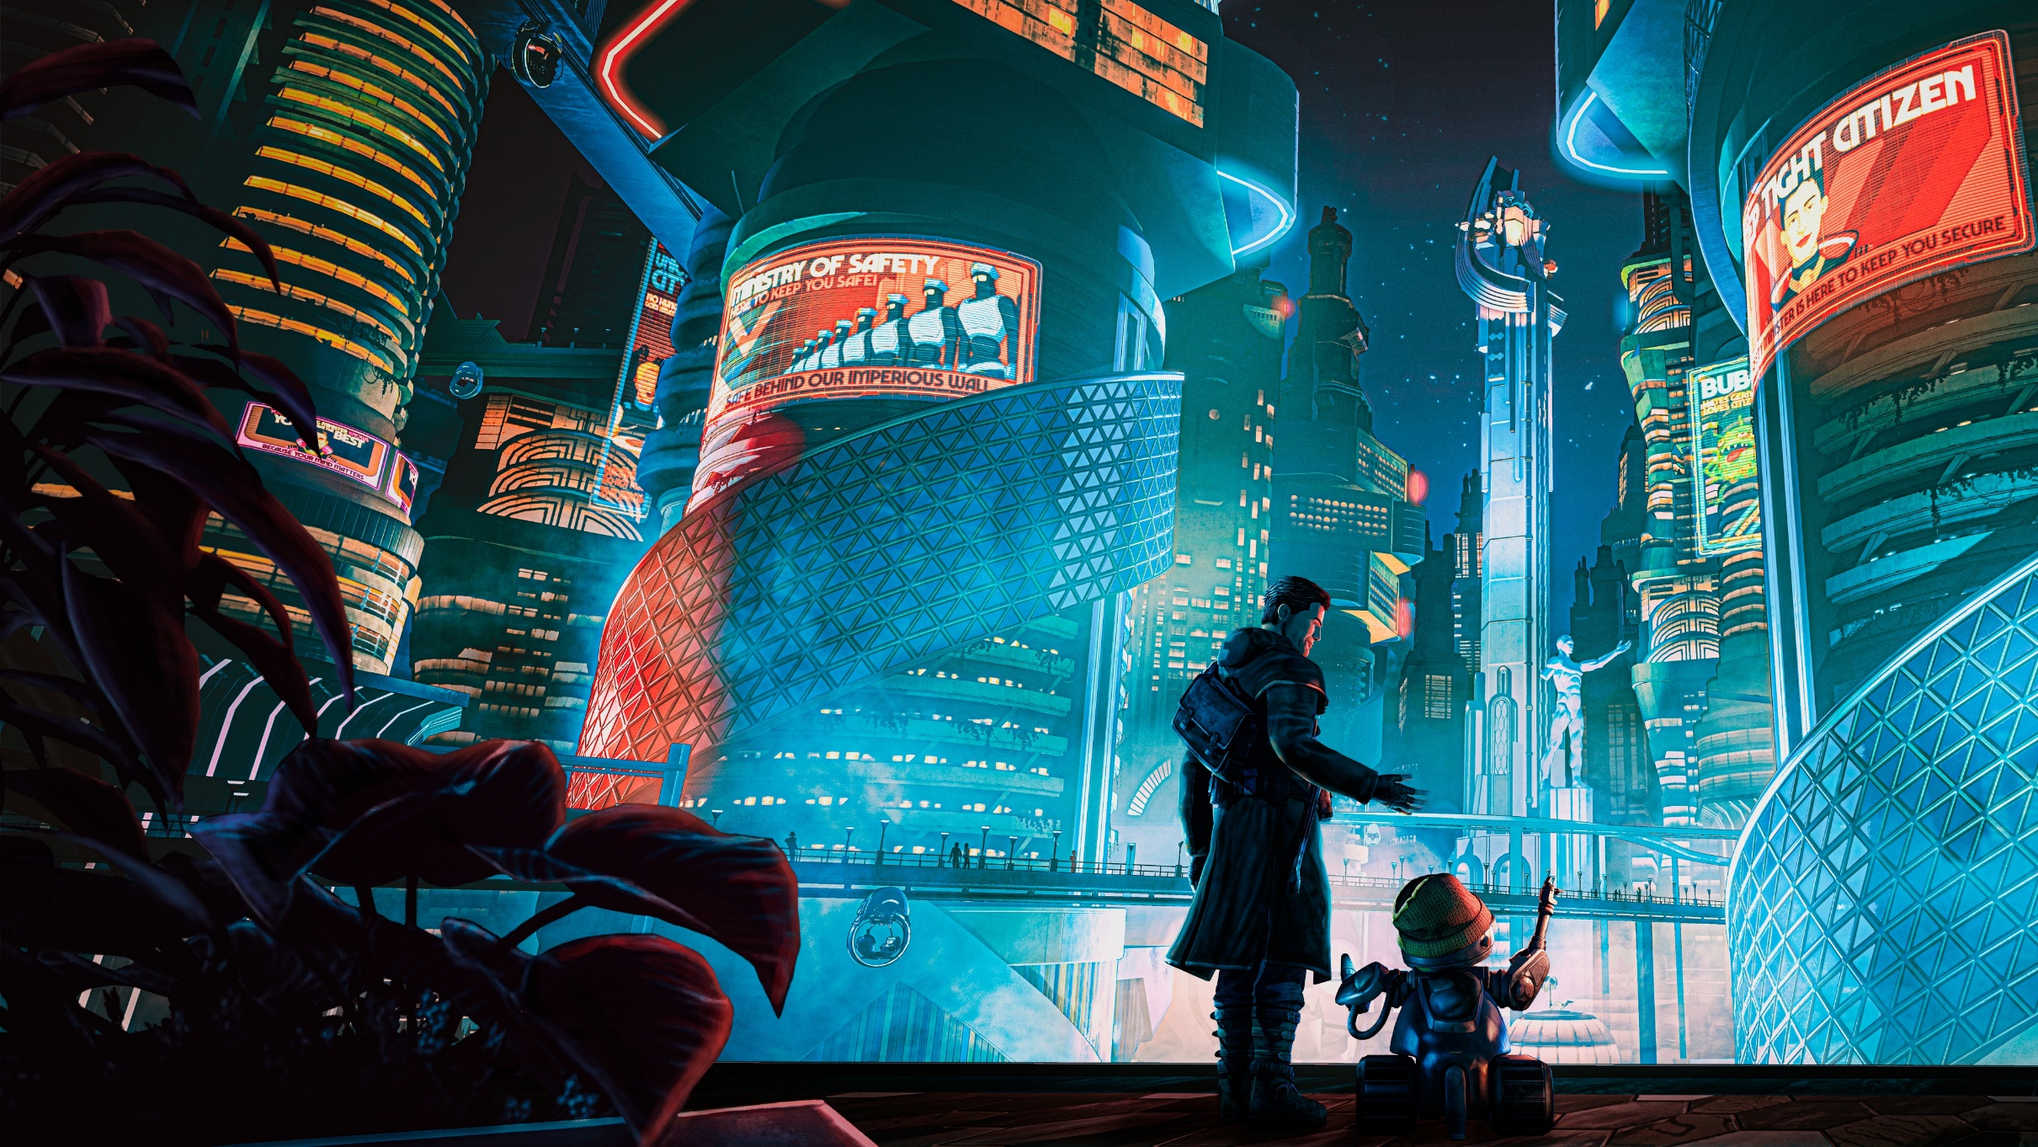
Beyond a Steel Sky (2020)
Microids
We are Storytellers
in Video games

Slide 12







Video games
Development and publishing
of Video games
For PC, PS4/PS5, XSX and Switch
Partnerships with renowned studios and authors: Pendulo Studios, Eden Games, Benoît Sokal, Paul Cuisset, Charles Cecil, Oddworld, Inhabitants…
Partnership with Taito, Dynamic Planning, Gmode…
Famous licenses: Syberia, Garfield, Agatha Christie, The Smurfs, Grendizer
Syberia
Microids

Slide 13



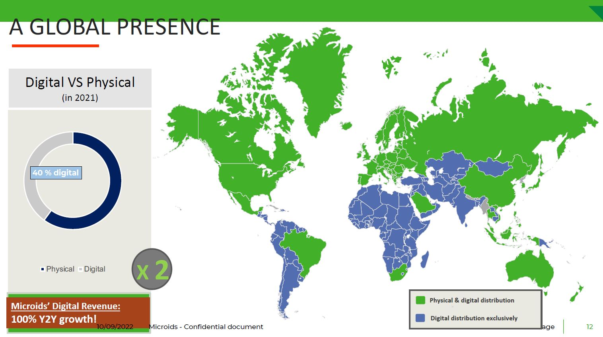
Partnership and Distributed in MENA by
Video games
Worldwide distribution

Slide 14

The Smurfs (2021)
Ellipse Animation (Dupuis Edition & Audiovisuel)
We are Storytellers
in Audiovisual

Slide 15


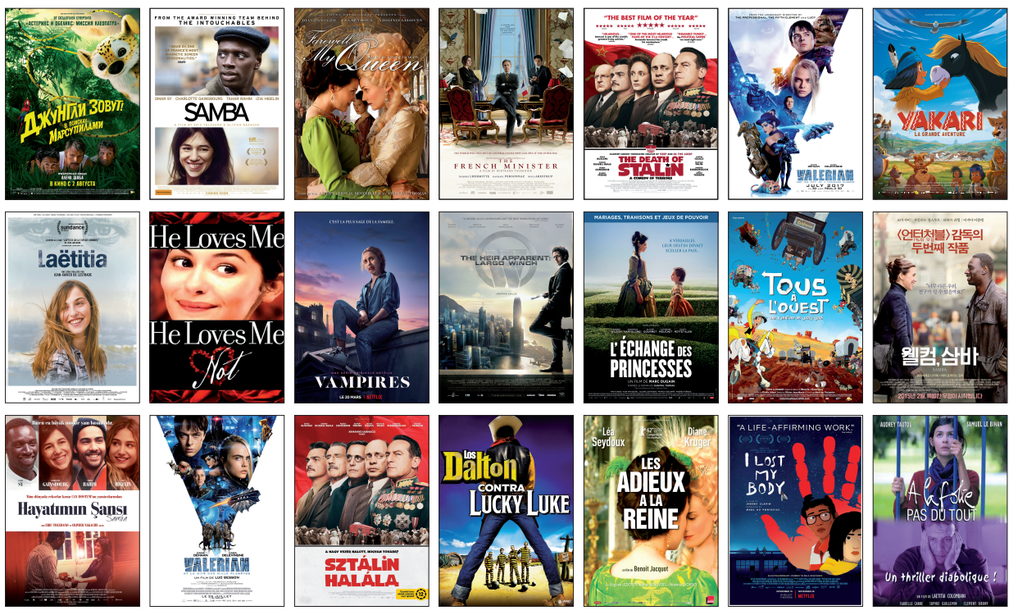
Movies & Series
Worldwide adaptations of our books
by external producers

Slide 16







Production
The Smurfs (2021)
Ellipse Animation (Dupuis Edition & Audiovisuel)
2 leading animation producers
in Europe
4 to 6 series and one Feature Film per year
29 hours of animation delivered in 2022, to international Networks (TF1, Paramount, M6, Kika, FTV, Warner Media..)
3 In-house 2D & 3D Studios in France and Belgium with 380 seats
Producers of the Smurfs & Garfield series, distributed in 140 countries with a top kids audience ratings all over the world, including US.
#1 animation catalog in Europe with more than 4,000 hours of iconic series distributed by
Visuel de Garfield

Slide 17



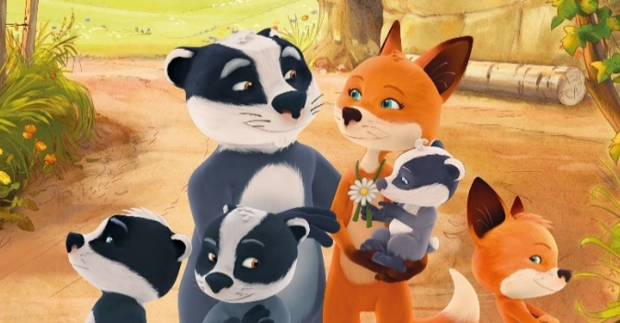
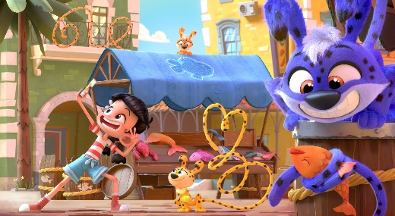



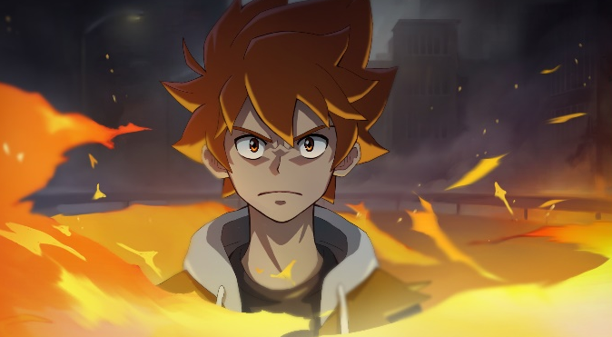
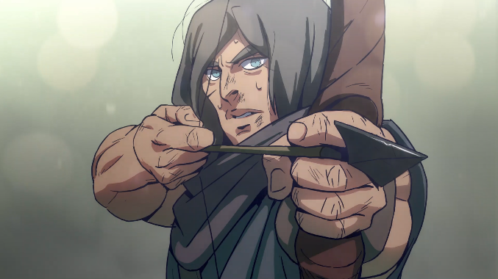


Current projects
The Smurfs (3rd season)
The Marsupilamis
Louca
The Fox-Badger Family
Versailles Unleashed
Living with Dad
Trotro & Zaza
Yakari 2
Dreamland
Thorgal
Vaillant

Slide 18
Collaboration opportunities :
Média Participations has a proven expertise in creating and diversifying IPs, and we are looking for business partners interested in content co-production and IPs developement in Europe and beyond. We want to set up a duplicable model for production and distribution that could be expanded in the Middle East, by onboarding and training local artists and storytellers, and streamlining the production process.
Coproduction & worksplit possibilities between the 2 countries with an opportunity of sharing French expertises.
Audiovisual distribution Mandat for MENA territories & possibilities to extend the right with Asian territories.

Slide 19
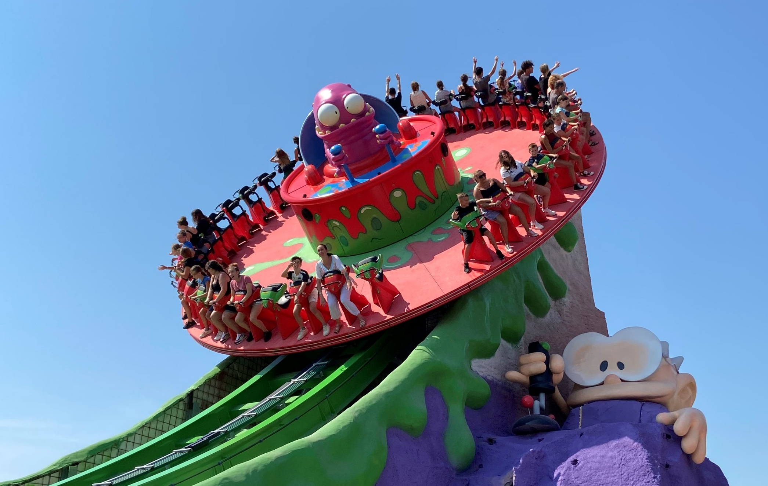
We are Storytellers
in Parks

Slide 20
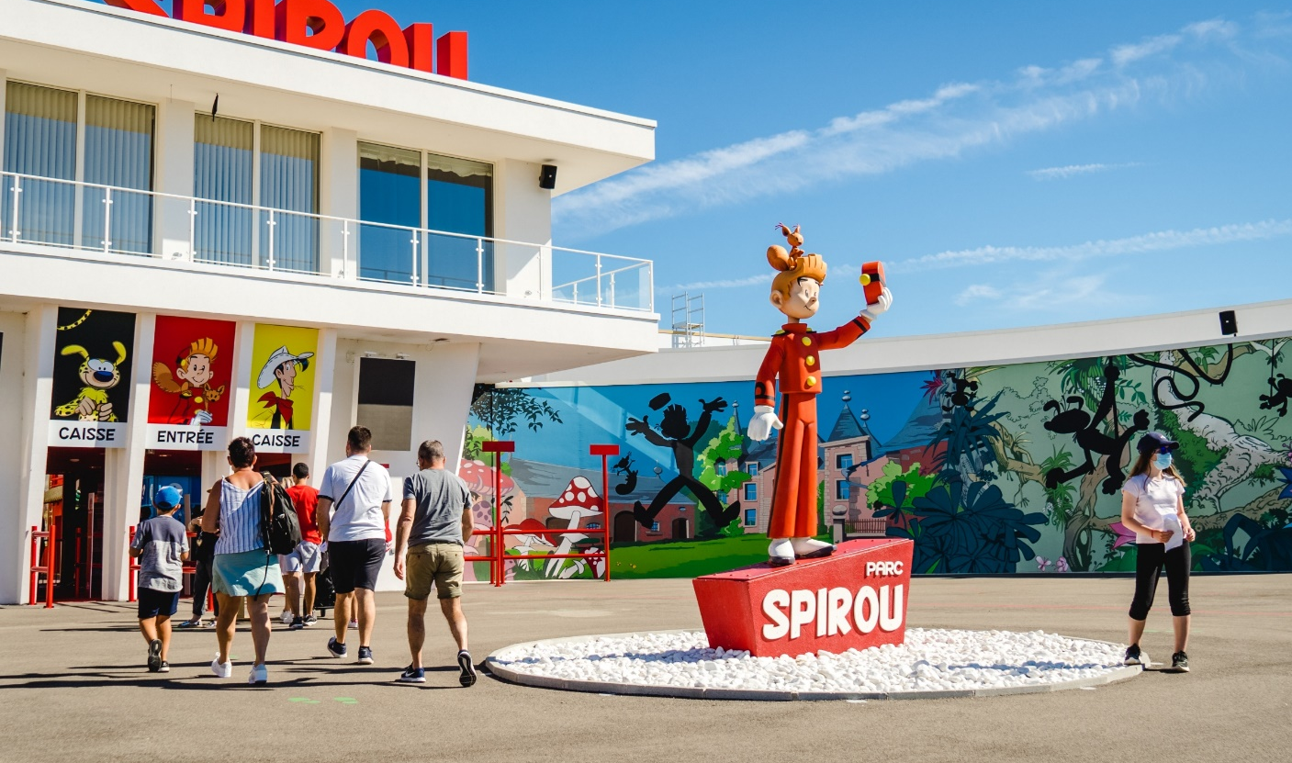
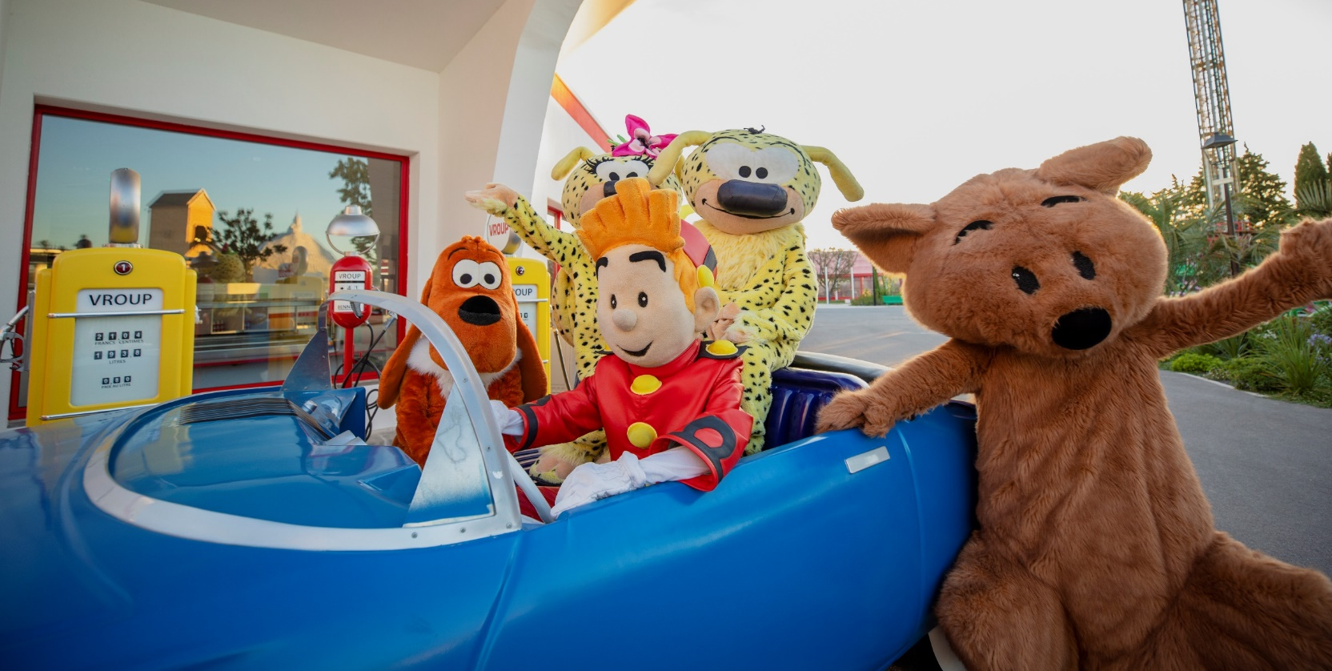
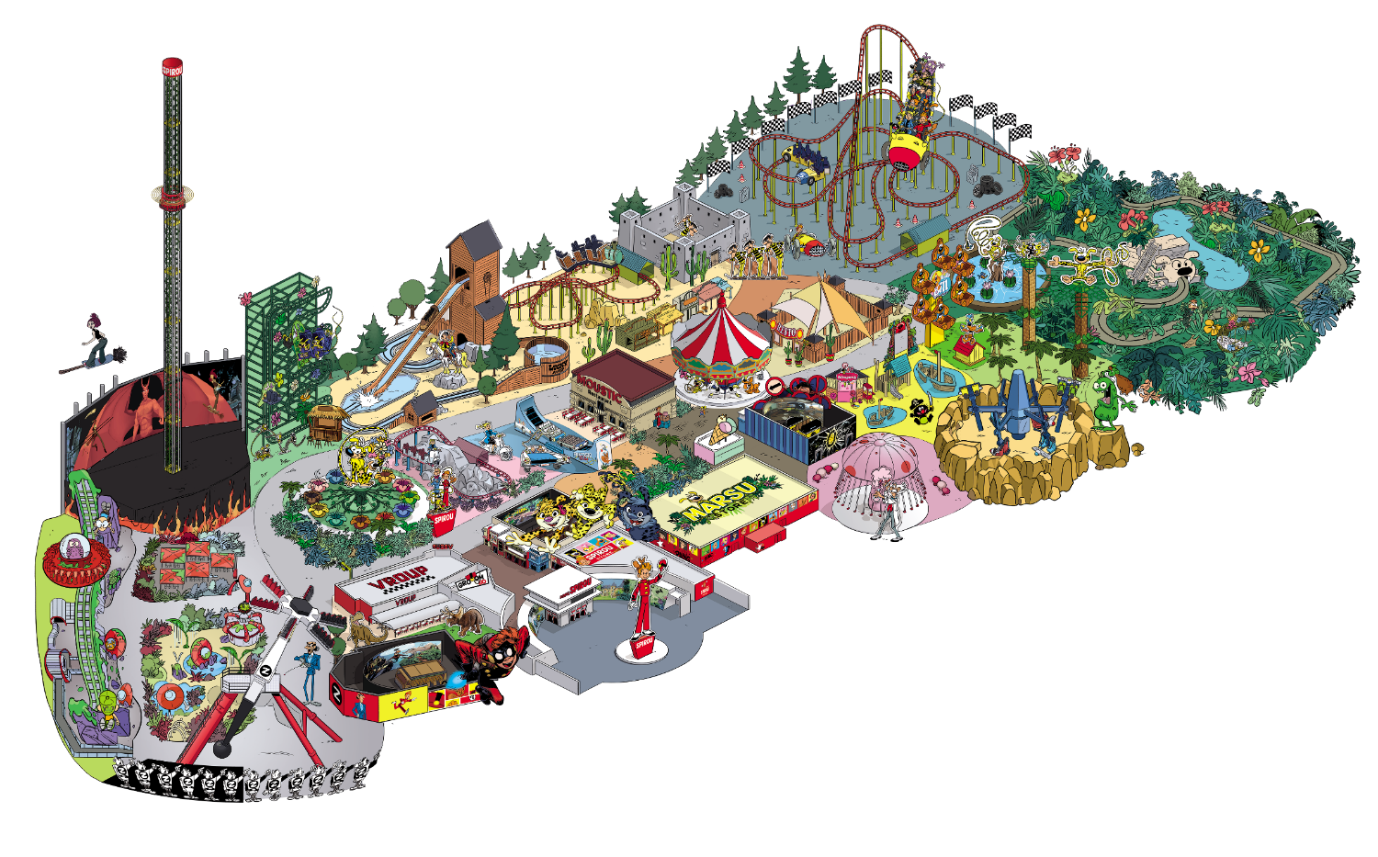

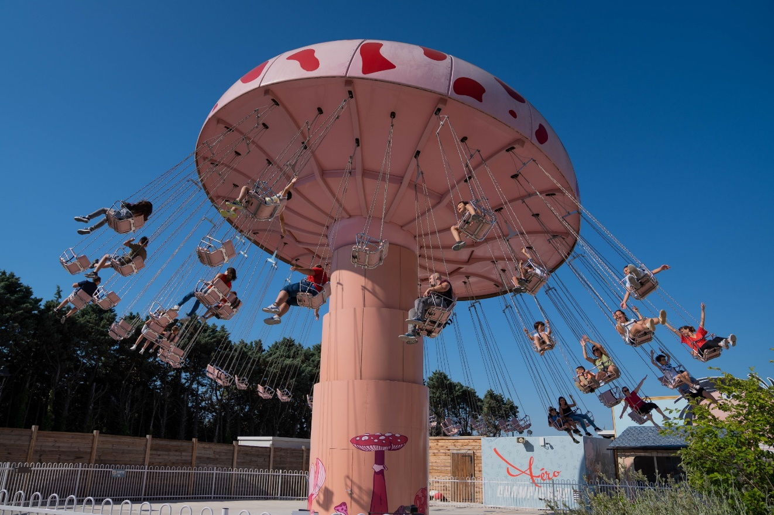
Parks
From comics
to themed entertainment
Watch the demo here

Slide 21
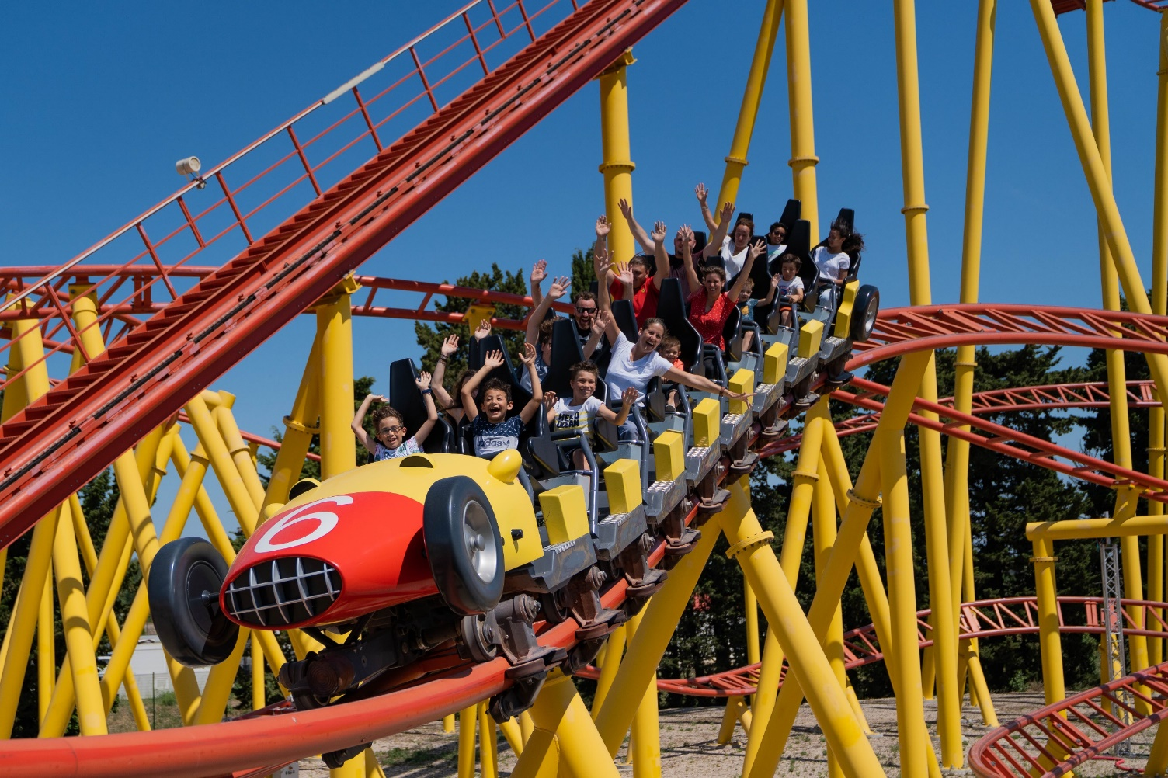
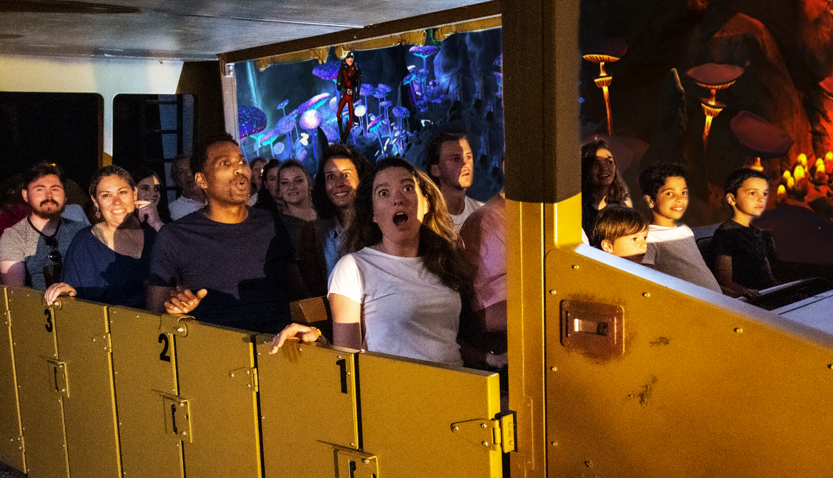
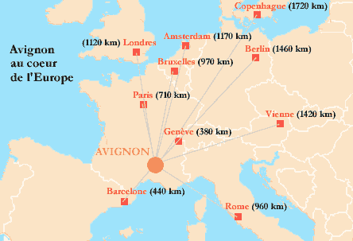

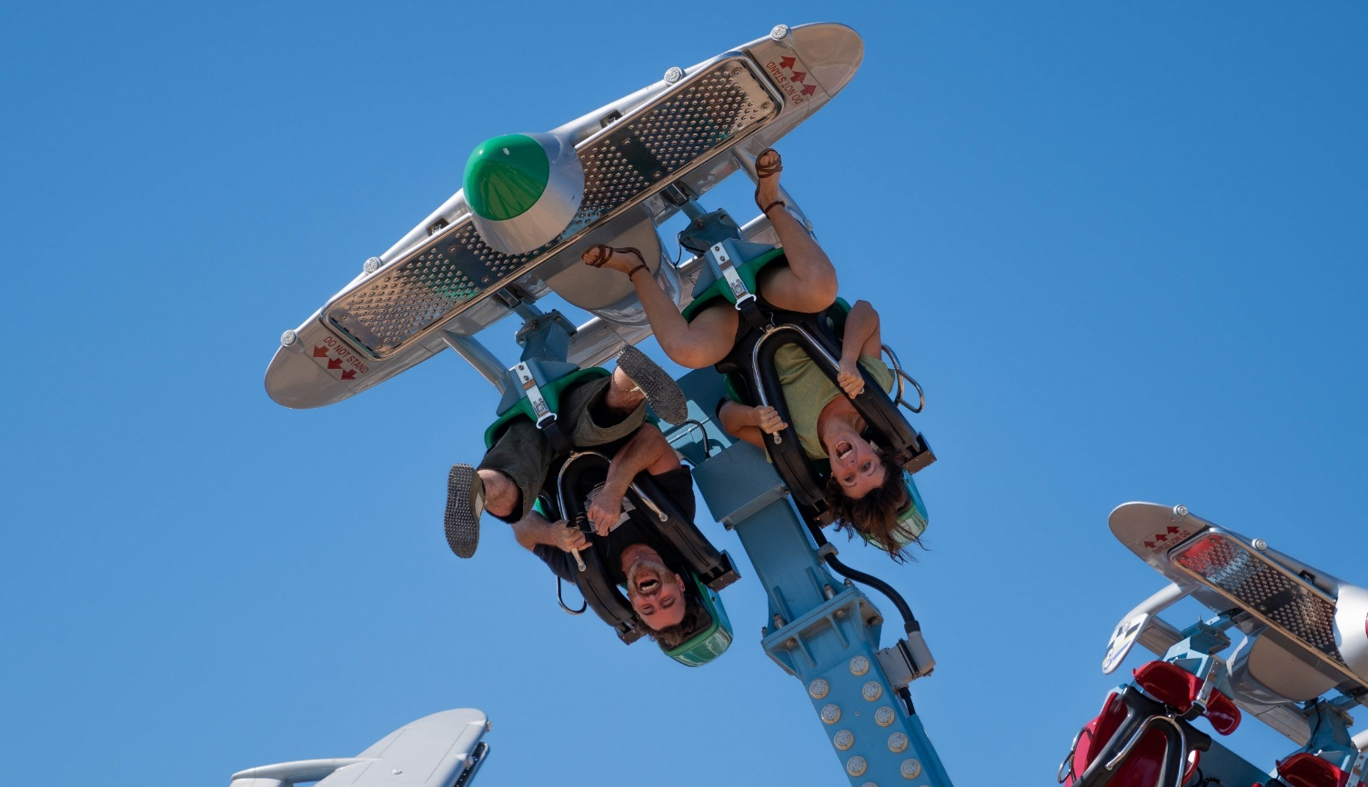
Complément « Pour des sensations »
Parks
The perfect location for a parc
1 million visitors including 300K in 2022

Slide 22


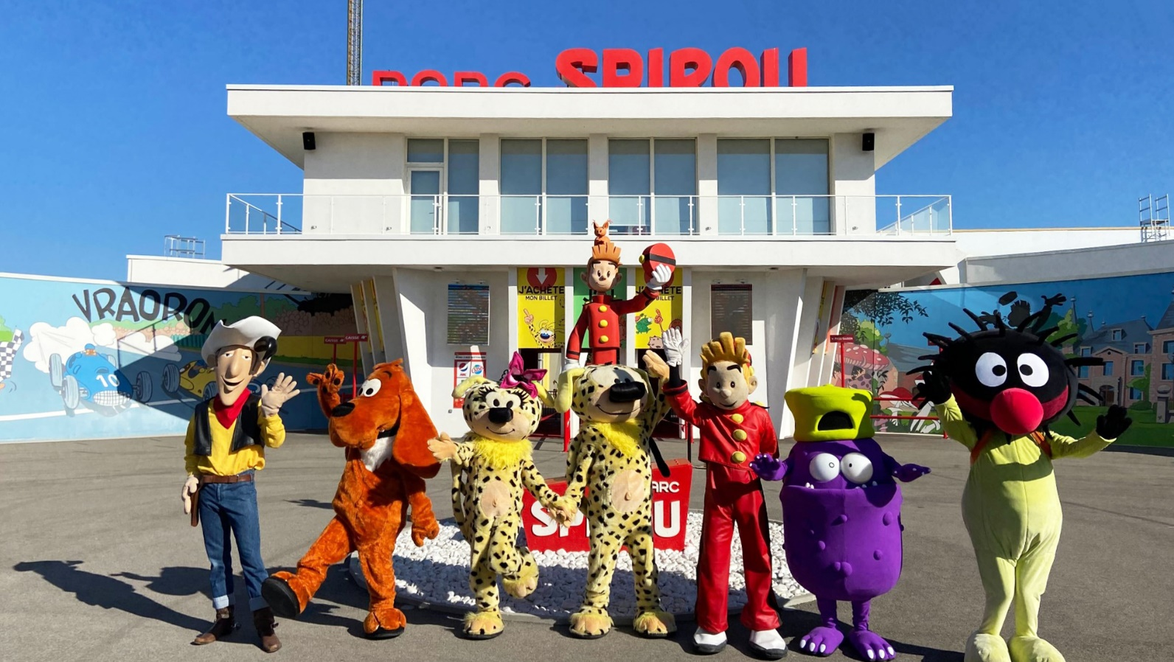
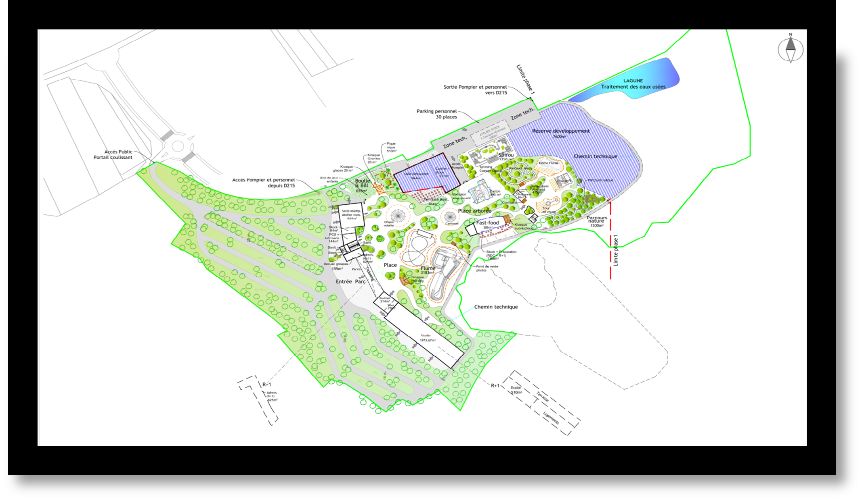






Complément « Pour les familles »
Parks
Next Step:
We are looking for investors for our new park in Angoulême, supported by the French sovereign fund (CDC).
We propose the same turnkey concept of Park in Saudi Arabia.
Remettre la partie
Become eyc…
Et mettre cette partie dans les next steps
THEME PARK
MUSEUM
Investment Phase 1 : 45M€
12 attractions of which 3 Coasters, 1 Dynamic 5D Theater…
2 restaurants,
2 Boutiques,
A museum,
Our Animation Studio
A school linked to the Studio
SAUDI ARABIA
SCHOOL

Slide 23

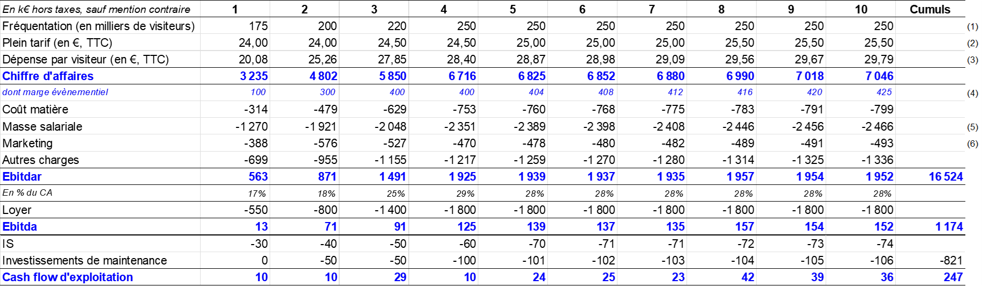

A place of entertainment and culture around the world of comics & mangas
Business Plan
SAUDI ARABIA

Slide 24

Dreamland (Coming soon) Ellipse Animation x ADN
We are Storytellers
in digital platforms

Slide 25

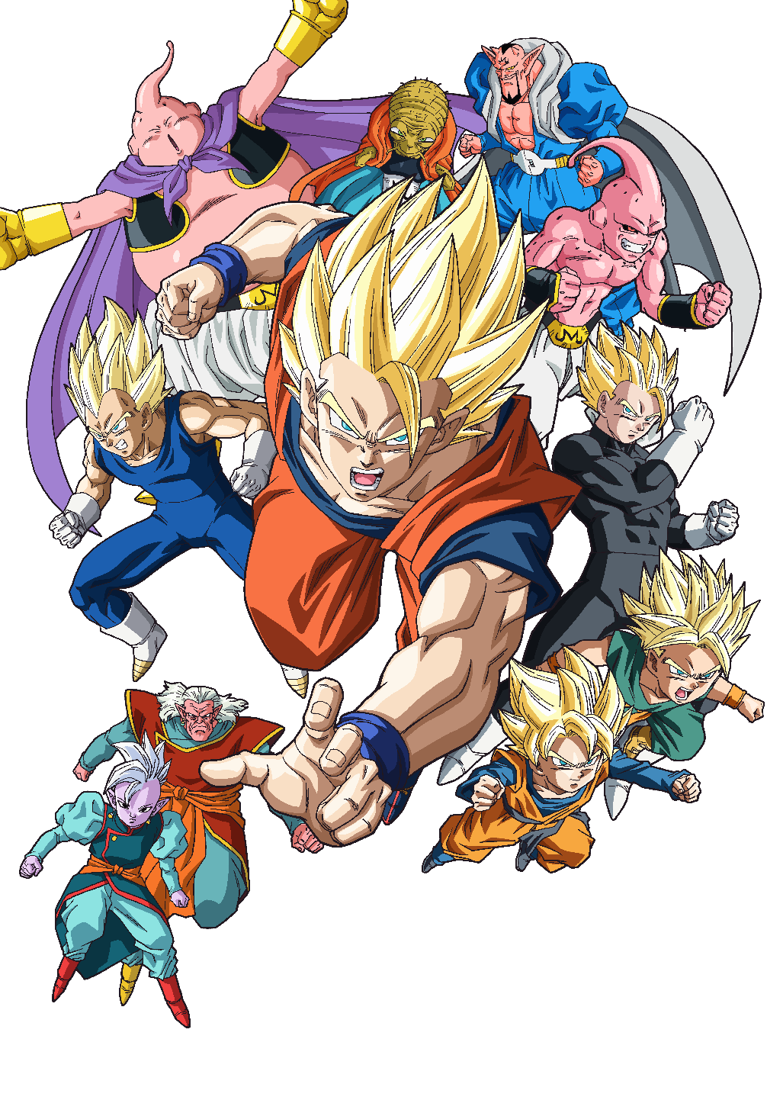
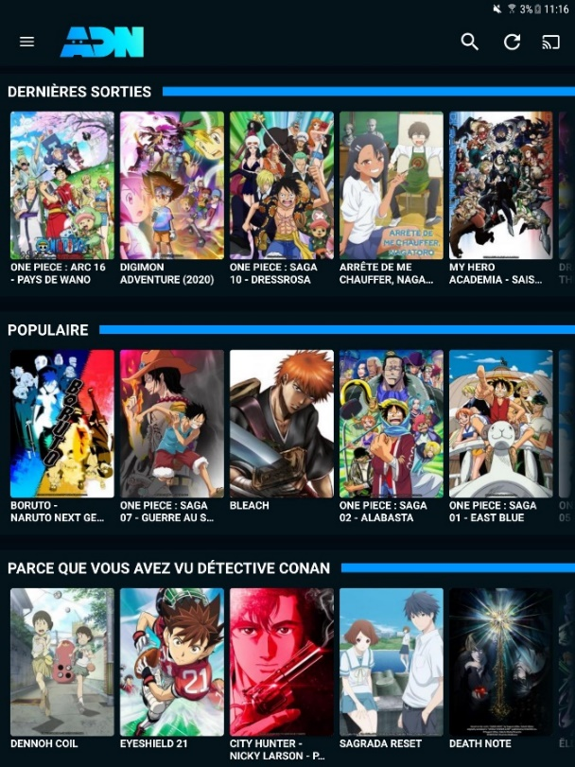


Streaming
A 10-year expertise
In managing content platforms
SVOD/AVOD platform dedicated to animation
335,000+ subscribers (x3 in 2 years)
2.8 million registered accounts
Large catalogue of Japanese anime
12,000+ episodes, 360+ series, 70+ films
Simulcast + back catalog
EMEA expansion in 2023

Slide 26
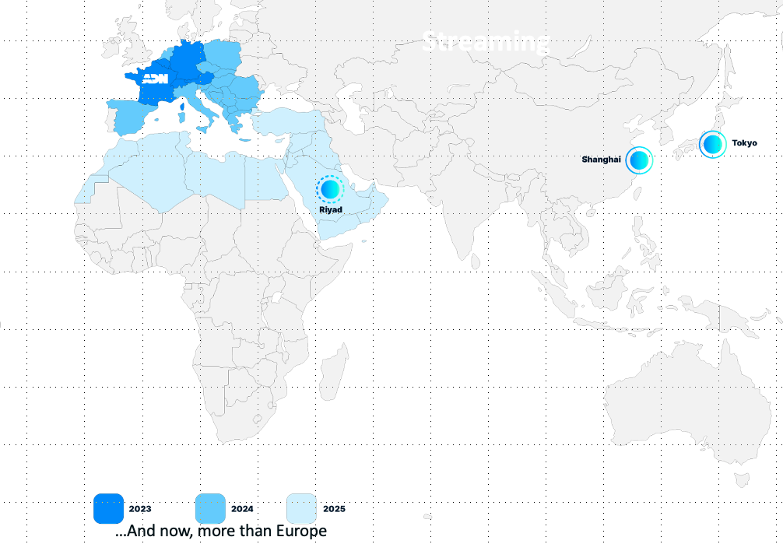

Streaming
Two main objectives
Our Objectifs
1) Existing in the MENA zone as a platform
Directly OTT or distribution deals with telco operators
JV with a local partner
2) Securing content on a worldwide or EMEA basis
Co-buying then sharing the exploitation
We provide a direct access and good track record to most of Japanese Licensors
We need local expertise for local exploitation
Investors who could get revenues from the world wild exploitation

Slide 27



























One of the largest Japanese IP catalogue in EMEA

Slide 28
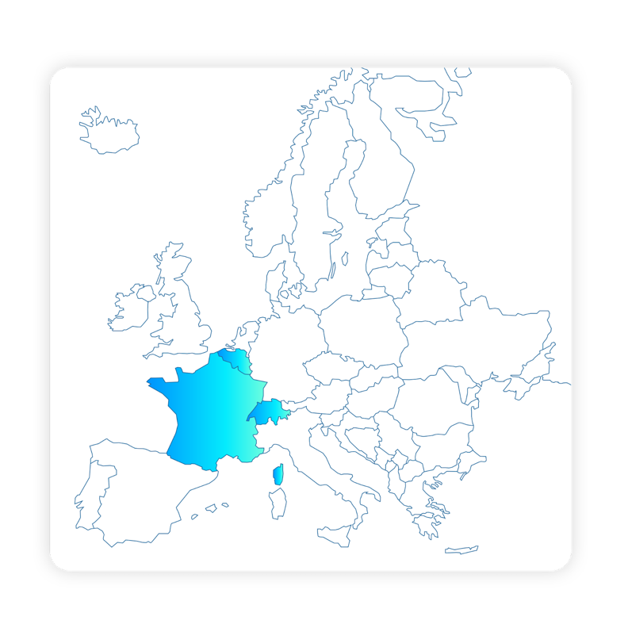

















ADN – Key partner for distribution in Europe
We partner with all relevant companies to maximize exposure and exploit all rights available from TV to Home video or merchandising.
Mettre en avnt la non exclusivité
Le windowing pour maximiser la visibilité

Slide 29



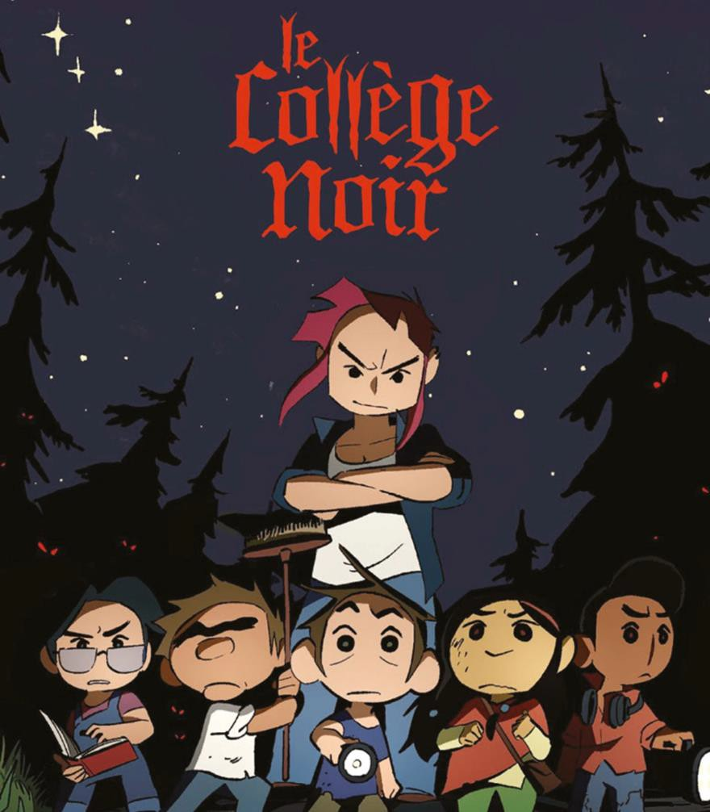

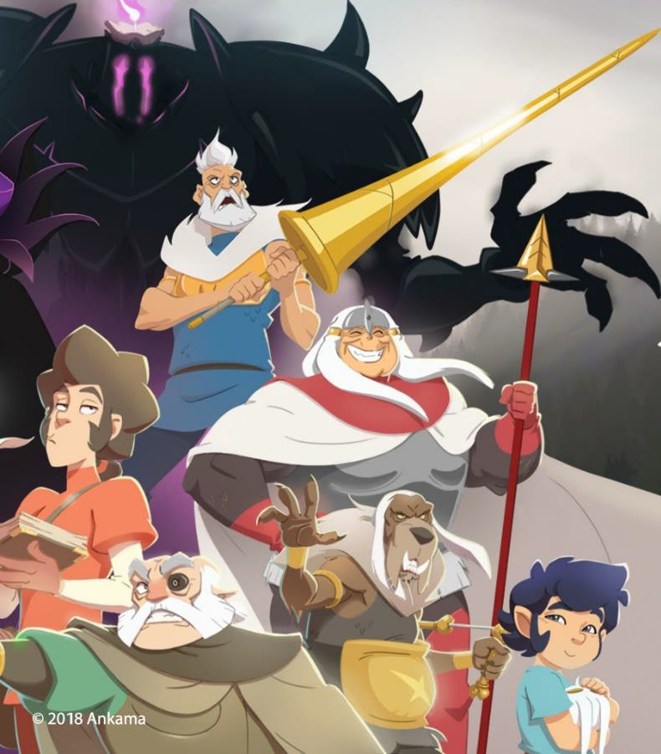










Slide 30
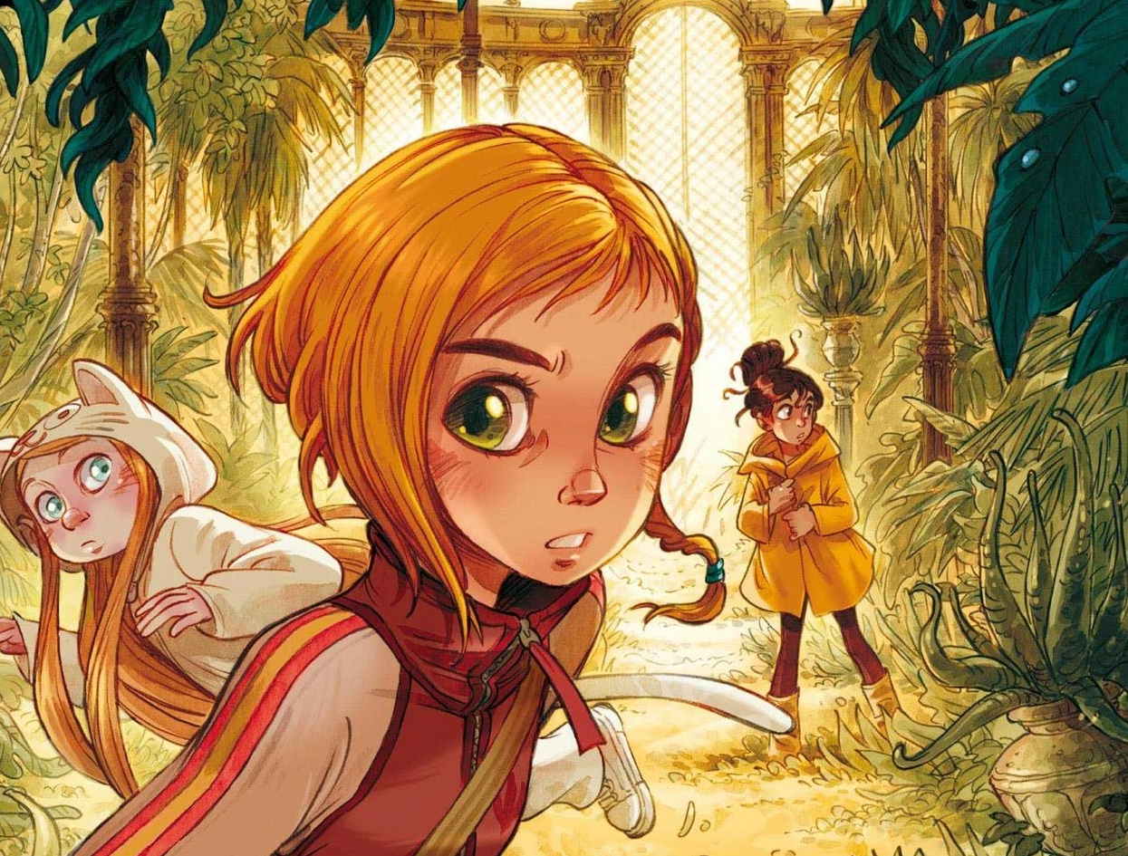


Slide de référence
Digital reading
Our digital reading platform
      Our ambition is to become the reference platform and production entity in Europe, achieving the following milestones:
      January 2023: French launch with 100+ webtoon series
      Q2 2023: inclusion of Manga catalogue (France is the 2nd largest market for manga)
      Q4 2023: European expansion starting with Germany
      2024: set up of a local production entity to create and produce European series

Slide 31


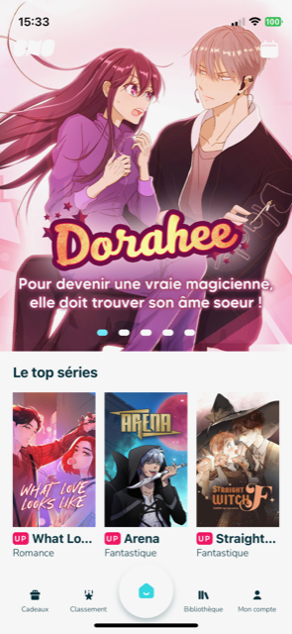
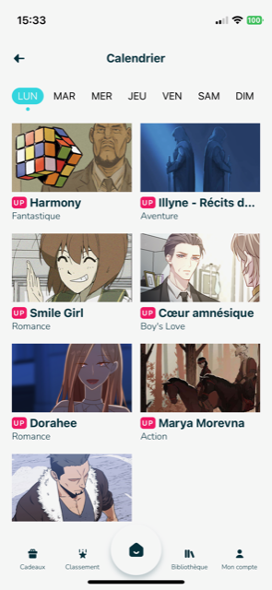
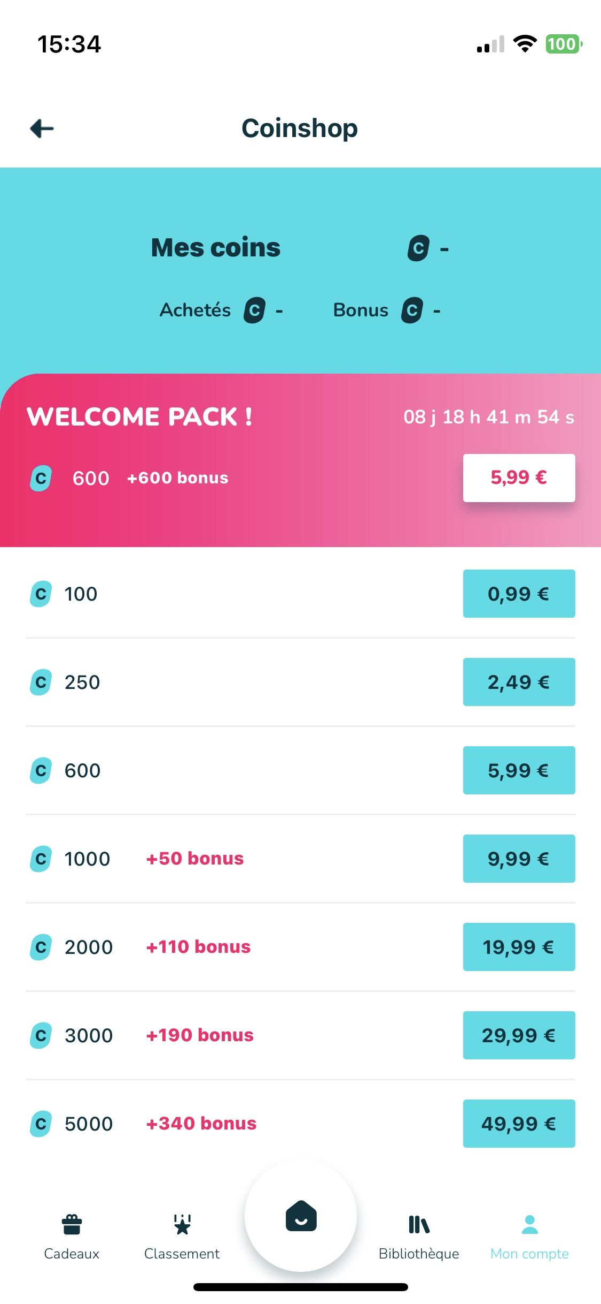
Notes:
Encore enlever Q4 dans le dernier bloc.

Slide 32



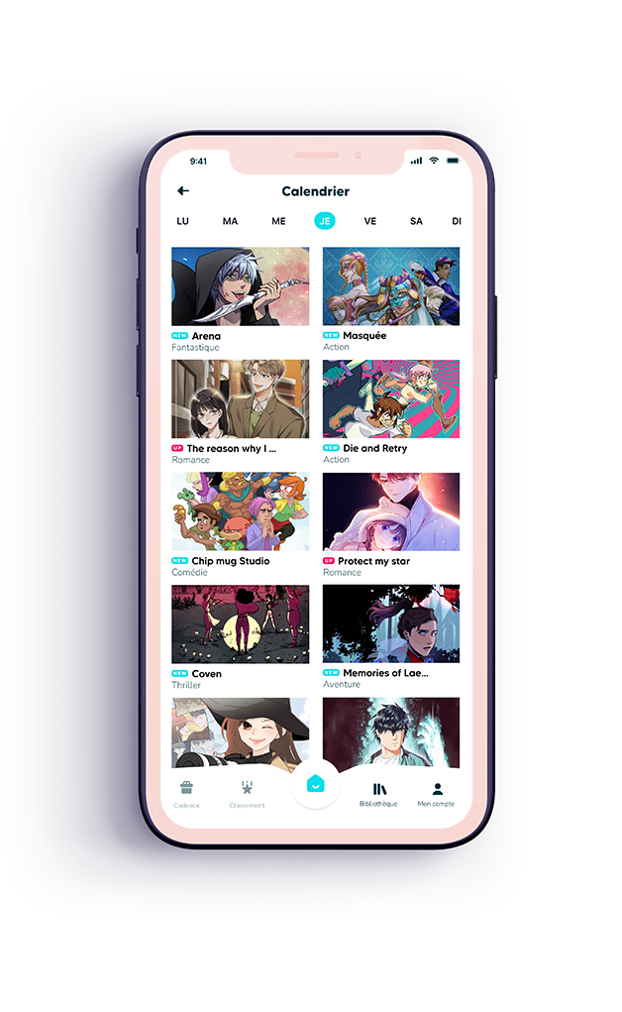

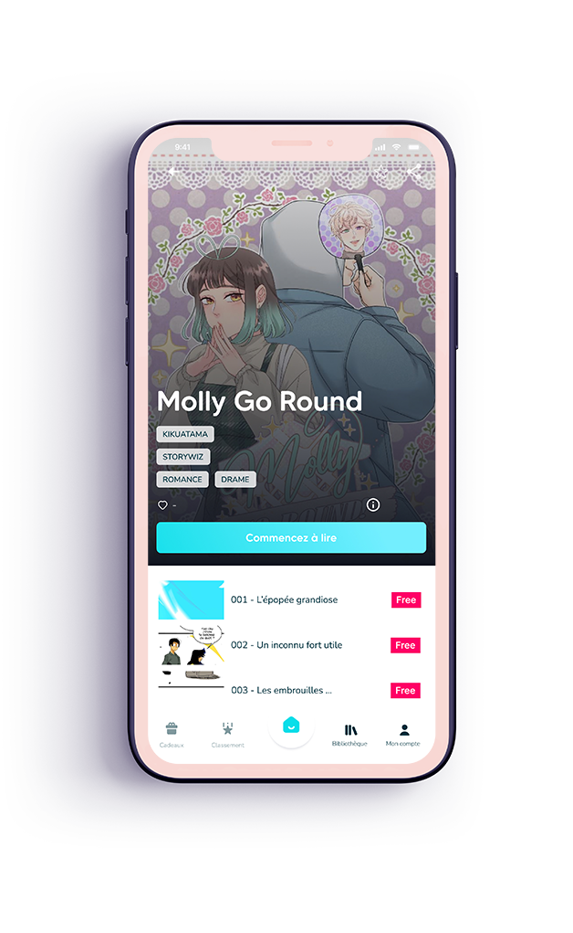
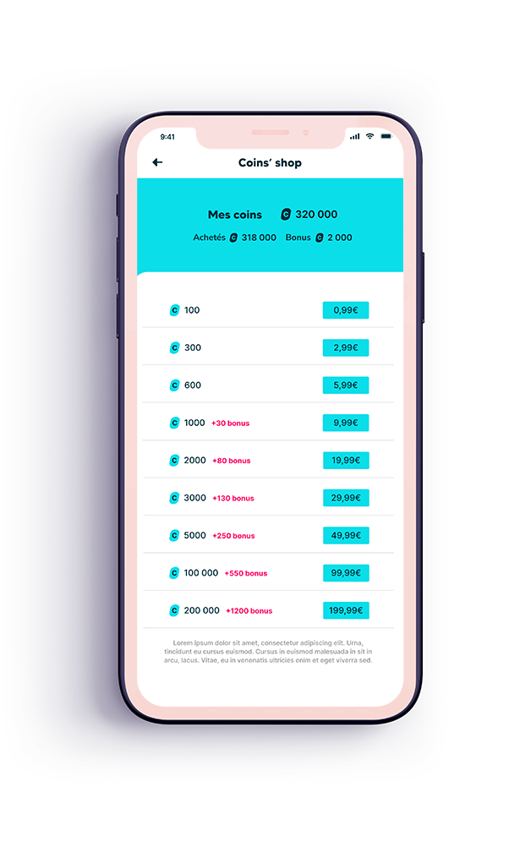
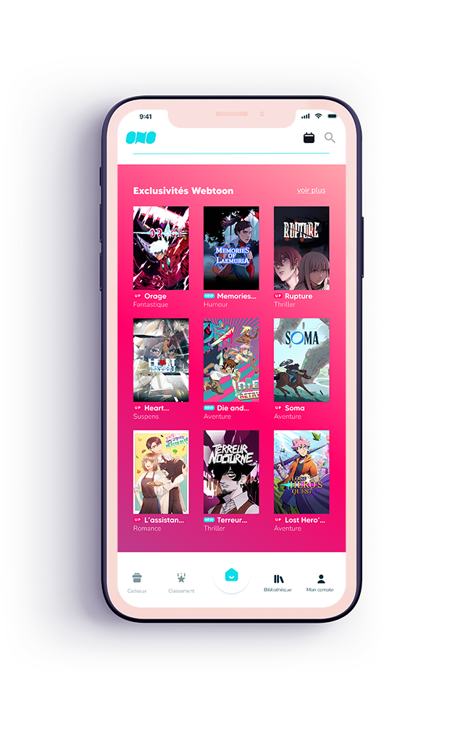
Digital reading
A dedicated app: ONO
A rich catalogue
of Asian and European webtoons
Thousands of episodes: Romance, Action, Fantasy, Drama
A free advertising digital reading experience
A freemium mode to discover
Pay-as-you-read system through micropayments (coins), no subscription
Exclusive original series
only available on ONO

Slide 33


The new Mobile App for Webtoons and Mangas
      France is the most advanced and fastest growing European country in the webtoon market, reaching €80M in 2022, and #3 international market after US and JP. The webtoon market is expected to grow by x20 by 2030 to reach $56MM globally.
      Our ambition is to become the reference platform and production entity in Europe, achieving the following milestones:
      January 2023: French launch with 100+ webtoon series
      Q2 2023: inclusion of Manga catalogue (France is the 2nd largest market for manga)
      Q4 2023: European expansion starting with Germany
      2024: set up of a local production entity to create and produce European series
      In order to reach this goal and compete with Korean conglomerates, we need to leverage funds to produce
      content at scale, and offer a strong European alternative.
      Média Participations has a proven expertise in creating and diversifying IPs, and we are looking for
      business partners interested in content co-production and IPs developement in Europe and beyond.
      We want to set up a duplicable model for production and distribution that could be expanded in the
      Middle East, by onboarding and training local artists and storytellers, and streamlining the production process.

Slide 34

The new Mobile App for Webtoons and Mangas
ONO platform is available on IOS and Android.
It leverages the existing standards of successful Webtoon platforms for the best users’ experience, without ads:
Monetization through coins (50 coins = €0.5)
A dynamic calendar: 7+ new episodes available on a daily basis
Freemium model: 3 first episodes for free + « Wait until read » covering 1/3 of the full series
A gamification strategy to acquire and engage new users
We aim at acquiring +1.5M users by 2025, and reaching the French podium, alongside Naver and Kakao,
by leveraging and strenghtening our existing assets:
Deep knowledge of local readers’ profiles and expectations
Highly skilled digital team to monitor users’ acquisition and retention
Direct access to local influencers to make our content viral
Strong network of strategic partners across Europe
Large set of in-house activities for content diversification (animation, video games, print books)

Slide 35
Business Plan 2023 - 2026

Slide 36
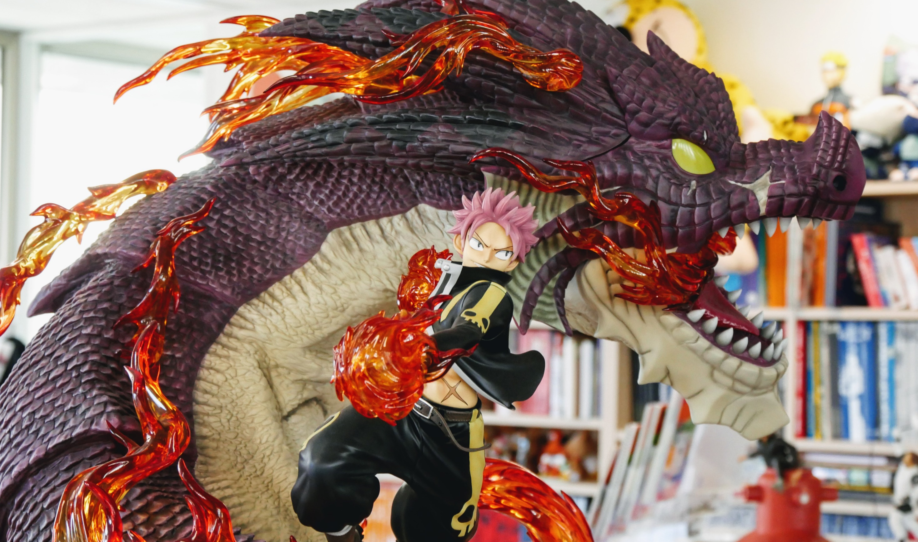
Beyond a Steel Sky (2020)
Microids
We are Storytellers
in Consumer products

Slide 37
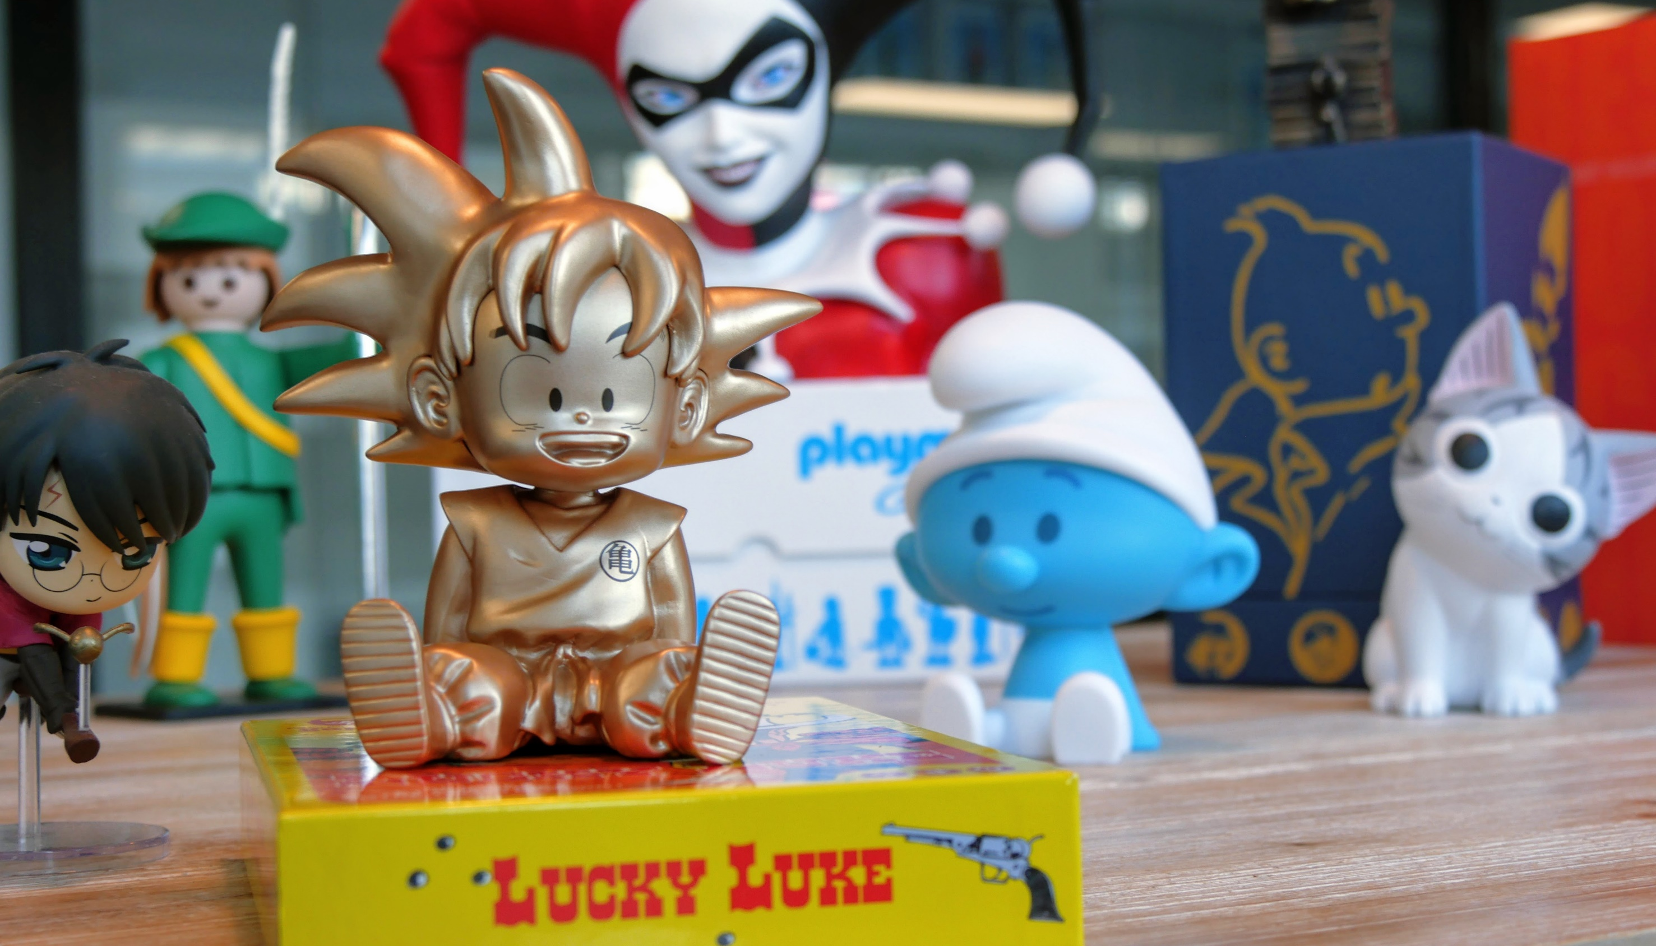








Consumer Products
In-house creation of merchandising
Creation of a wide range of products, including figurines, toys, games, DVD, Blu-ray, vinyles for internal and external brands (DC Comics, Playmobil, One Piece, Dragon Ball Z…)
Targeting mainstream audiences as well as collectors
Creation of merchandising for our theme park
We are also an e-retailer through 9e-store.fr and collectorbd.com

Slide 38
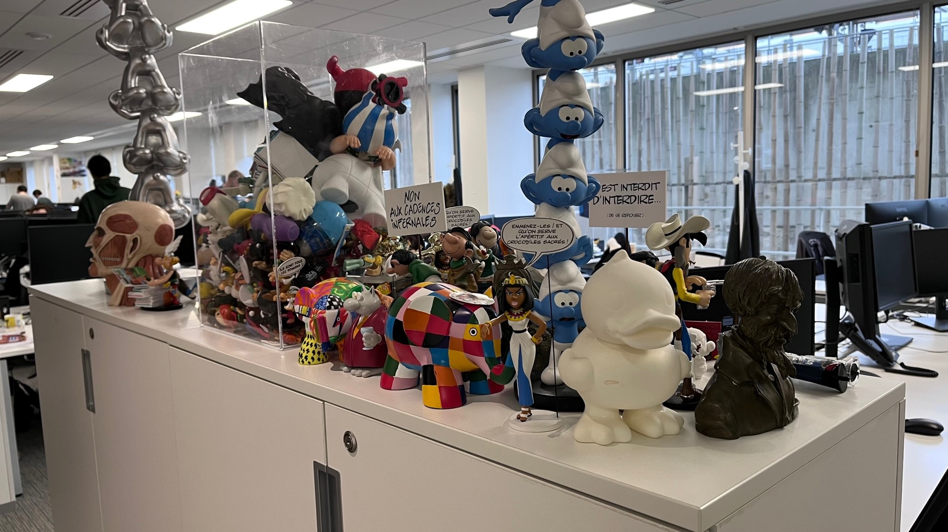




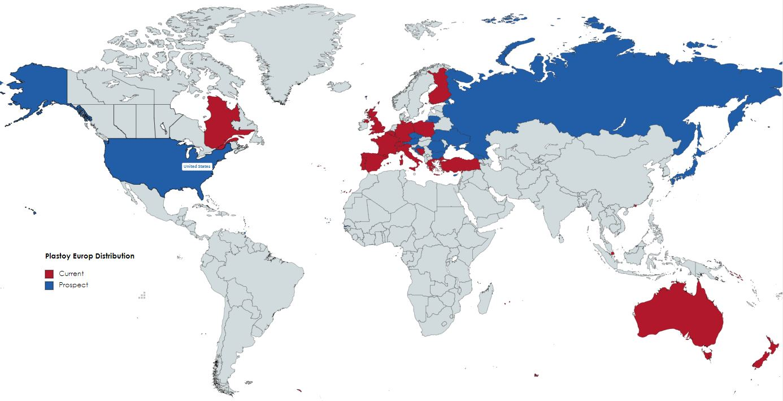
Consumer Products
In-house creation of merchandising
For 30 years we have been working on the most iconic licenses
to create fans-favourite figurines & decorative objects.
3 main categories
- Historic with Franco-Belgium « BD » (Smurfs, Astérix, Gaston…)
- Manga Culture (DBZ / One Piece, Naruto…)
- Pop Culture (Harry Potter, DC Comics, Garfield, GOT…)
Distribution Map

Slide 39
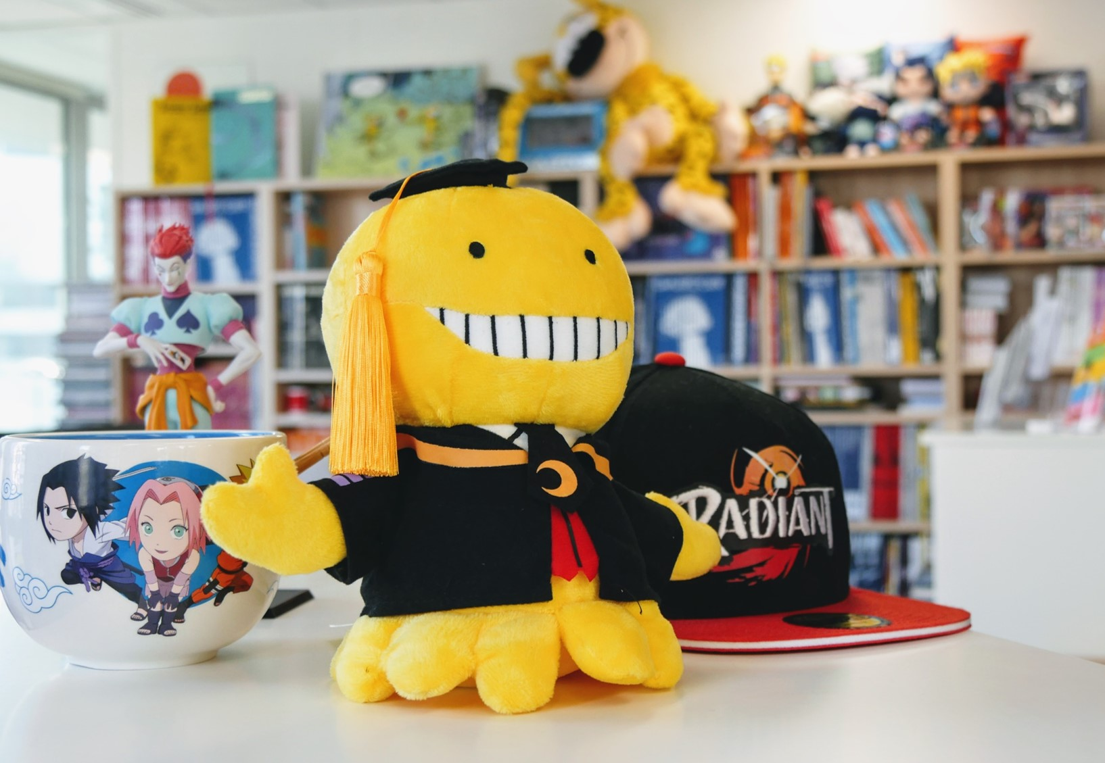


Licensing
A leading entertainment
licensing agent in EMEA
Development of the group’s IP portfolio on all media and products
European licensing agent of many successful Japanese IPs from TV Tokyo, Fuji, Kodansha, NTV, Aniplex, TMS such as Naruto, Hunter X Hunter, Full Metal Alchemist, Fairy Tail
Leading agent in China with the support of its Chinese sister company Dargaud Shanghai
A constant goal: guarantee our licensors the best representation and provide a dedicated support to licensees in terms of approval, information and marketing

Slide 41

The Music Box (2018)
Dupuis
We are Storytellers
in Publishing

Slide 42

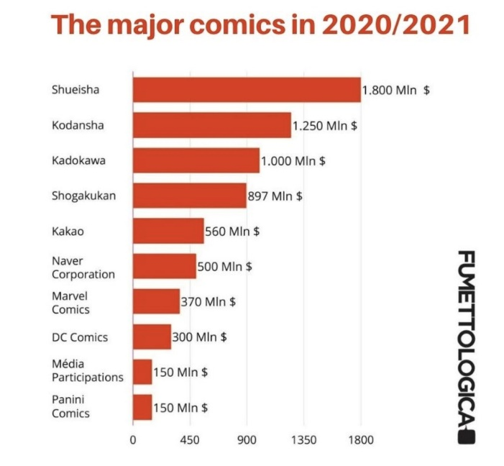














V1 – Positionnement INTERNATIONAL
companies worldwide
Books
Worldwide comics leading group
40+ publishing houses for all audiences
Fiction and non-fiction for kids, families and adults
100,000 references, 3,000+ new books published every year
50 million books sold every year
In the US, Abrams Books, is the #1 publishing house to specialize in art books, illustrated and coffee-table books, including international bestseller Diary of a Wimpy Kid (230m copies sold, 73 editions in 61 languages)
2,000+ translated titles every year
The market leader
for comic books in Europe
20 million books sold every year
Extensive development of manga: Naruto, Death Note…
DC Comics French partner – 120 books published every year
Batman Infinite (2022)
Urban Comics

Slide 43







Mangas
#2 Manga Publisher in France
9+ million manga sold in 2022
Editorial skills: seinen / shonen / shojo / kodomo
30+ serials, including best-sellers Naruto, Death Note, Saint Seiya, Grendizer, and Detective Conan
Naruto Artbook (2007)
Kana

Slide 44


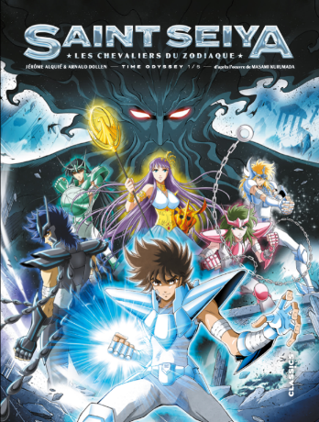


Mangas
Publisher of creations in partnership with Japanese publishers
Goldorak : 323+ K copies sold
Publisher of new creations

Slide 45






Mangas
Editorial skills: seinen / shonen / shojo / kodomo
30+ serials, including best-sellers Theseus no Fune, Natsuko no Sake, Deep Sea Aquarium Magmell, Peleliu Gernica of Paradise, Manchuria Opium squad and Team Phoenix
Deep Sea Aquarium Magmell (2021)
Vega-Dupuis

Slide 46
We are inovators

Slide 47







Next Steps
We are dedicated to maximizing and optimizing the visibility of brands
PUBLISHING
DISTRIBUTION
LICENSING
PRODUCTION
VIDEO GAMES
Our
publishers
Our distribution
company
Our streaming
platform
Our licensing
agent
Our merchandising
creators
Our animation
studios
Our video games developer and publisher

