Slide 1
Edward Simoni

Slide 2






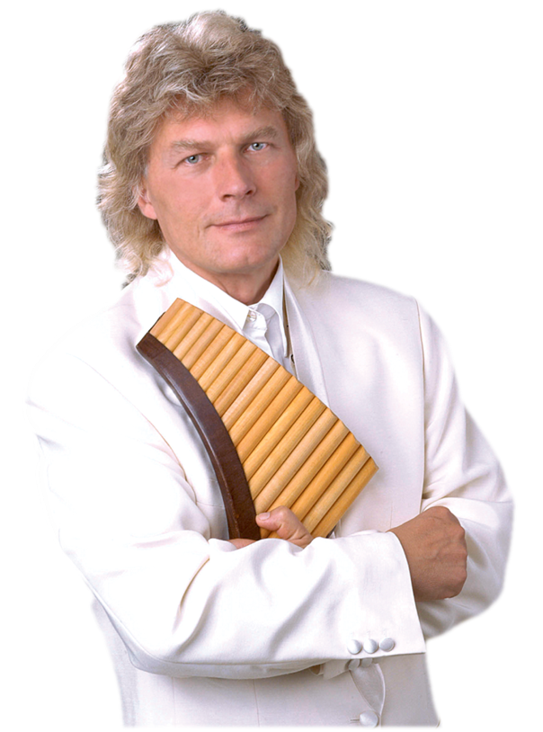
Edward Simoni
Presentation by y@t@t@
Dream
Amazing grace
Nabucco
Barcarole
Pastoral land
Memory
Guantanamera
Plaisir ď Amour
www.yatata-blog.eu

