Slide 1
The very best of
ENYA

Slide 2



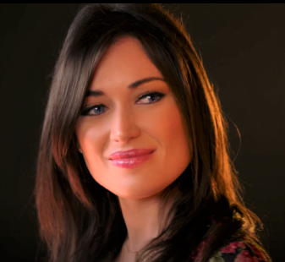
Very best of Enya
Once
Only time
Hope has
a place
Adeste
Caribbean blue
Smaointe
A day without rain
On your
shore
Journey of the Angels
Amarantine
Paint the sky
with stars
How can I keep
China roses
Marble halls
May it be
www.yatata-blog.eu
Relaxation

