Slide 1
Scorpions

Slide 2







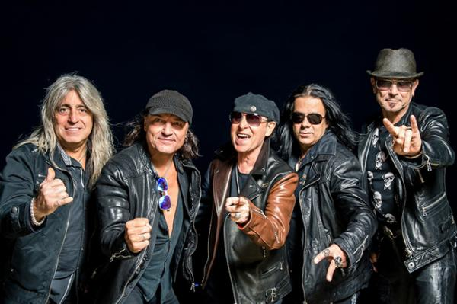
… SCORPIONS …
Lorei
Send me an
angel
When you
came
You I
Humanity
Other when
the smoke
A
moment
presentation by y@t@t@
Still loving
you
www.yatata-blog.eu

