Slide 1
Country music 125

Slide 2


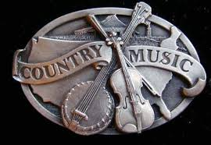

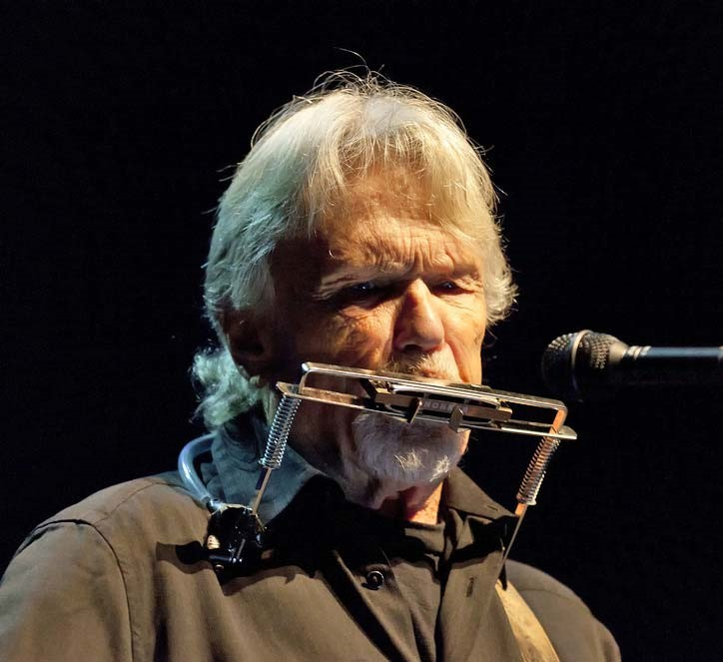


Country music 125
200 miles
Country
music
Red river valley
My old
home
Darlin‘
Nellie
When your old
wedding ring
Tonight my lady learns to love
Name this song
How can I tell my dreams
Tom Dooley
presentation by y@t@t@
Willow garden
www.yatata-blog.eu

