Slide 1
K adventní pohodě

Slide 2




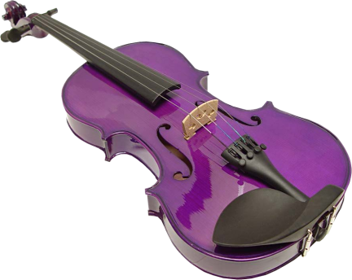



K adventní pohodě
Adoro
Do not be
sad
Ballet of
light
Te sigo
amando
Fleur
ďamoure
Peace
fulness
Relaxing
1
Relaxing
2
The end of
august
O mio babbino
caro
Guitar and
violin
Relaxing
3
Prierr
pour
Desire to
stay
Ballerina
Silk
Soul
Vals
www.yatata-blog.eu

